Slide 1






Families Matter…
Growing God-Connected Kids
KAREN HOLFORD
TED DIRECTOR OF FAMILY, CHILDREN’S AND WOMEN’S MINISTRIES
Photo by Cynthia Magana on Unsplash

Slide 2


Families matter – we have an amazing responsibility!
Photo by Rajesh Rajput on Unsplash
u Families are more effective than churches in transmitting healthy faith to the next generation.
u The everyday opportunities for spiritual interaction with our children have a much greater impact on them than what happens in our local schools or churches.
u Parents are the ones that God has designated to pass on their faith to their children. They are supported and encouraged by their local churches and communities.

Slide 3
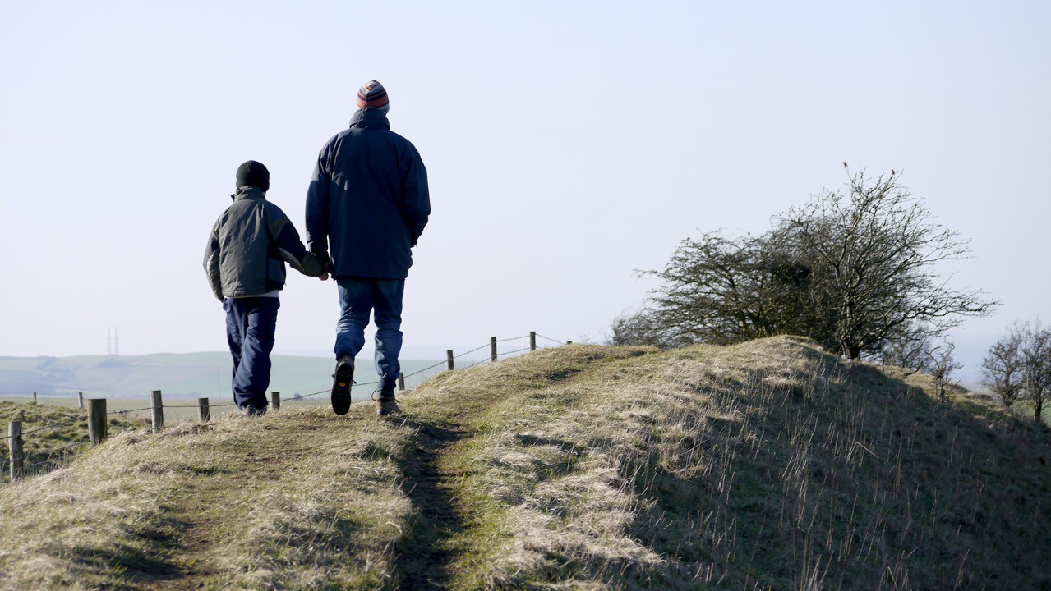

3
God’s Method of Family Faith
Hear, O Israel: The LORD our God, the LORD is one. Love the LORD your God with all your heart and with all your soul and with all your
strength. These commandments that I give you today are to be on your hearts. Impress them on your children…
Photo by Brett Jordan on Unsplash

Slide 4
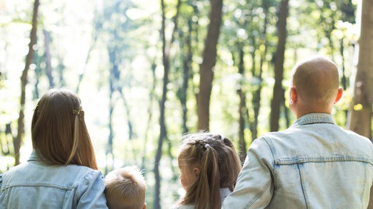
4
God’s Method of Family Faith
…Talk about them when you sit at home and when you walk along the road, when you lie down and when you get up. Tie them as symbols on your hands and bind them on your foreheads. Write them on the doorframes of your houses and on your gates. Deut.
6:4-9 NIV
Photo by John-Mark Smith on Unsplash

Slide 5

The Greatest commandment
“‘Love the Lord your God with all your heart and with all your soul and with all your mind.’ This is the first and greatest commandment. And the second is like it: ‘Love your neighbor as yourself.’ All the Law and the Prophets hang on these two commandments.” Matt. 22:37-40 NIV
Photo by Freestocks on Unsplash

Slide 6
Greatest Commandment
6
Soul
spiritual relationship faith, prayer, forgiveness, salvation
Mind
wondering, knowing, understanding, reflecting, creativity
Heart
loving relationships emotions
Loving others
because God loves them
Loving ourselves
because God loves us
Strength
active response – making and doing

Slide 7
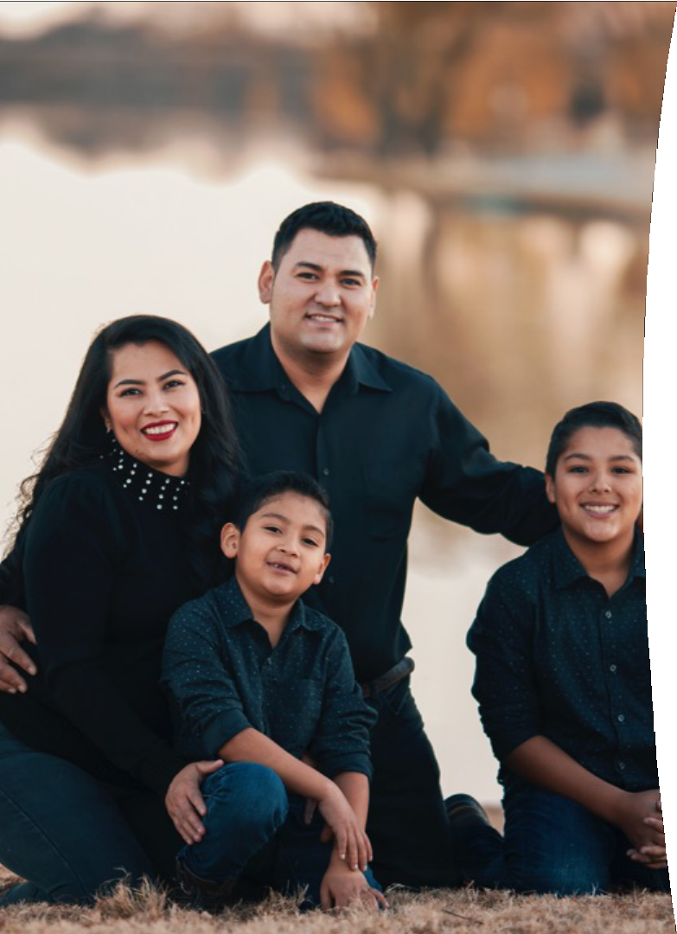

Reflecting on God’s method
u How do we, as parents of Gen Zs and Gen Alphas, make the best use of our everyday “talking, walking, sitting, and rising" opportunities to nurture their connection with God?
u How do we help them to love the Lord their God with all their heart and mind and soul and strength?
u What can we do to nurture their relationships with Him, so that we help them to fall in love with Him forever?
Photo by Gabriel Tovar on Unsplash

Slide 8
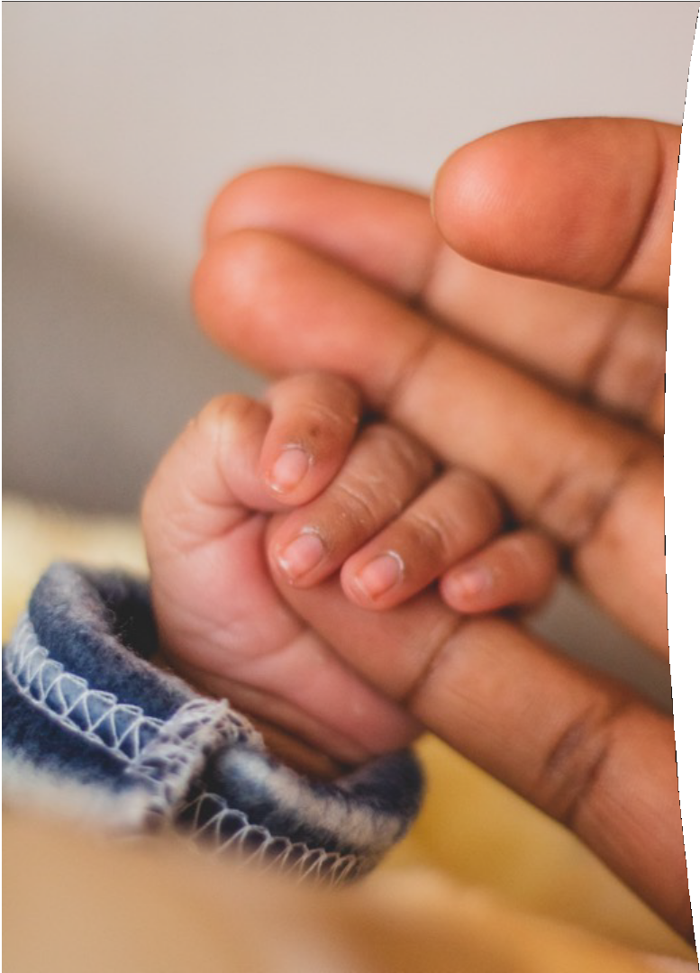
It starts with us…
8
u We need to grow in our relationship with God.
u The more we experience God’s love and grace, the more we’ll share His love and grace with our children.
u Through being parented, and becoming parents, we learn about God’s love for us.
Photo by Tembinkosi Sikepula on Unsplash

Slide 9

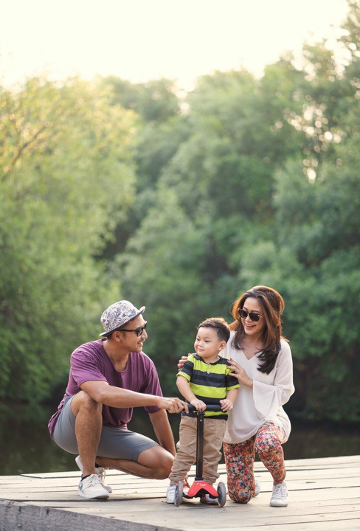
Spiritually nurturing parents:
9
u Have a growing and learning relationship with Jesus
u Build close, encouraging and supportive relationships with their children
u Show love, patience and forgiveness to each other
u Nurture their child’s faith according to the child’s needs, interests, understanding and gifts, etc.
u Live out positive Christian values
Photo by Rendy Novantino on Unsplash

Slide 10
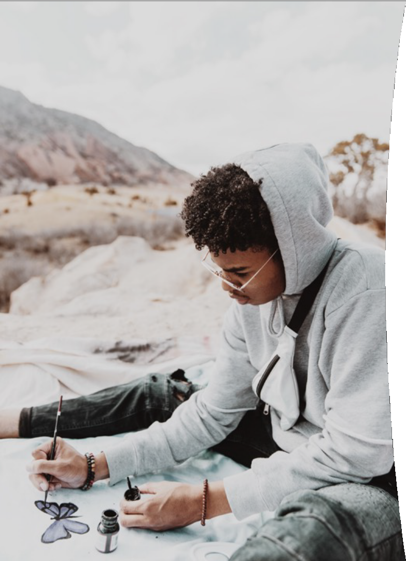
Everyday moments
Photo by Logan Weaver on Unsplash
10
u Often the best times to teach our children about God are in the spontaneous teachable moments of our lives.
u Ask the Holy Spirit to make you aware of these special opportunities.
u Look for God in everyday stories.
u Explore nature and be filled with wonder at God’s creation.

Slide 11

Making sense of life and faith
u Help children to see that the “Big Picture of Everything” is that God is love and His love is the purest and most perfect love in the universe.
u Make them aware that God is looking for the best possible ways to show us His love, every single moment of every single day.
Photo by Pine Watt on Unsplash

Slide 12

Making sense of life and faith
u Discuss the spiritual aspects of life and faith with your children so that your faith perspective makes sense to them.
u Look for God at work in your lives.
Regularly ask the question: “Where did you see God today?”
u This will help them become more aware of God’s presence around them, and the way in which He works.
Photo by Tyler Nix on Unsplash

Slide 13

Living transparently
Children need to see us having a real and imperfect relationship with God so they can see how it works. They need to see and hear us:
u Praying about our every day lives
u Listening for God’s guidance
u Exploring our Bible in creative ways
u Looking for God’s wonder around us
u Thanking God for His many gifts
u Using our gifts to strengthen our local church
u Joyfully giving back to God and sharing with others
u Taking care of God’s creation, etc.
Photo by Marc Schulte on Unsplash

Slide 14
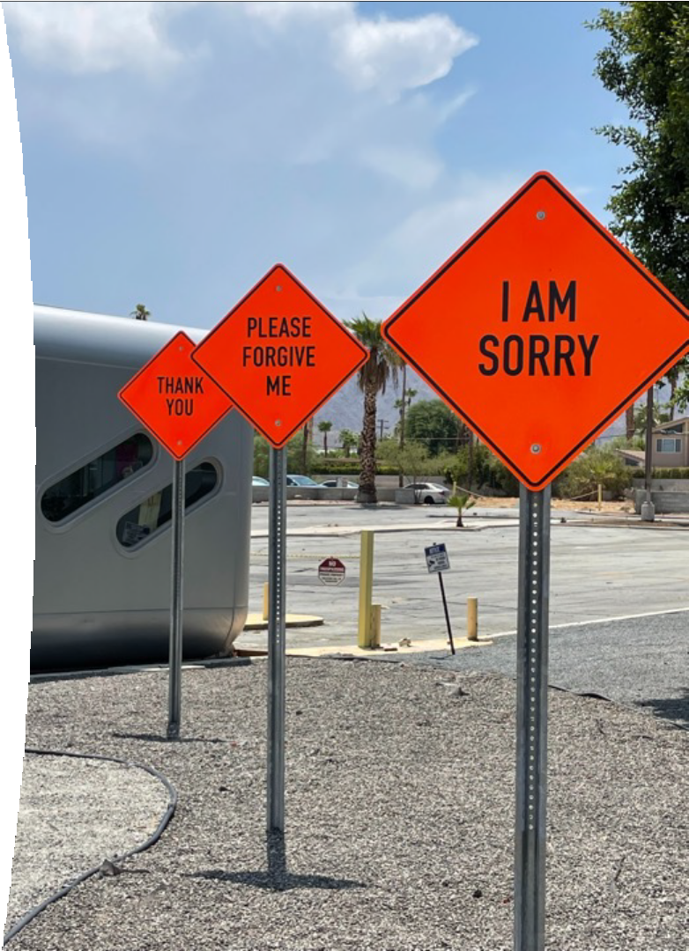
Modelling an apology
We need to ask our kids for forgiveness when we mess up and hurt them. We need to model a good process of apology, asking for forgiveness, repairing well and forgiving well. Here is one model:
u I am sorry
u What I did was wrong
u What I did hurt you, and God felt that hurt with you
u I love you and I don’t want to hurt you that way again
u Next time I want to do … instead
u Please forgive me when you are ready
u What can I do now to help you feel better?
Photo by Mark Tulin on Unsplash

Slide 15

Helping kids repair after hurt
Photo by Priscilla Du Preez on Unsplash
u When we have hurt our children – we need to use a humble, honest and loving process of apology and forgiveness.
u We need to comfort the pain that we have caused them.
u We need to support their healing.
u When our children have hurt others – we need to show them how to repair the relationship.
u They need to listen to the pain of the person they hurt, reflect on what happened, learn from the situation, make a sincere apology and do acts of restorative kindness.

Slide 16
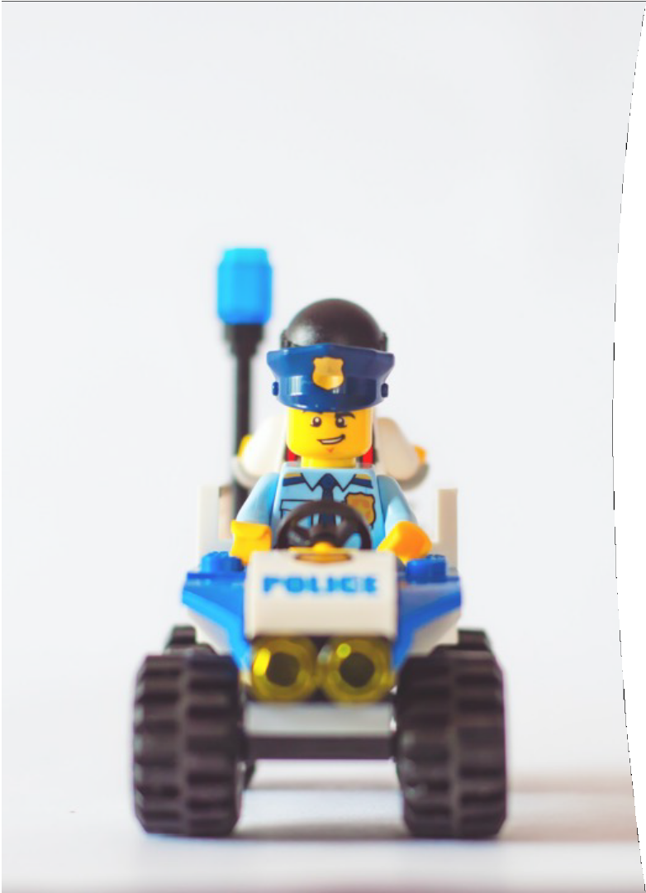
Correcting distortions
Photo by Praveesh Palakeel on Unsplash
u Distant Father – busy working in a distant place and not really interested in connecting with His children
u Disappointed teacher – always writing on their report – “Could do better”
u Father Christmas – a big, jolly person who gives us what we ask for, if we’re really good
u Policeman on the corner – looking out for everything we might do wrong
u Grumpy old man – angry, irritable and easily offended

Slide 17

Adjusting the lens
u We need to check whether we have any misconceptions and distorted ideas that prevent us from helping our children to have a clearer picture of a totally loving and gracious God.
u Children need to develop a healthy understanding of who God is, and His loving relationship with all His children in the world.
Photo by Luke Porter on Unsplash

Slide 18

Adjusting the lens
u Listen to them – what are they already thinking and saying about God and faith?
u Ask them to describe God, or to draw Him and write some of His character traits around the picture. This can show you where their lens needs adjusting.
u If they have a picture that needs adjusting, tweak it gently. Share your picture, read Psalm 103, the story of the prodigal son and similar passages.
Photo by Mimi Thiuan on Unsplash

Slide 19
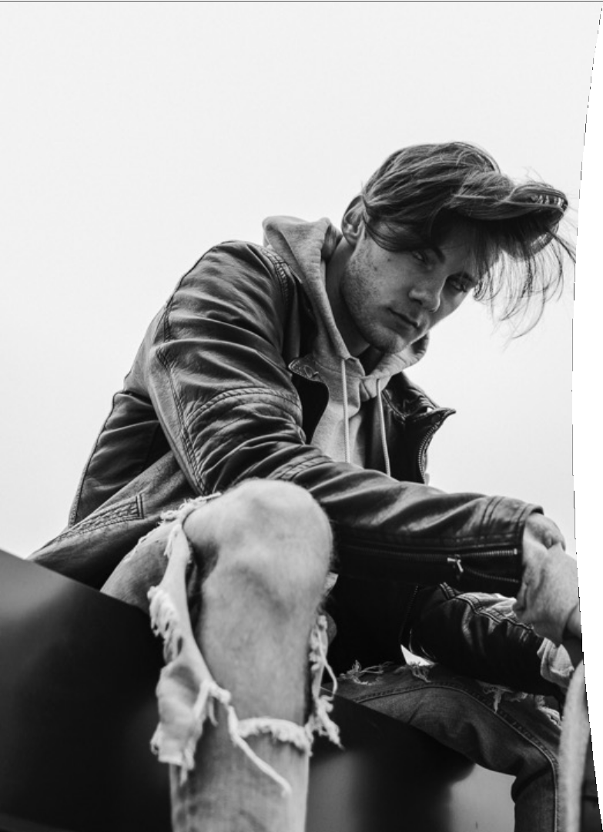
The Story of the Prodigal Son - Luke 15:11-31
Ask:
u Who are really the sons in the story?
u Who is really the Father in the story?
u What do you like best about the story?
u What is the most important message in the story for you today?
u Which part of the story is most about you?
u What have you learnt about God’s love from the story?
u How do you want to respond to the story? (Create, write, reflect, discuss, etc.)
u (Questions inspired by the Godly Play approach to the Bible)
Photo by Seth Doyle on Unsplash

Slide 20

Chatting with God
u The best way they can talk to God is in the way that they would naturally talk to the best father ever!
u Imagine how they would talk to their dad about their day. Help them to use informal language and talk about what happened, feelings, fears and worries. Ask Him for help.
u Model talking to God in your everyday family life. Press pause in a challenging situation and tell God your needs out loud in a couple of sentences.
u God hears our best prayers whatever we say, because He can hear the things we don’t have words for yet.
Photo by Olivia Snow on Unsplash

Slide 21
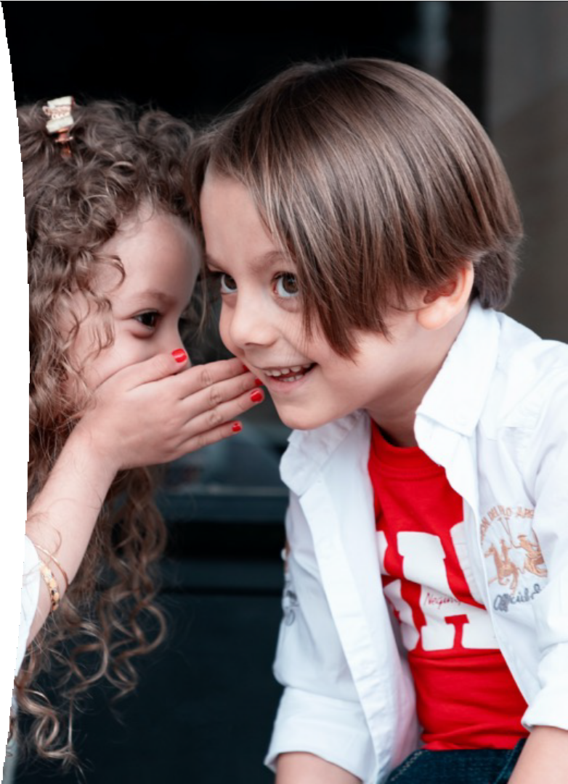
Chat starters:
Photo by Saeed Karimi on Unsplash
u Tell God what frightens you the most.
u Tell God the things on your worry list and give them to Him.
u Ask God how He wants to help you with your worries.
u Tell God what you like doing best.
u Tell God something that made you laugh today.
u Tell God what you love most about your family.
u Ask God what He loves about your family.
u Tell God about the most beautiful things He made. u Ask God what He most enjoys about His creation. u Tell God how it feels when you’re sad or lonely.
u Ask God what makes Him sad.
u Tell God what you like, and don’t like, about school.

Slide 22

Listening for God
u Model how you listen for God’s voice and recognize it.
u Tell your children about the times when God communicates with you by putting a picture in your mind, giving you an idea, speaking to you through a Bible verse, or another person etc.
u Help them to spot those moments in their life and listen for God.
Photo by Aaron Burden on Unsplash

Slide 23

We need to follow our children’s spiritual flow.
Responsive parenting
Going with their flow
They are interested in different things at different times, and they will have different feelings and needs.
We need to pay attention to them and help them to make the best of these flowing interests and passions.
What are their questions about God, the themes in their conversations, the Bible stories they go back to?
Connect with their emotions: help them to find God in the ups and downs of life – Psalm 23?

Slide 24
We need to follow our children’s flow, not stem it.
Responsive parenting
Going with their flow
Maybe they want to lead worship at home, help someone, pause and pray, light a candle, etc… Follow their promptings.
Purple flower story.
Maybe they have a desire to help at church: music team, audiovisual team, creative arts, tidying up, helping with lunches and drinks, etc.
Maybe they are passionate about a cause or a mission: caring for others, refugees, homeless, social justice, caring for the planet, etc.
Hopes and dreams for their future lives together with God.

Slide 25



Bedtime moments
Photo by Annie Spratt on Unsplash
25
u What do you most want to thank God for today?
u Where did you see Jesus today?
u What made you most sad/happy today?
u What character strengths did you practice today?
u I saw you making this good choice today…
u I was proud of you today when you…and I think God was too!

Slide 26

The big questions
26
u Am I growing closer to God and letting my child witness my faith?
u Is my child growing closer to God and loving Him more?
u What can I do to help myself and my child grow closer to God together?
Photo by Júnior Ferreira on Unsplash

