Slide 1
Caring for the Mental Health of
Gen Z and Gen Alpha
Leadership Certification
Level 11, Course #3
Marissa Leslie, MD
Adventist HealthCare

Slide 2
Notes:
Objectives:
Definitions
Comparison between Gen Z and Gen A
**Mental Health Perceptions
**Technology
SDA Health Message & Mental Health
**How does the SDA health message promote good mental health?
**What can we do to promote mental wellness among Gen Z & Gen A

Slide 3
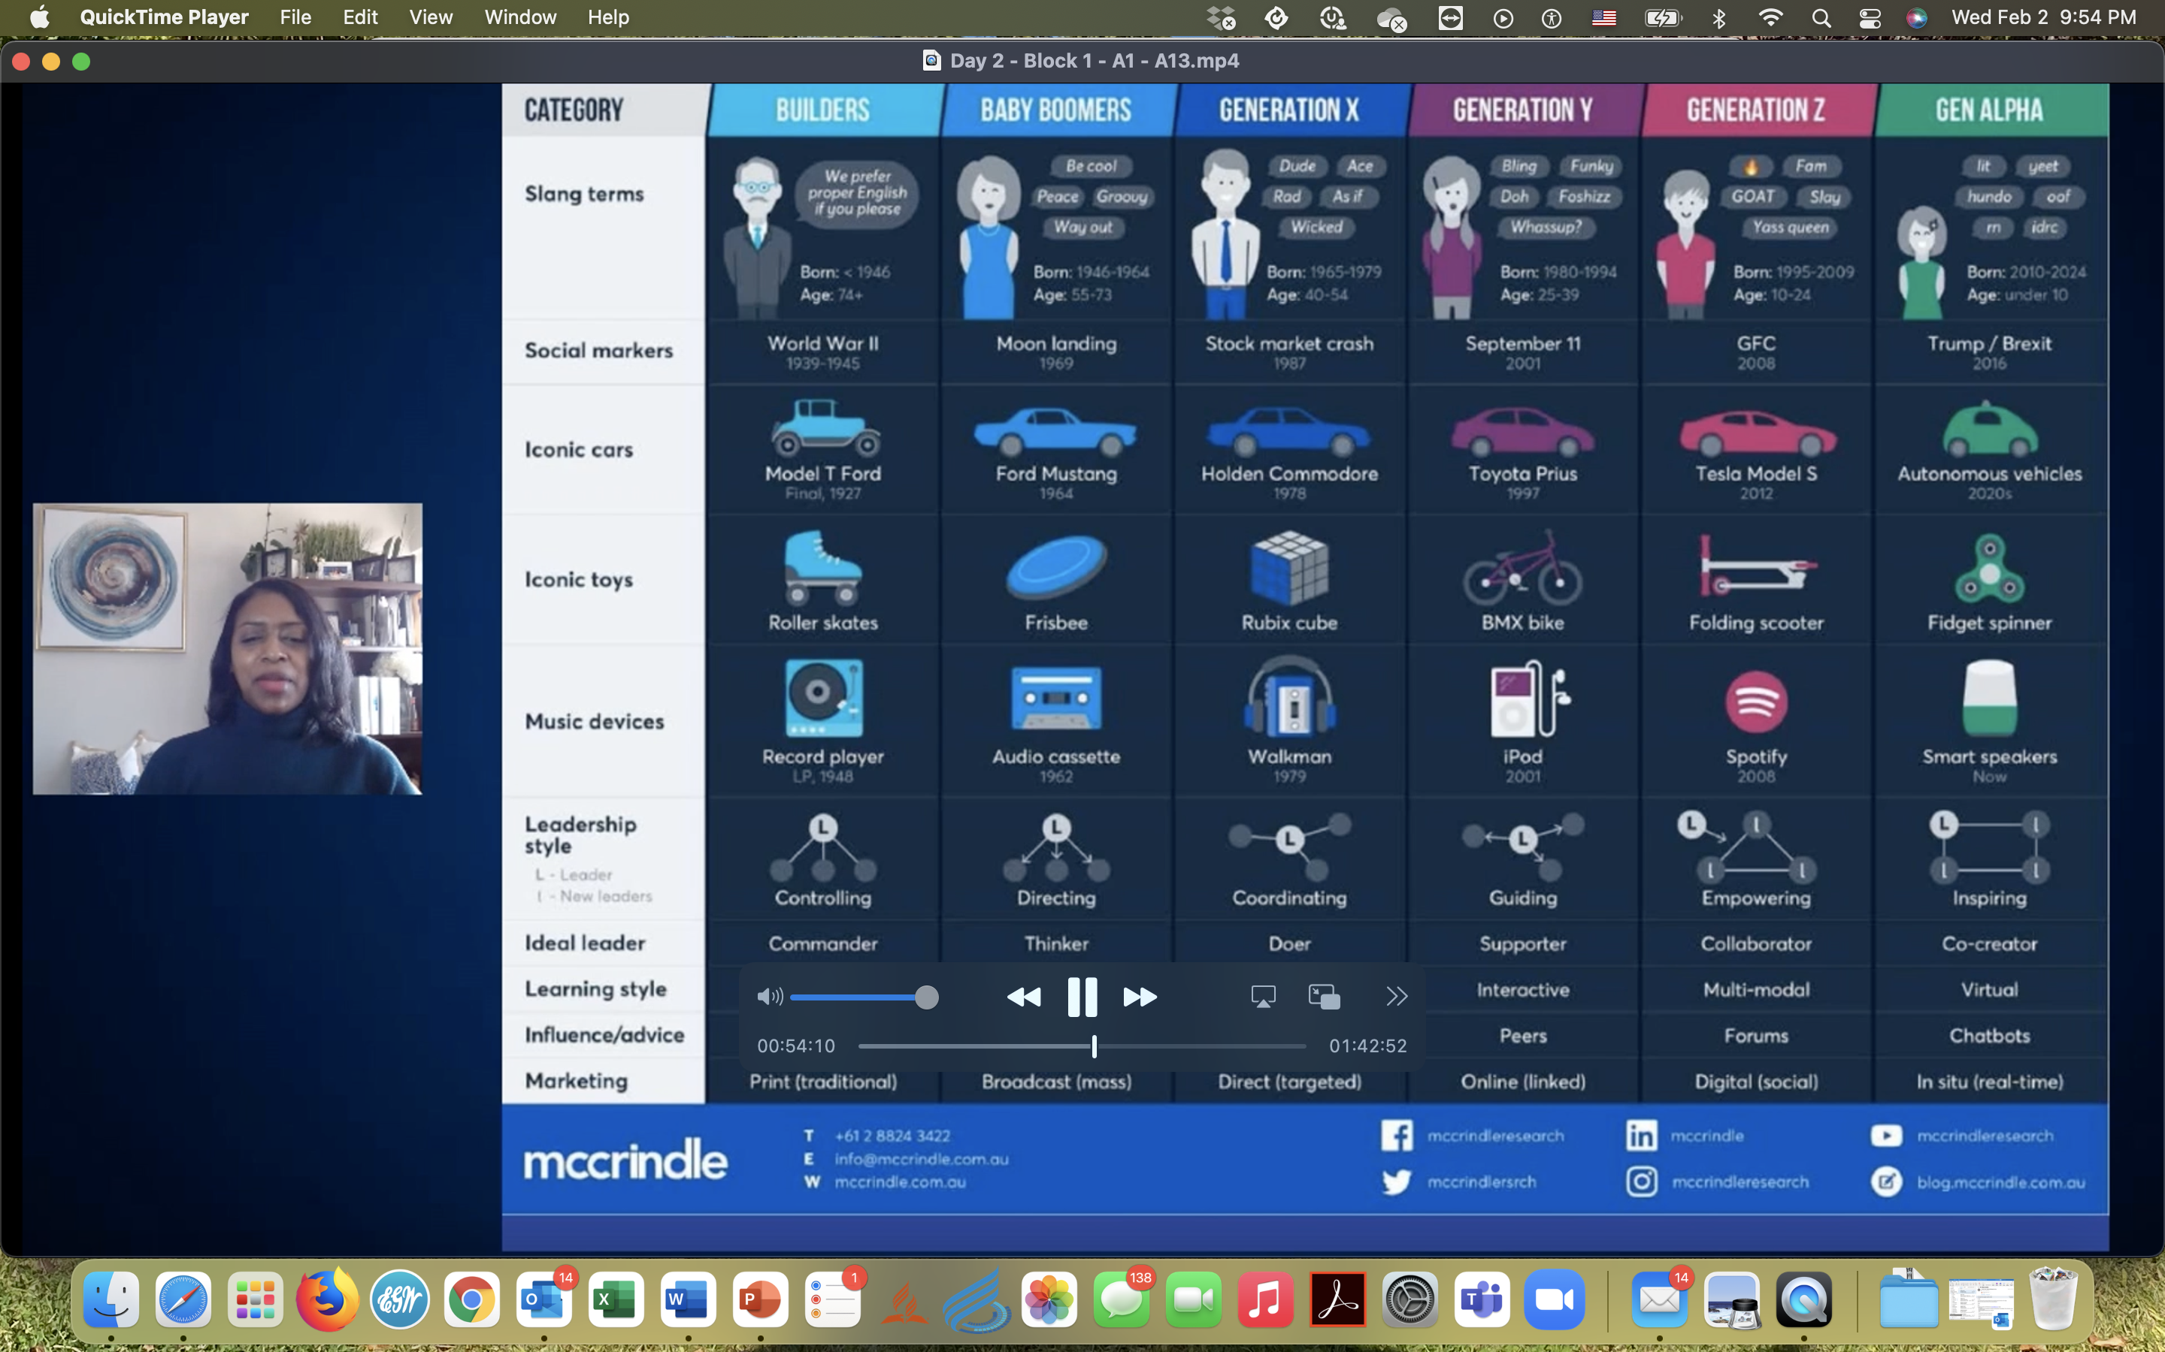
Notes:
McCrindle Research (Australia)
A look at the generations:
Builders
Baby boomers
Generation X
Generation Y
Generation Z
Generation Alpha

Slide 4
Characteristics of Gen Z
Generation Z are the largest generation ever, almost 30% of the world’s population. Globally there are almost 2 billion of them.
They are the first fully global generation, shaped in the 21st century, connected through digital devices, and engaged through social media.

Slide 5
Generation Z facts
Also known as ‘generation connected’ or ‘dot com kids’
1 in 2 predicted to obtain a univ degree
By 2025, will make up 27% of the workforce
Predicted to work 18 jobs across 6 careers and live in 15 homes in their lifetime
There are 2,000,000,000 Gen Zs globally
Use slang like ‘Fam’, ‘FOMO’ and ‘YOLO’

Slide 6
Generation Alpha
Born 2010, they are the first generation who will be entirely born and shaped in the 21st century. This first generation we will see in record numbers in the 22nd century.
They are logged on and linked up – known as ‘digital natives’. Most materially endowed and technologically literate generation to ever grace the planet!
Characteristics of Generation Alpha
Born since the year 2010, they are the first generation who will be entirely born and shaped in the 21st century, and the first generation that we will see in record numbers in the 22nd century as well.
They are logged on and linked up – known as ‘digital natives’. They are the most materially endowed and technologically literate generation to ever grace the planet!

Slide 7
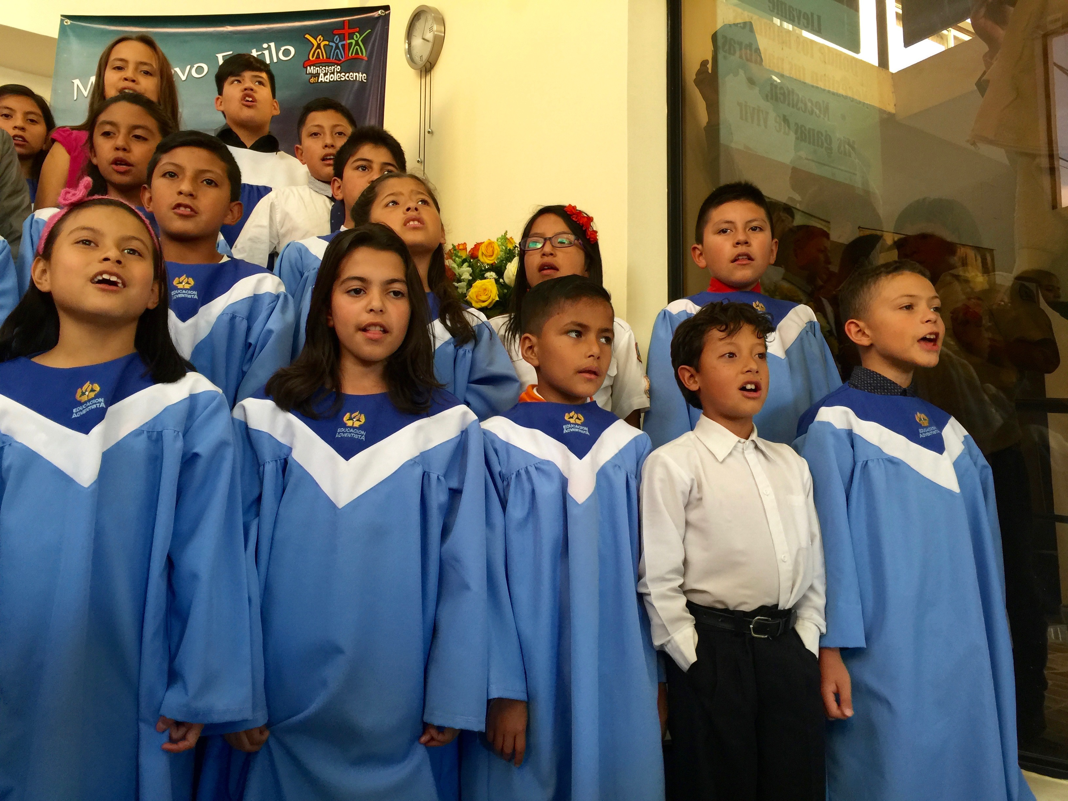
Generation Alpha Facts
2.8 million Gen Alpha’s born around the globe each week.
They are mobile, global, visual, digital, and social.
Very independent—make their own decisions.
Diverse in taste, lifestyles and points of view.

