Slide 1
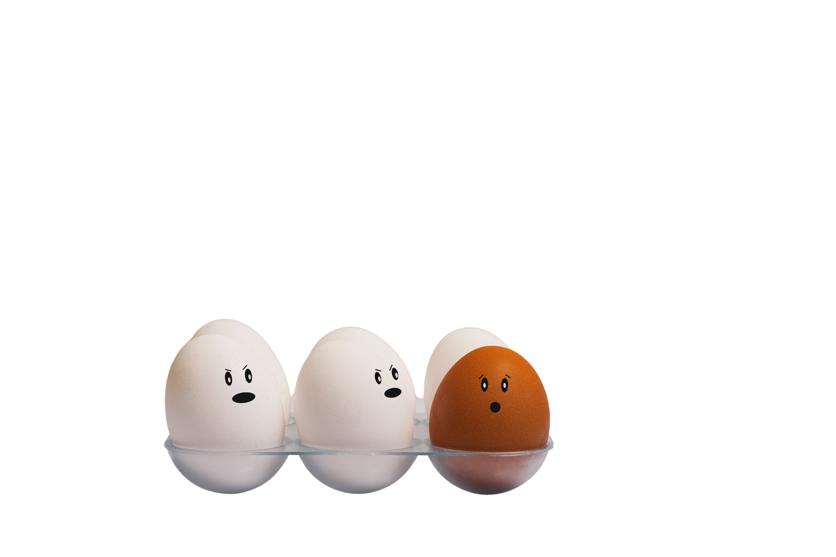
Leadership Certification
Level 11, Course #2
RACIAL ISSUES AND DISCRIMINATION
They begin in the
Orathai Chureson, PhD
Adventist Children’s Ministries
Southern Asia-Pacific Division

Slide 2
The World is a Global Village
IF THE WORLD CONSISTS OF 100 PEOPLE, WE WILL SEE
1.3 - JAPANESE
1.6 - BANGLADESH
2.0 - PAKISTANIS
2.6 - INDONESIANS
5.0 - NORTH AMERICANS
9.0 - LATIN AMERICANS
10.0 - EUROPEANS
13.4 - INDIANS
13.9 - CHINESE
16.0 - AFRICANS
25.2 - OTHERS

Slide 3
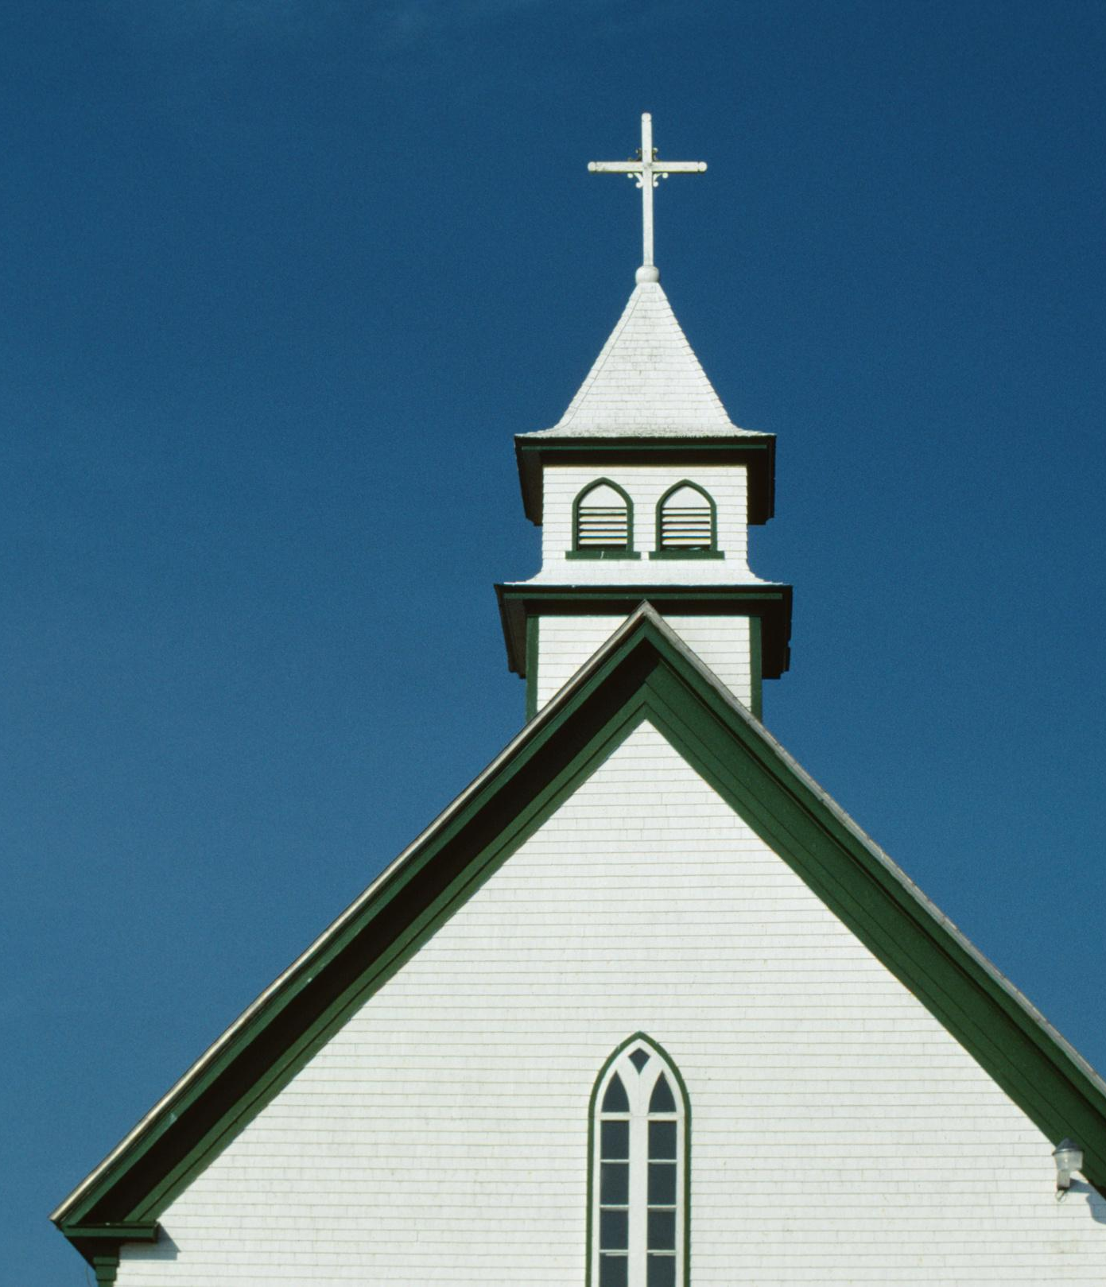
SDA World Membership Distribution 2017
6/15
We are Many in One Body of Christ!
Africa - 41%
Latin America - 30%
Asia - 18%
North America - 6%
Oceania - 3%
Europe - 2%
Middle East - 0%

Slide 4
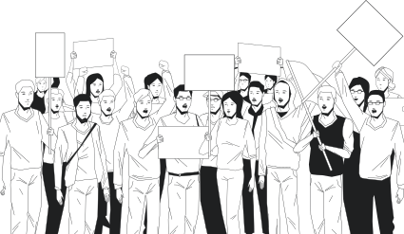
CURRENT ISSUES OF RACISM & SOCIAL DISCRIMINATION
HAS GLOBALIZATION BEEN A REAL SUCCESS?

Slide 5
Statistics of
UNITED STATES DEPARTMENT OF JUSTICE 2019

Slide 6
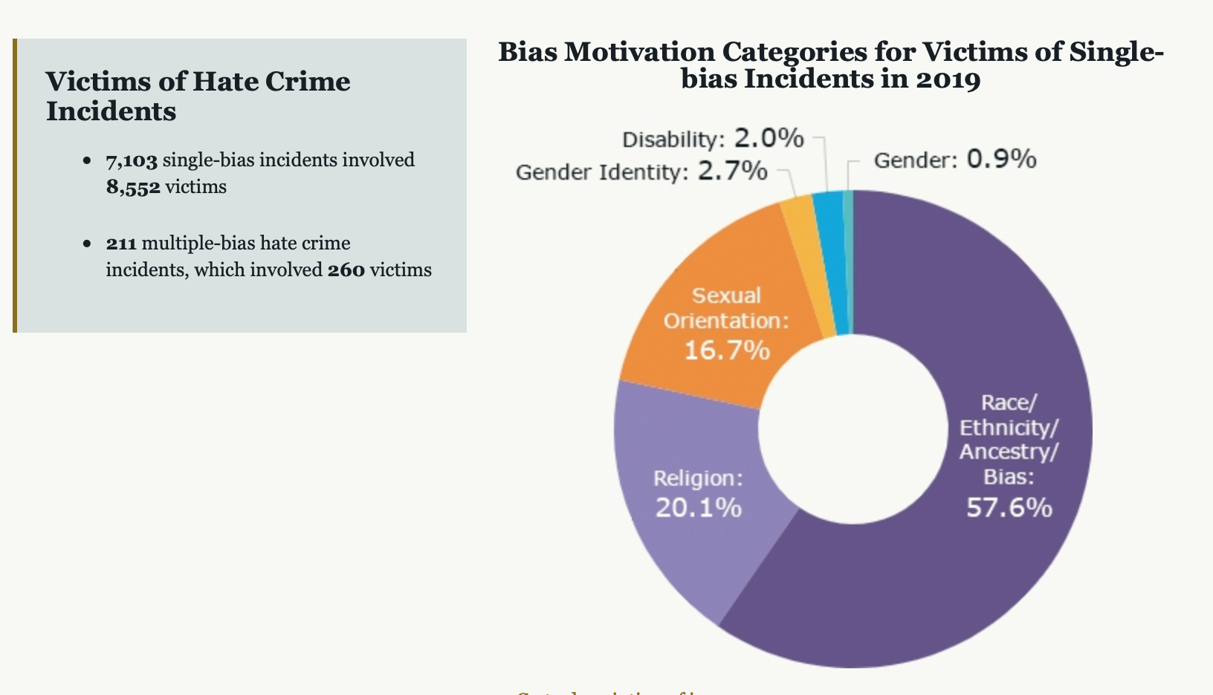
https://www.justice.gov/hatecrimes/hate-crime-statistics

Slide 7
Racial Discrimination
Racial discrimination may be demonstrated in a wide range of overt behaviors
Verbal/emotional harassment - Harassment can include, for example, racial slurs, offensive or derogatory remarks about a person's race or color, or the display of racially offensive symbols
Giving less favorable treatments or minimize opportunities of those of other races than your own.
Create a hostile or offensive working environment.
Putting people at the disadvantage side
Racial discrimination is both direct and indirect (refusing services or using policy to marginalize someone of another race and this leads to social discrimination.
Systematic racism -the formalization of a set of institutional, historical, cultural, and interpersonal practices within a society that more often puts one social or ethnic group in a better position to succeed, and at the same time disadvantages other groups in a consistent and constant manner that disparities develop between the groups over a period of time.” (USA Today, 2020) https://www.usatoday.com/story/opinion/2020/09/23/systemic-racism-how-really-define-column/5845788002/

Slide 8
The FBI warned at the start of the Covid outbreak in the US that it expected a surge in hate crimes against those of Asian descent - and it did by 150% increase in 2020.
Advocates for Asian Americans say the violence can be linked to rising anti-Asian sentiment in the US.
Late last year, the United Nations issued a report that detailed "an alarming level" of racially motivated violence and other hate incidents against Asian Americans.
More than 2,800 reports filed last year and the level of violence against American Asians has been intensified.
In the year 2021, among many reports, an elderly Thai immigrant dies after being shoved to the ground. A Filipino-American is slashed in the face with a box cutter. A Chinese woman is slapped and then set on fire. A 78- year-old woman was punched in the face. Shooting at Asian spas killed 8 people, 6 of them were of Asian origin. A wave of violence against Asian elderly.
10/15
HATE CRIMES
Reported in 2021

Slide 9
Recognized Causes of Discrimination
02
01
STEREOTYPING
MISTRUST
03
04
PREJUDICE
MISUNDERSTANDING
05
LACK OF OPPORTUNITY TO MINGLE WITH OTHER CULTURAL GROUPS - CLIQUISH

Slide 10
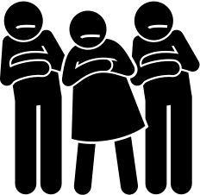
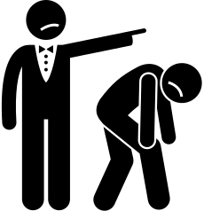
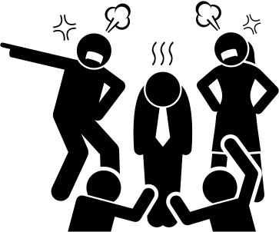
Possible Reasons for the
Rising HATE CRIMES toward Asians
Making Sense of Hate Crimes Pandemic
ANCESTRY BIAS
SUPERIORITY MINDSET
BLAMING ATTITUDE, PRIDEFUL SPIRIT & FINDING LOGIC WITH NEGATIVITY
Children learn from history being passed down for generations and the belief has embedded in the mind influencing reasoning ability and power. History should be written from a neutral perspective.
Self-absorption is one of the moving factors for bullying, personal bias, racial opinion, and hate crimes. Influential people can misguide the followers - Kung Fu.
When things do not go right, human tendency is to blame other first for the existing problem by scapegoating Asians.

Slide 11
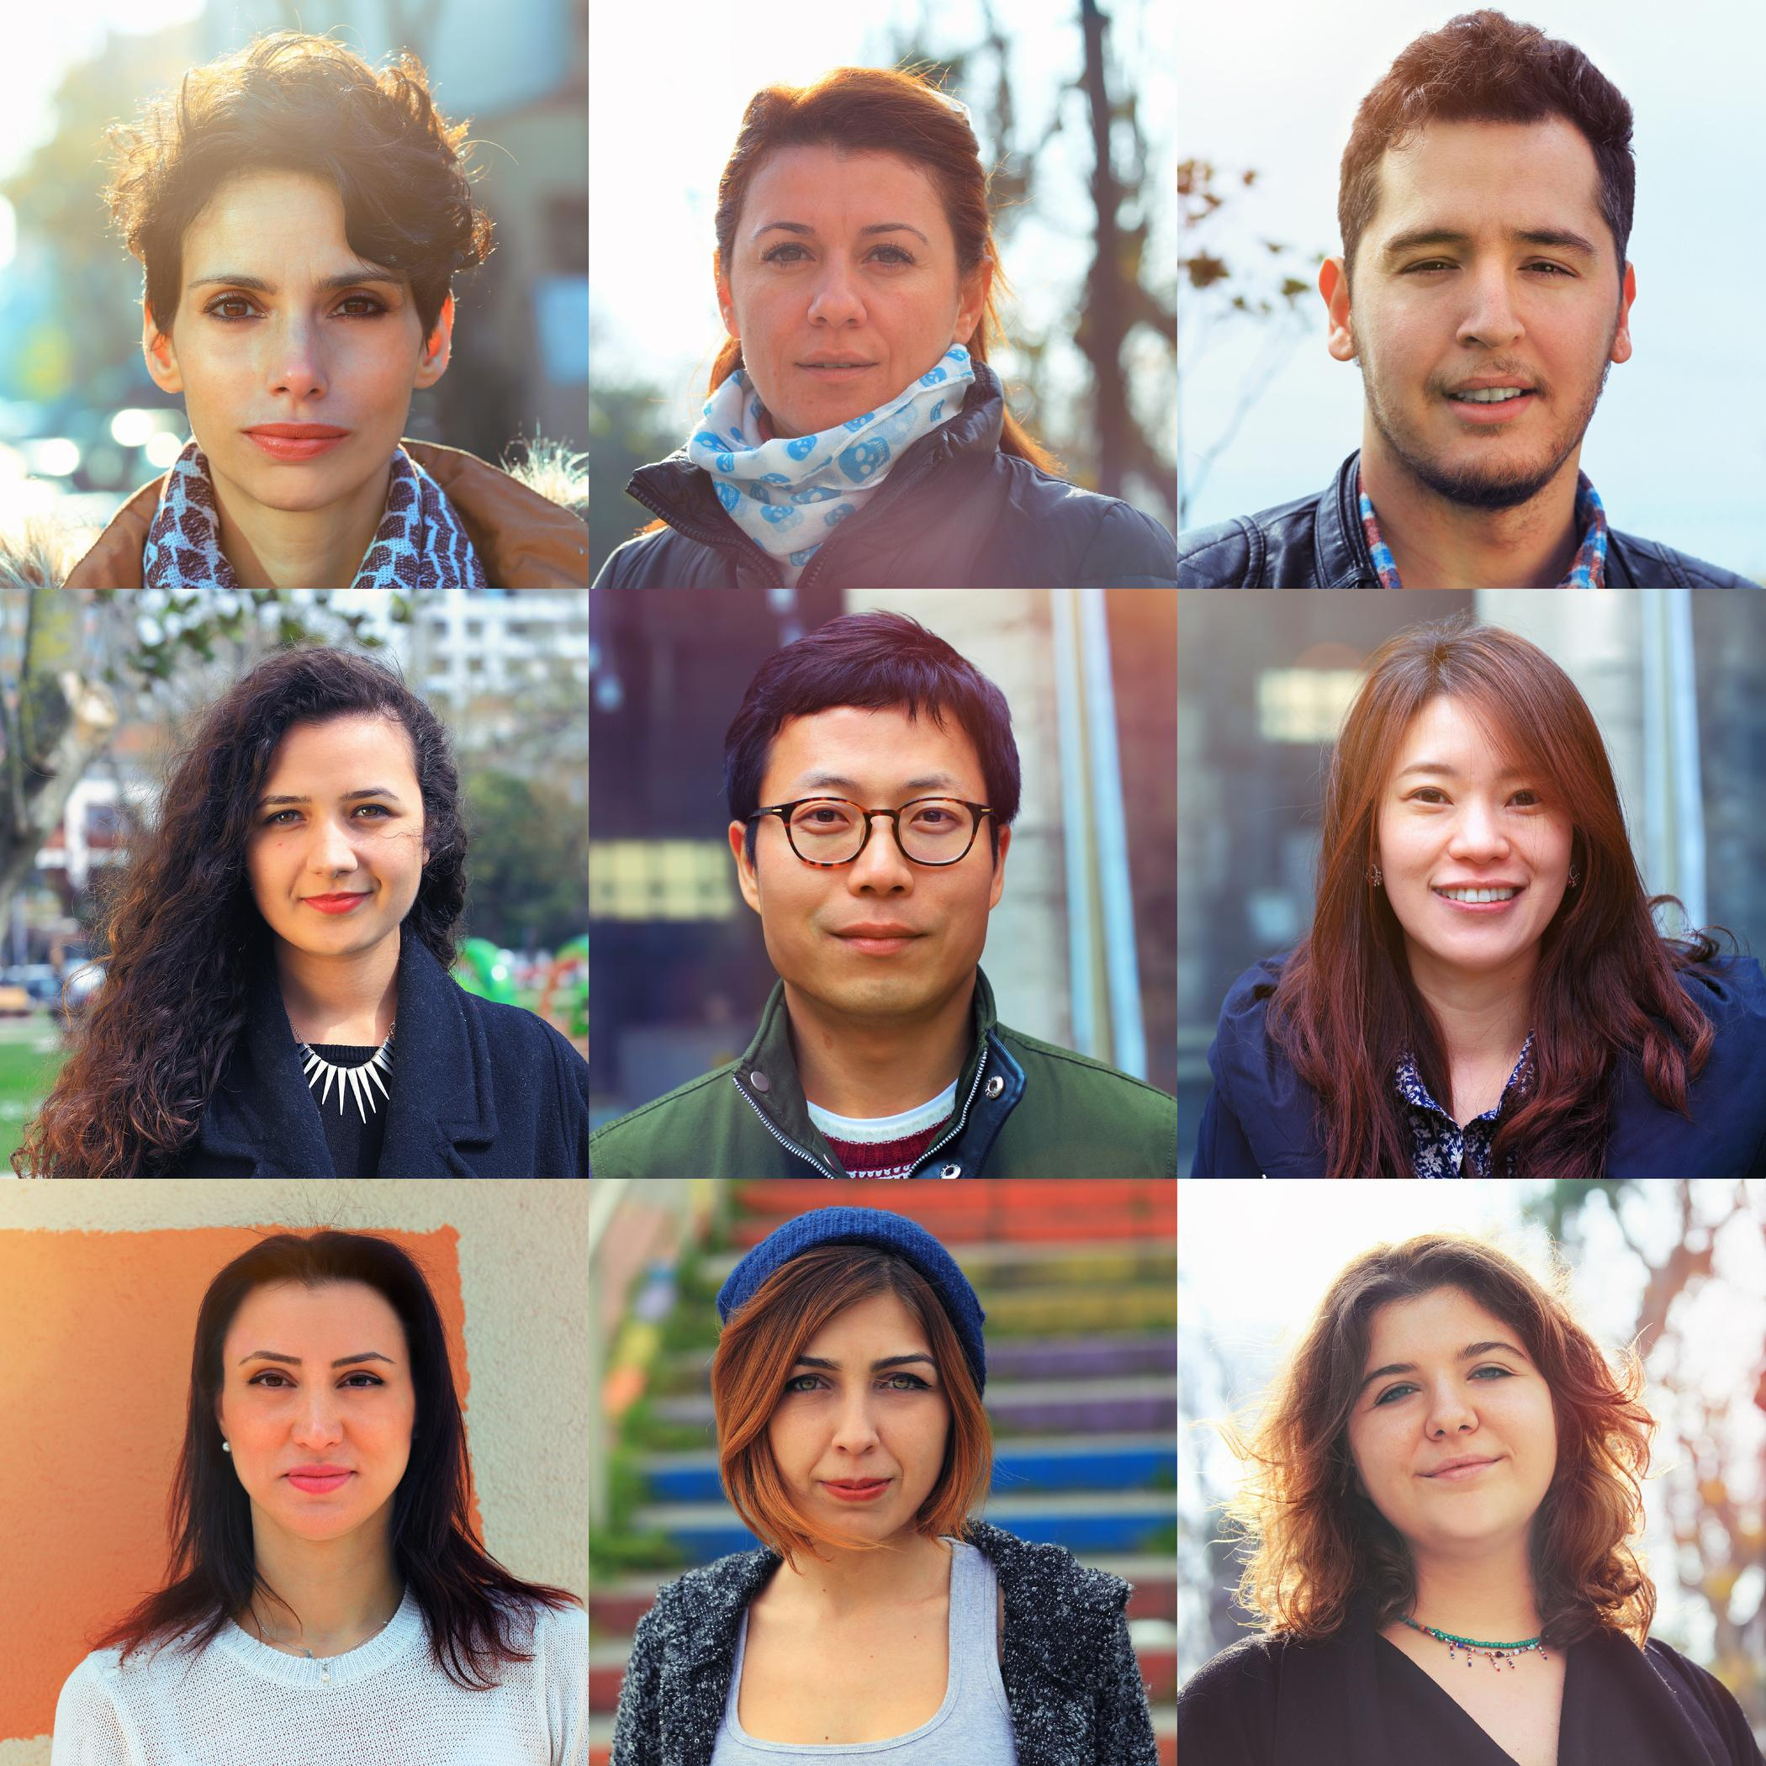
WHO AM I?
THE FACT IS NOT EVERYONE LIKES US.
How are we identified and perceived by those around us?
Ethnicity or Race (Appearances)
Social Status
Material Possession, Wealth & Success
Intelligence/Physical Ability or Disability
Educational Background
Belief System & Culture
Sexual Orientation

Slide 12
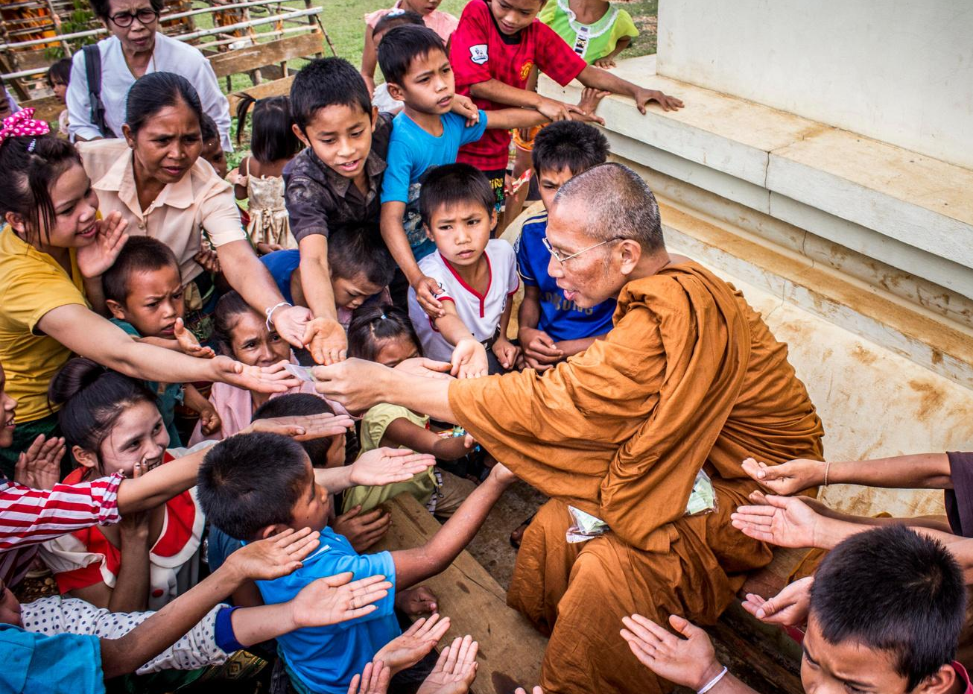
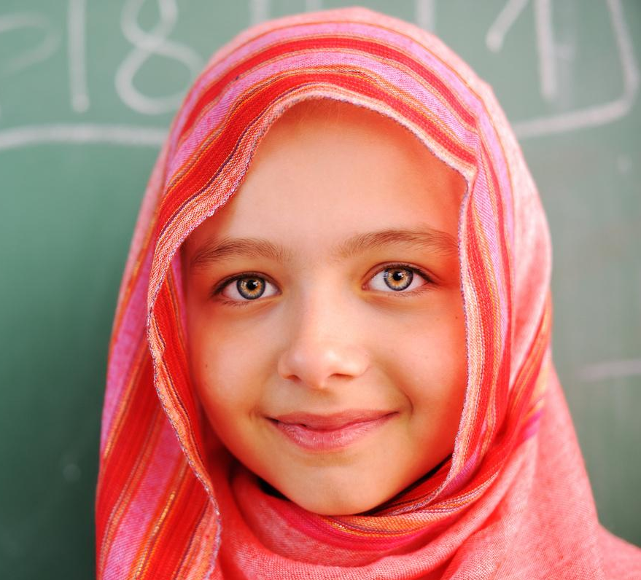
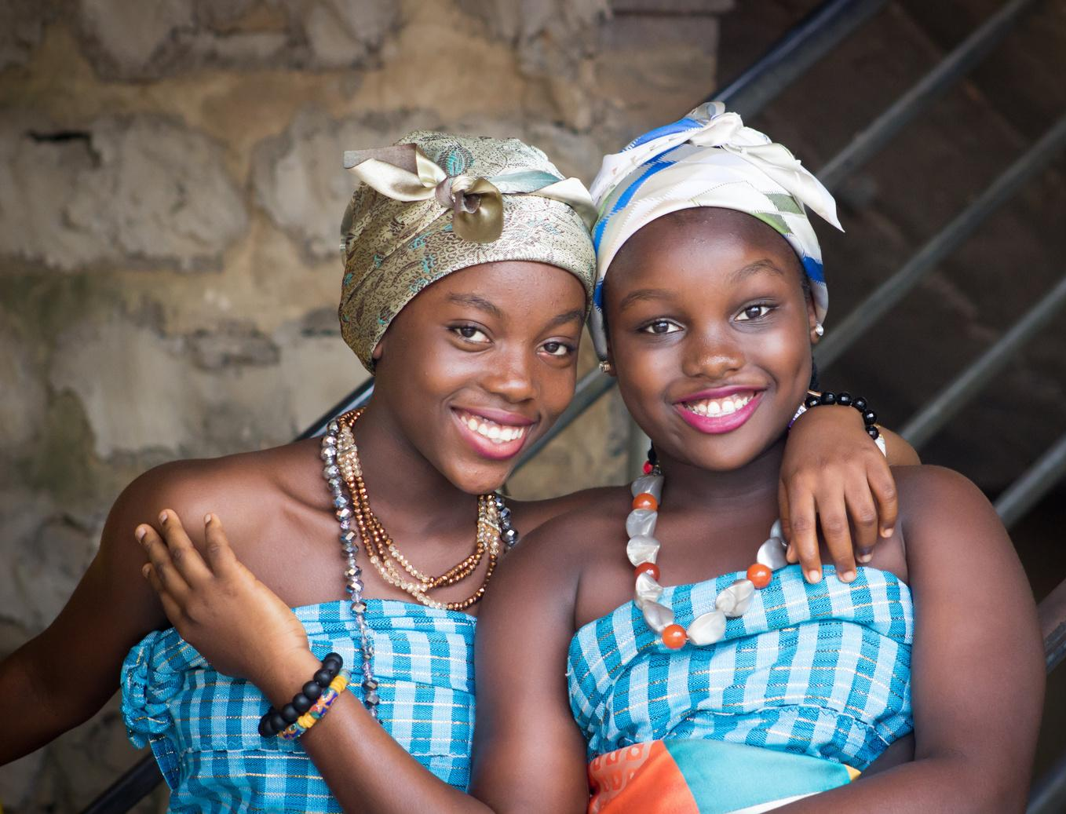
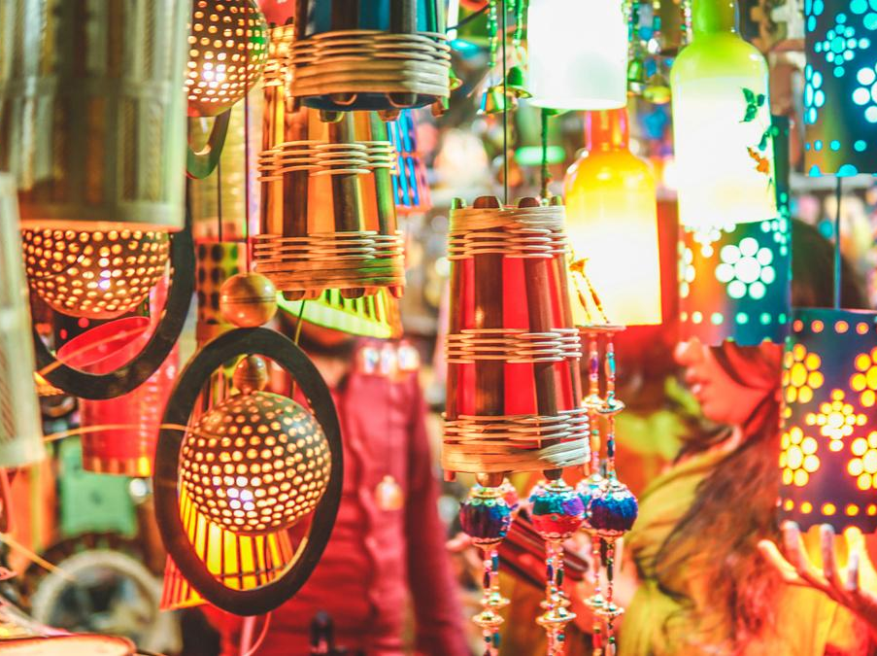
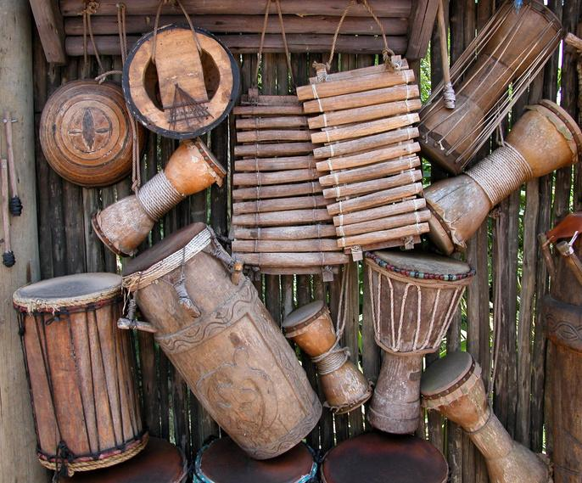
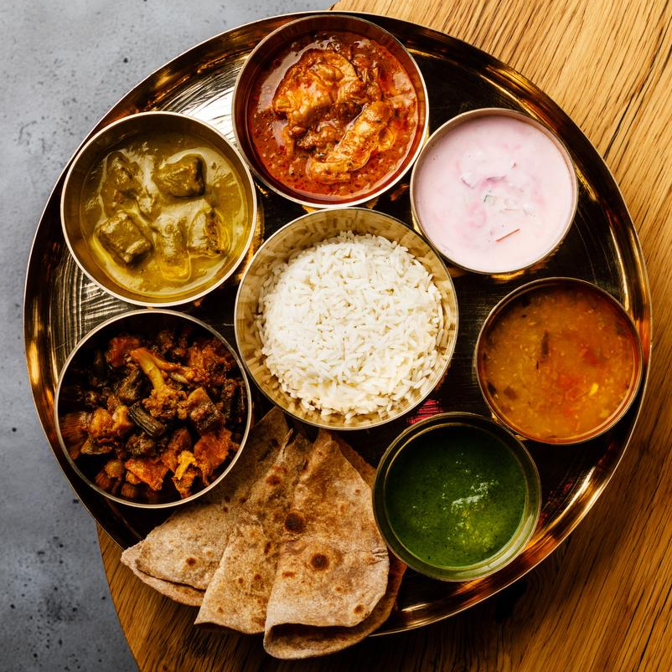
What is the
CULTURE?
Culture is the sum of shared assumptions, values, and beliefs held by a large group of people that result in characteristic behaviors - culture defines us greatly.
Take notice of the invisible parts - assumptions, values, and beliefs
Take notice of the visible parts - behaviors

Slide 13
Defining the Term
Ethnocentrism
Seeing the world through the lens of my own culture
Evaluating other people by my cultural values, beliefs, and behaviors
Assessing other cultures according to the perceptions originating in the standards and customs of one's own culture
In cross-cultural situations, we cannot assign meaning to a given behavior until we know for certain what each behavior means in the other person's culture.
Not all behaviors are cultural.
Culture & Ethnocentrism
Culture unavoidably leads to ethnocentrism.

Slide 14
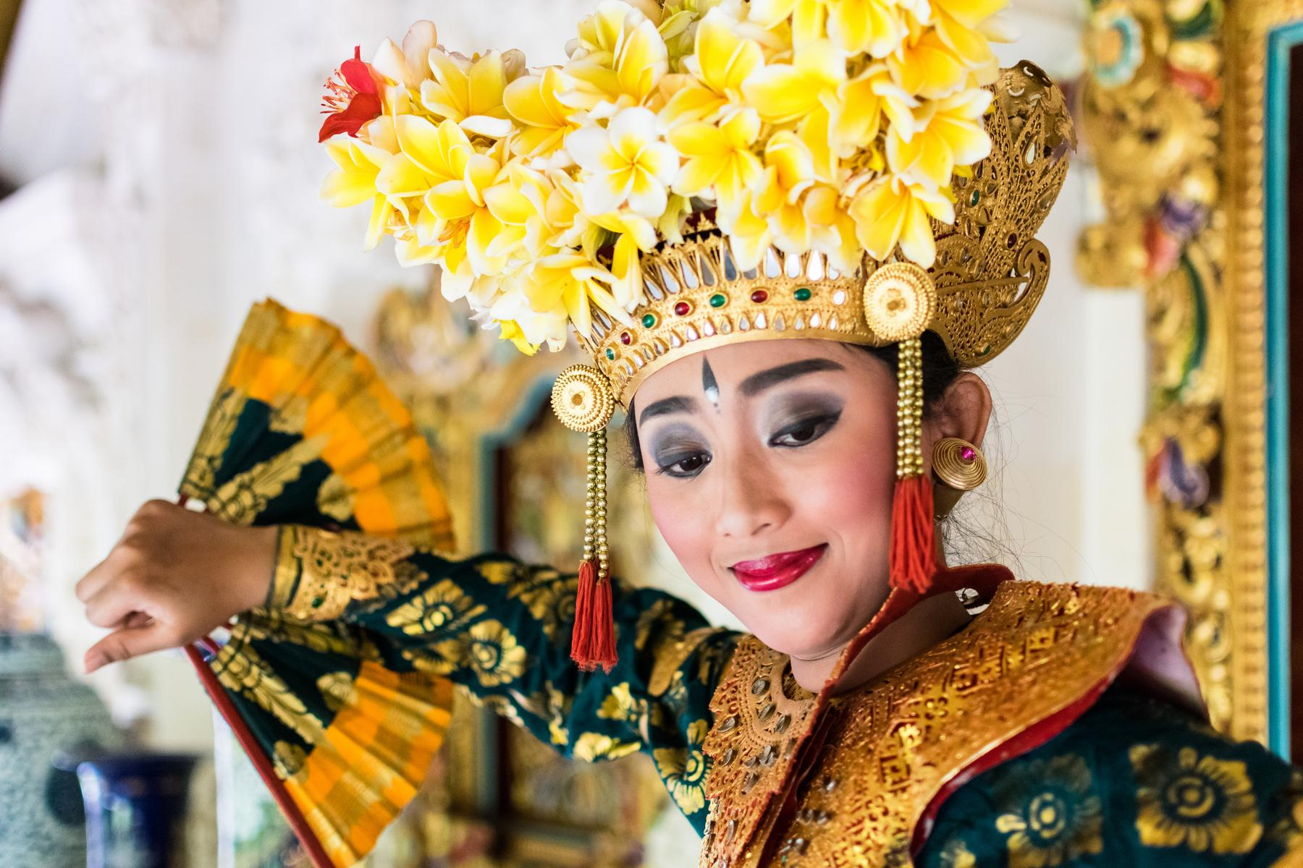
WE SEE OTHERS THROUGH OUR CULTURAL LENS
How do we SEE and UNDERSTAND Others?
There is no doubt that our cultural upbringing shape us in many ways - especially on how we perceive and understanding things. Stereotyping is Stereotypes are the idea that everyone within a certain group shares the same characteristics
WE SEE OTHERS THROUGH OUR LIMITED COMPREHENSION
We sometimes forget to realize the full complexity of the situations and things how they have gotten to where they are.
WE SEE OTHERS THROUGH OUR BIAS, PREJUDICE, AND HATE
We tend to give more weight on what we know rather than on what we do not. Bias, hate, and prejudice are the by-product of self - centeredness, lack of self-control, pride, and sense of superiority. These are the outcomes of polluted mindset, causing imbalanced views of people.

Slide 15
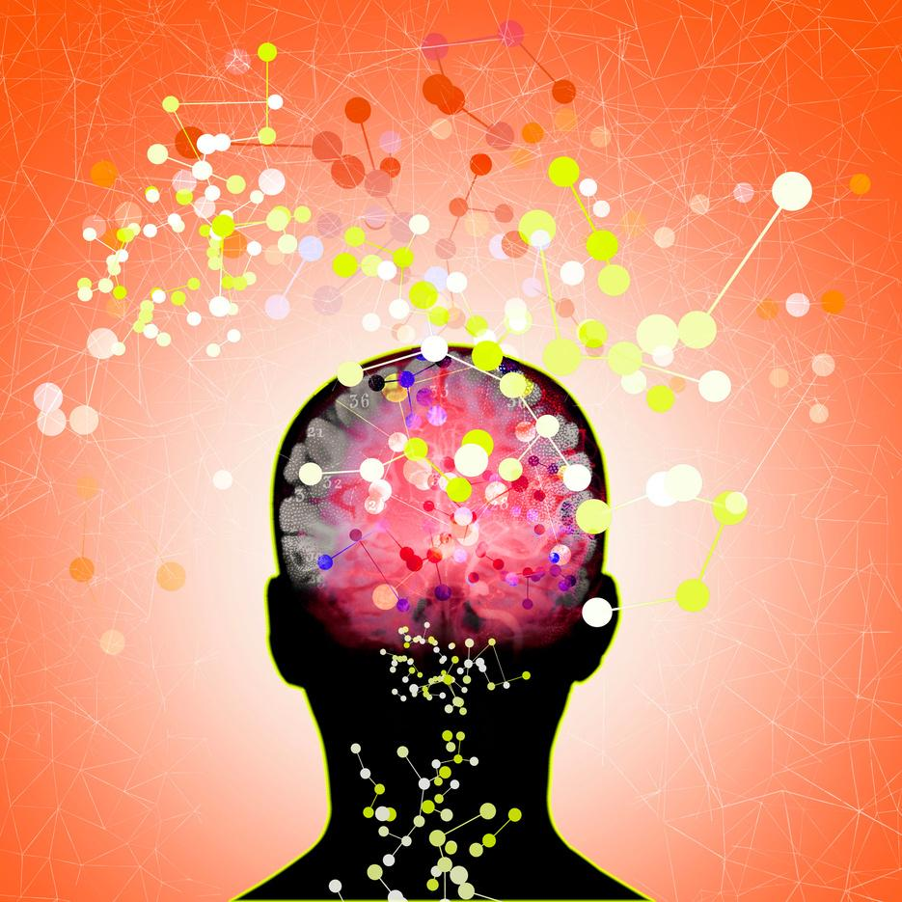
The DANGER of
Stereotyping & Generalization
Mind needs daily renewal and moral brain must have exercise to develop good conscience
Stereotype - a fixed opinion, over generalized belief about a particular group or class of people. One disadvantage is that it makes us ignore differences between individuals; therefore we think things about people that might not be true.

Slide 16
When We Stereotype...
We will miss the beautiful side of humanity or diversity.
We will miss acknowledging God's varying handiwork.
We will miss learning more about colorful and exciting cultures.
We will miss navigating the world with our minds and our brain.
We will miss great opportunities to connect with many good people.
We will miss building and nurturing long-lasting friendships.
We will miss the blessings of being respectful towards one another.
We will miss God and appreciate His character exemplifying in other people.

Slide 17
Romans 12:2
“Do not conform to the pattern of this world but be transformed by the renewing of your mind. Then you will be able to test and approve what God’s will is—his good, pleasing and perfect will.”

Slide 18
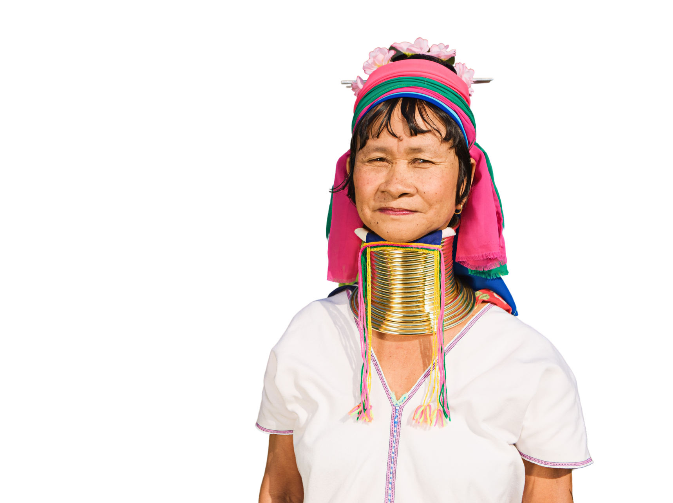
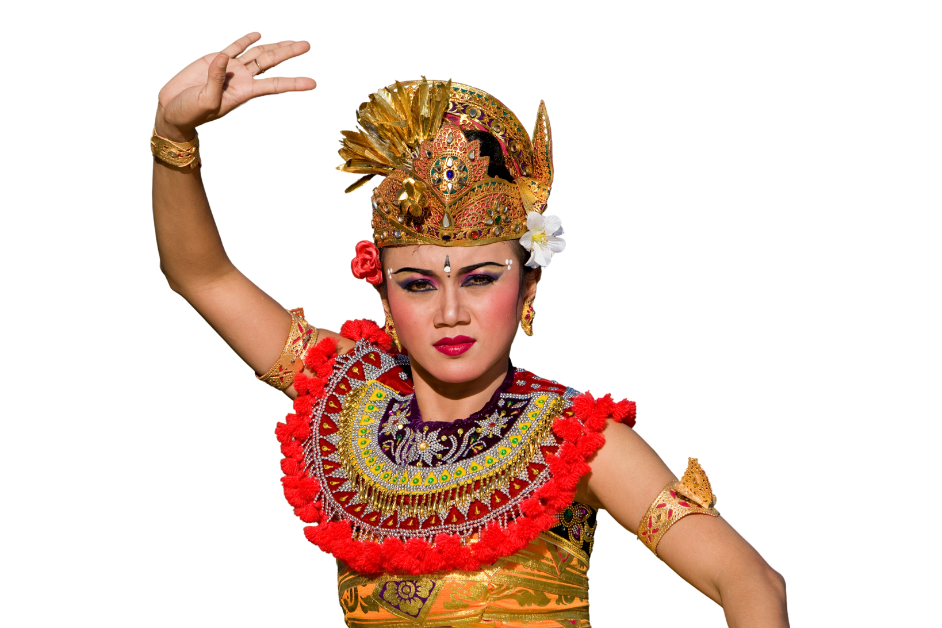
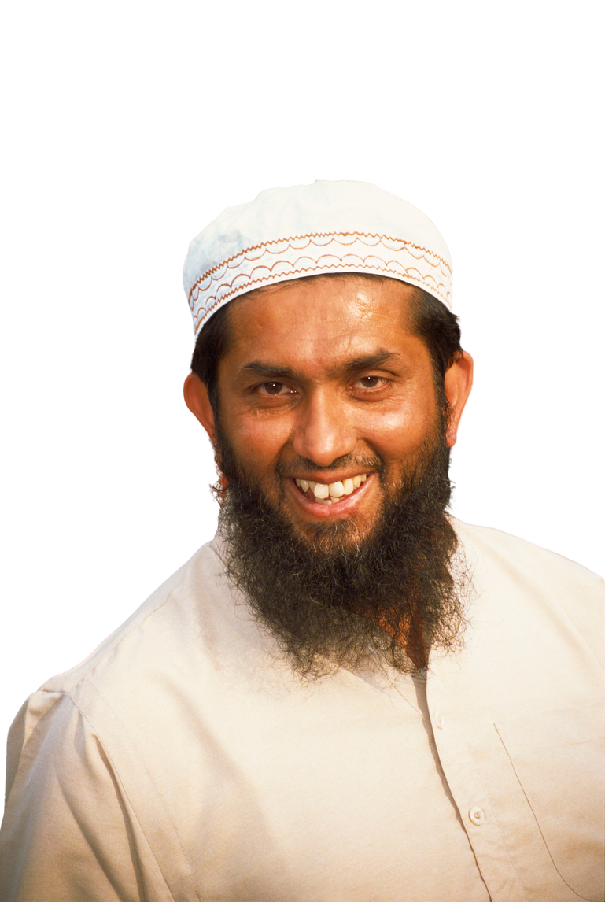
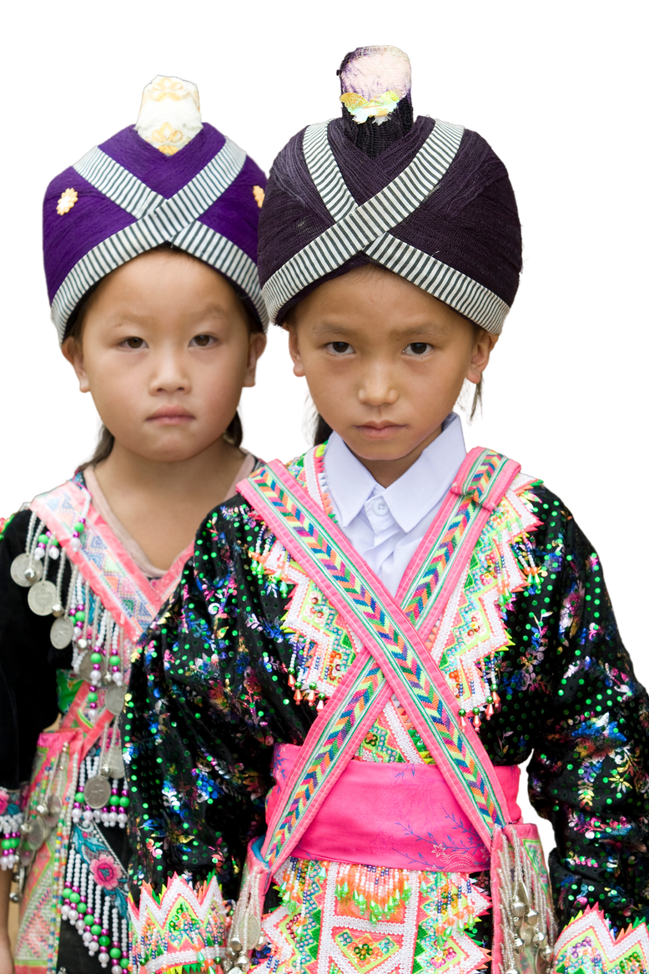
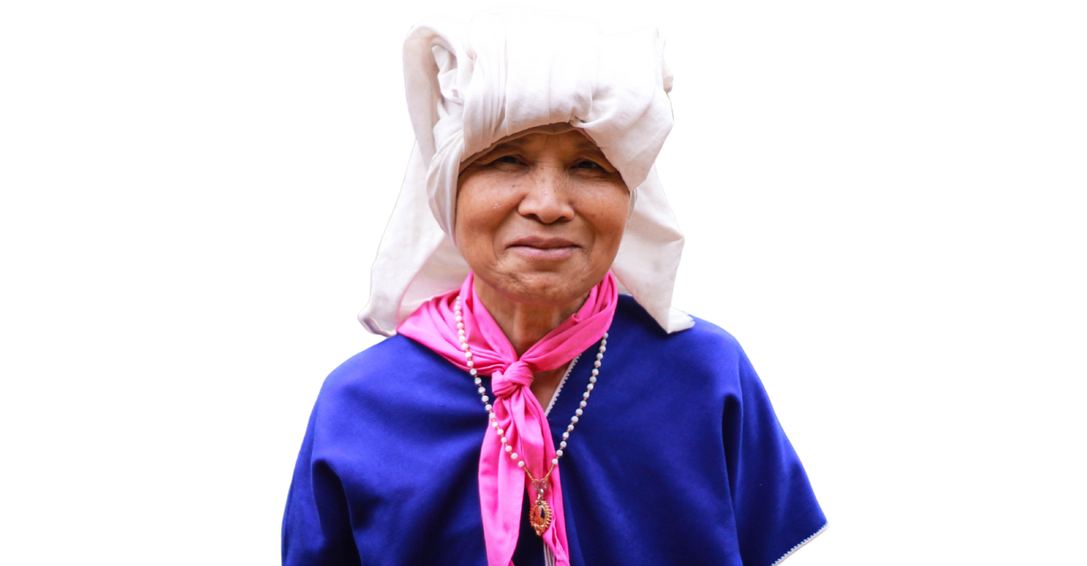
The Issue of Tribalism
The discrimination may also exist within the same race: Asian, Europeans, South Americans, etc.
DEFINITION OF TRIBALISM
The behavior and attitudes that stem from strong loyalty to one's own tribe or social group (Online Dictionary, n.d.) It is discriminatory behavior or attitudes, based on loyalty or corporation within the small group.
ADVANTAGES AND DISADVANTAGES
Tribalism can be good for the sustainability of a cultural group's heritage or ethnic pride; it can also be bad if it is mobilized against others with a superior mindset which may lead to bullying, discrimination, hate, and unrest.

Slide 19
IMPACTS
of Social Discrimination and Racism
Racism & discrimination can happen anywhere. It can happen at school, at work, or at home
Nobody should not feel ashamed of who they are and how they look.
Being treated differently or unfairly because of our race, skin color or ethnicity can negatively affect our mental health.
Racism directly and indirectly touches every person of color and has an effect on emotional & mental well-being of people.
Some may live in constant fear and paranoid due to unhealthy way of dealing with it.
The important thing is how you see the situation and how it makes you feel.

Slide 20
DEALING with Racism Healthily
Decide that we should not feel ashamed of who we are, especially the things we were born with which cannot be changed.
If we experience racism and we cannot let go by ourselves, we should talk to someone trustworthy. It is good to let someone know what we are experiencing - coping mechanisms & gaining support.
Learn our rights and how to report abuses.
Repay racist comments and treatments that are non-threatening with something positive.
Stop the chain of hate within our lifetime and learn to be blessed from the situation by seeking good among those who are being compassionate, caring, and loving to others.

Slide 21
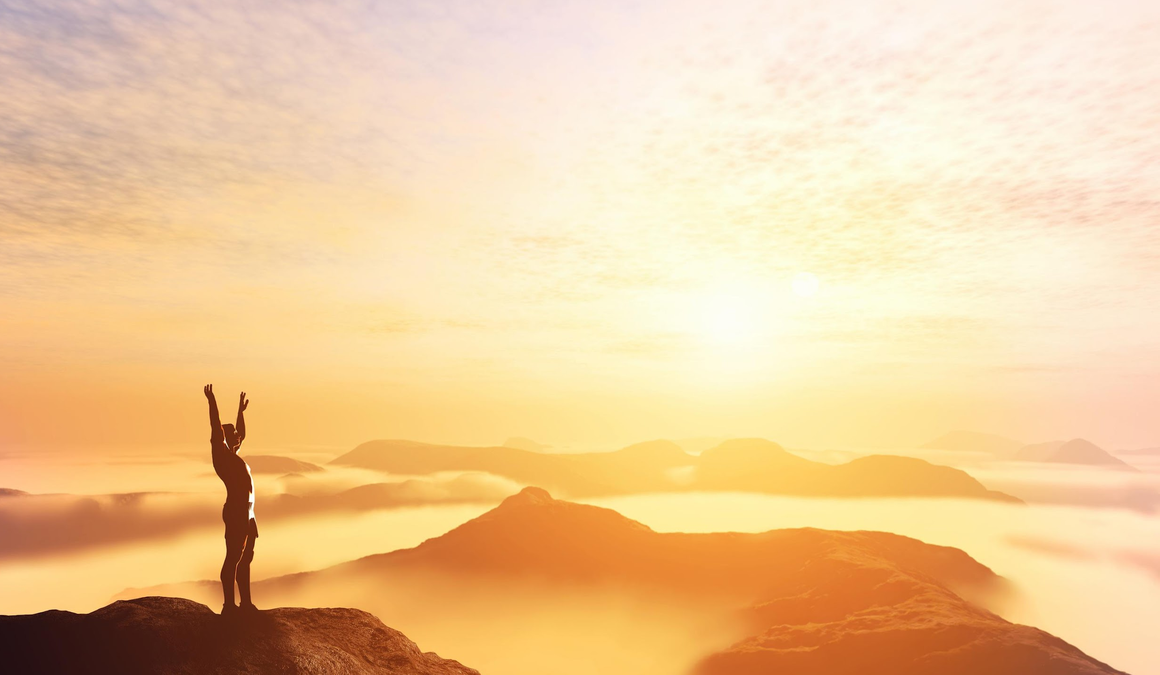
2 CORINTHIANS 10:4-5
"For the weapons of our warfare are not of the flesh but have divine power to destroy strongholds. We destroy arguments and every lofty opinion raised against the knowledge of God, and take every thought captive to obey Christ,..."

Slide 22
Battling Against
Racism & Discrimination at Home
Home is the place that generally breeds habits, beliefs, attitude, mindset, values, etc.
Regardless of our world being globalized, we continue to see sorts of hate, particularly in some countries, where immigrants are in great number.
The unwilling blended society may tend to exhibit all types of hate—racism, misogyny, anti-Semitism, homophobia, transphobia—all types of bullying. Parents worry that their children will be exposed from early childhood, warping their views about diversity and inclusion. We must counter hate's insidious reach before it's too late.

Slide 23
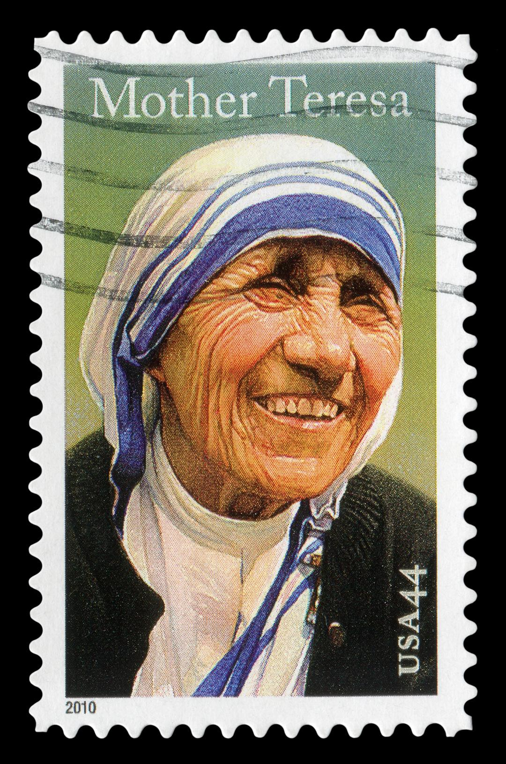
PHILIPPIANS 2:3
"Do nothing from rivalry or conceit, but in humility count others more significant than yourselves."

Slide 24
Romans 3:22-23
"This righteousness is given through faith in Jesus Christ to all who believe. There is no difference between Jew and Gentile, for all have sinned and fall short of the glory of God,.."

Slide 25
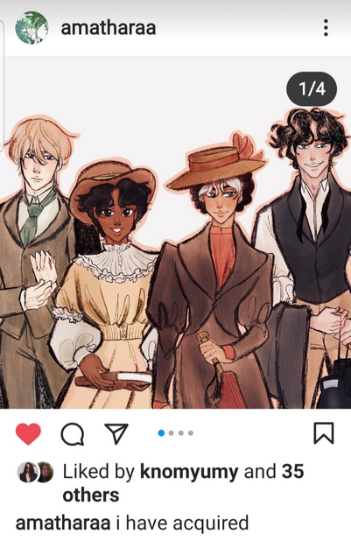
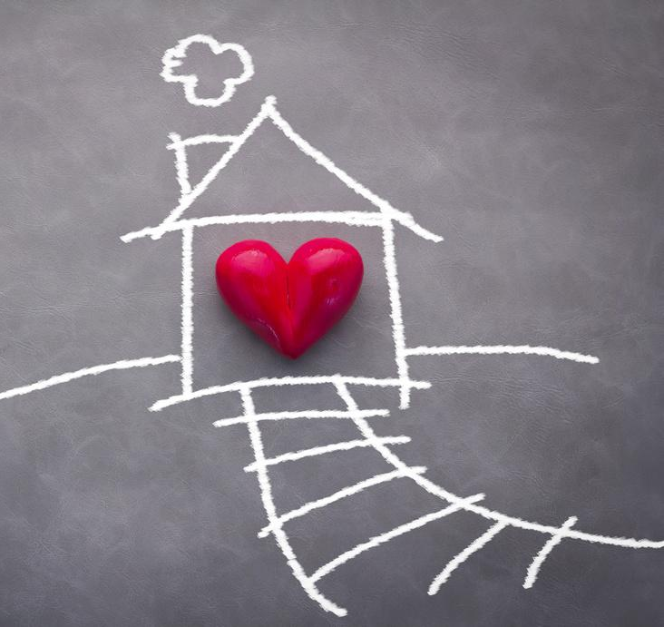
Battling Against
Racism & Discrimination at Home
Teaching Cultural Sensitivity & Widening Children's Mindset.
Teach the concept of beauty that varies in color, shape, and forms.
Read books with children with images of multiracial and differing cultural groups.
Encourage children to develop social relationships with different races and multiracial groups.
If kids do not grow among those who look different than them, experts advise bringing the world home: Study other cultures together by eating their foods and watching their films.
Encourage your child to study another language.
University of Chicago study revealed that children who hear multiple languages in daily life are more accepting of people whose language differs from their own—which is a stepping-stone toward a broader spirit of acceptance.

Slide 26
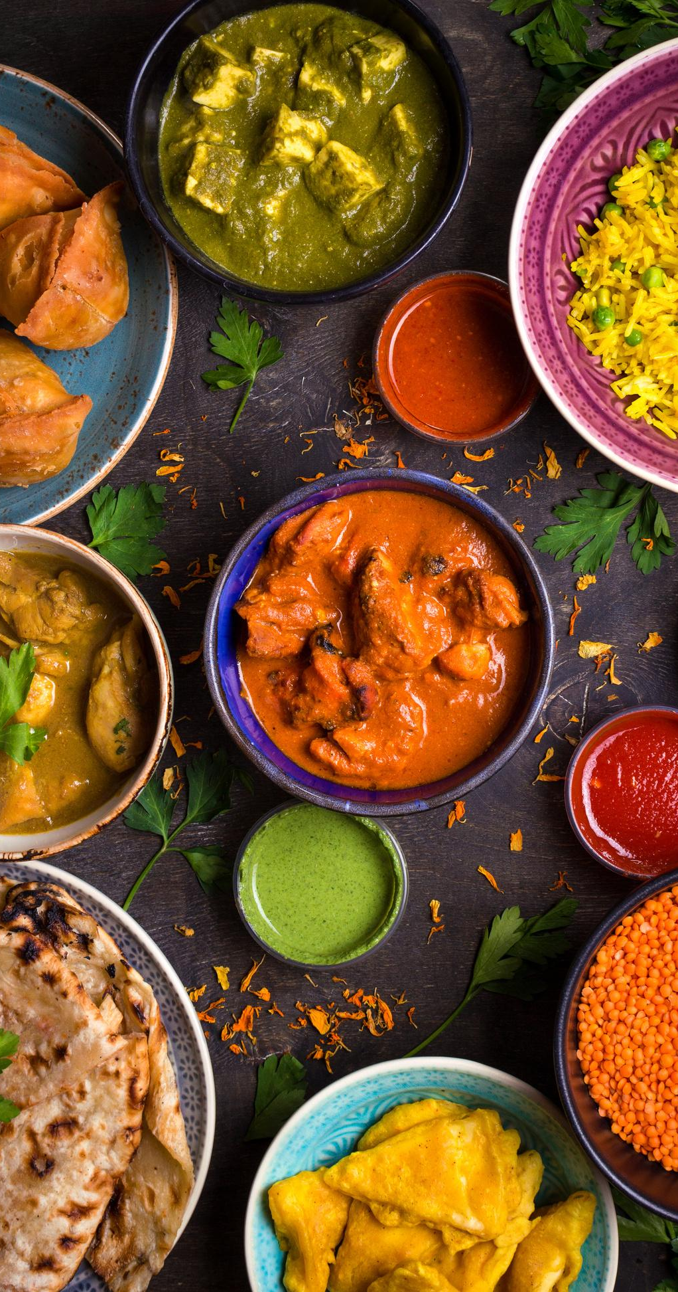
Battling Against
Racism & Discrimination at Home
Teaching Cultural Sensitivity by Widening Children's Mindset.
Take children out to eat different kinds of food and get them to experience the international buffet or learn to cook other cultural dishes together at home.
Invite your child's friends of different racial groups home and get to know their families.
Expose to different cultures and speak positively of other cultural beliefs, traditions, etiquette, and practices.
Model anti-racism as adults and help children value others as unique and created in God's image.
Project on the inward and eternal beauty of people.

Slide 27
Battling Against Racism at Home
Teaching Cultural Sensitivity and Widening Children's Mindset.
Discuss with children about race and point out interesting facts and practices and appreciate them by explaining the underlying reason for certain cultural practices.
Talk about prevalent issues to older children such as racial injustice, hate crimes, and social discrimination, and lead children to understand how damaging to God's image and the effects on mental health.
Educate children about the historical events and past conflicts in a balanced manner.
Speak and live against racism, prejudice, bias, and discrimination and reason with children that these are not God's intended plans to exist among His children.

Slide 28
IF WE ARE CAUGHT IN THE MIDDLE OF BIAS THINKING & HATED SPEECH
Dealing Racism Among Tweens and Teens
SPEAK UP AGAINST IT
REASON THAT HATE IS A CRIME AND BIASED THINKING IS UNJUST
RACISM AND HATE IS THE TRANSGRESSION OF GOD'S LAW
Immature adults and teens often fail to see things in their full complexity. Justice-minded parents do not let such unreasonable speech passes by without taking an action.
Hate is disrespect. It is the mental crime against others and ourselves.
God is displeased with hate the people who exercise this unlawful perception which is against the moral law of God. Unity in diversity is the promotion of Jesus for humanity.

Slide 29
The Church is against Racial Divide
Social status & race is not the determining factor of human worth - the Holy Spirit unites God's people and His church (Luke 4:18-19)
God's love is indiscriminate (John 3:16)
We are in God's family united by Christ and one in Spirit (1 Corinthians 6:17; Ephesians 4:4)
Romans 12:5 "so in Christ we, though many, form one body, and each member belongs to all the others.
Romans 1:14 "I am obligated both to Greeks and non-Greeks, both to the wise and the foolish."

Slide 30
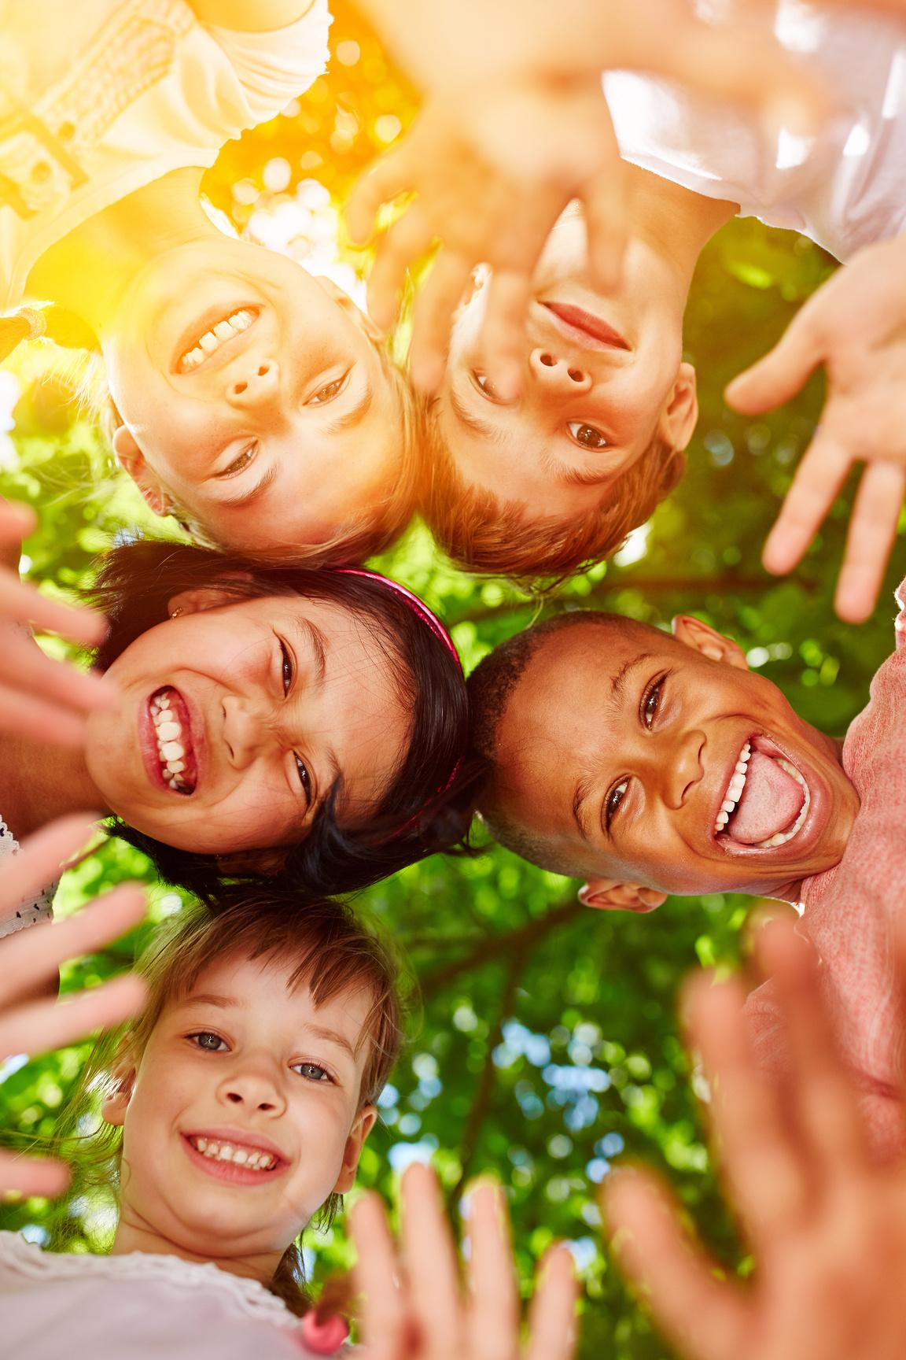
Galatians 3:28
There is neither Jew nor Gentile, neither slave nor free, nor is there male and female, for you are all one in Christ Jesus.

Slide 31
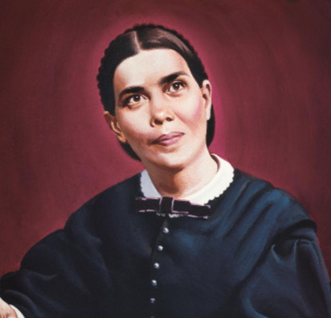
Ellen White's Stand on Racism
Mrs. White boldly preached on duties to colored people after the abolition of slavery on March 21, 1891
Equal love: Christ died just as much for the Black people as for the White people, and the God of the White man is the same God of the Black man.
Equal reward: The Black man's name is written next to the White man's name in the book of life.
Equal salvation: Unless God's Spirit is in your heart, whether you're White or Black, you are a slave and need to be freed.
Equal destination: We are all journeying to the same heaven.
Equal relations: God makes no distinction between the North and the South; therefore, we must learn to live together here on earth before we can get to heaven.
Equal responsibility: Let none of Christ's children be cowards in regard to the work for the Black race.
Equal priority: The Seventh-day Adventist Church must give the gospel to Blacks, and it should be at the top of the priority list (Adventist Review (Online Ed), 2002).
https://www.adventistreview.org/archives/2002-1508/story2.html

Slide 32
Ellen G. White: Caste is Hateful to God
If you have the spirit of Christ, you will love as brethren; you will honor the humble disciple in his poor home, because God loves him as much as He loves you, and it may be more. He recognizes no caste. He places His own signet upon men, not by their rank, not by their wealth, not by intellectual greatness, but by their oneness with Christ. It is purity of heart, singleness of purpose, that constitutes the true value of human beings.... All who are living in daily communion with Christ, will place His estimate upon men. They will reverence the good and pure, although these are poor in this world's goods.... Avarice, selfishness, and covetousness are idolatry, and are dishonoring to God.... Tenderness, compassion, and benevolence are enjoined upon Christians," (OHC, 180.3).

Slide 33
We stand in awe of the ocean,
The thunderstorm,
The sunset, the mountains
But we pass by a human being
Without notice
Even though the person
Is God's most
Magnificent creation.

Slide 34
Luke 10:27
He answered, "'Love the Lord your God with all your heart and with all your soul and with all your strength and with all your mind'; and, 'Love your neighbor as yourself.'"

Slide 35
"I prefer peace. But if trouble must come, let it come in my time, so that my children can live in peace."
-- Thomas Paine, died June 8, 1809

