Slide 2
19 Inexpensive Decorating Ideas for Sabbath School
Leadership Certification Course #8
Linda Mei Lin Koh
GC Children’s Ministries

Slide 3
Decorating your Sabbath School classroom to be an exciting learning environment for kids, can be tough on a limited budget.

Slide 4
Do you have the experience of having… bleak walls boring room layout stale carpet blank bulletin boards
BUT you have no Budget!

Slide 5
Guess What! You can transform your room on a limited budget.

Slide 6
Do you want your Sabbath School Class to say, “Wow!”

Slide 7
Here are 19 Ideas that will cost you next to nothing.

Slide 8
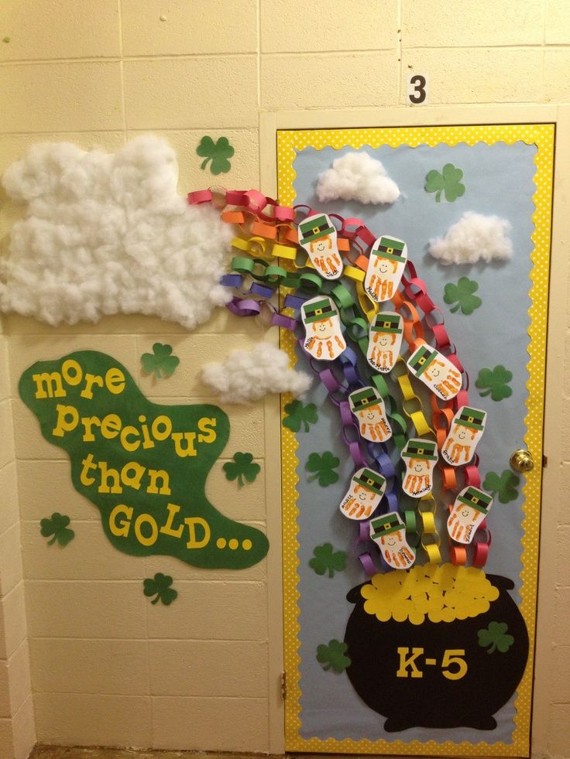
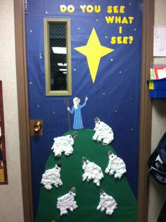
1. Dynamic Doors
Colour the door with paint, or crepe
paper, or hang child-friendly pictures to
make the door attractive.

Slide 9
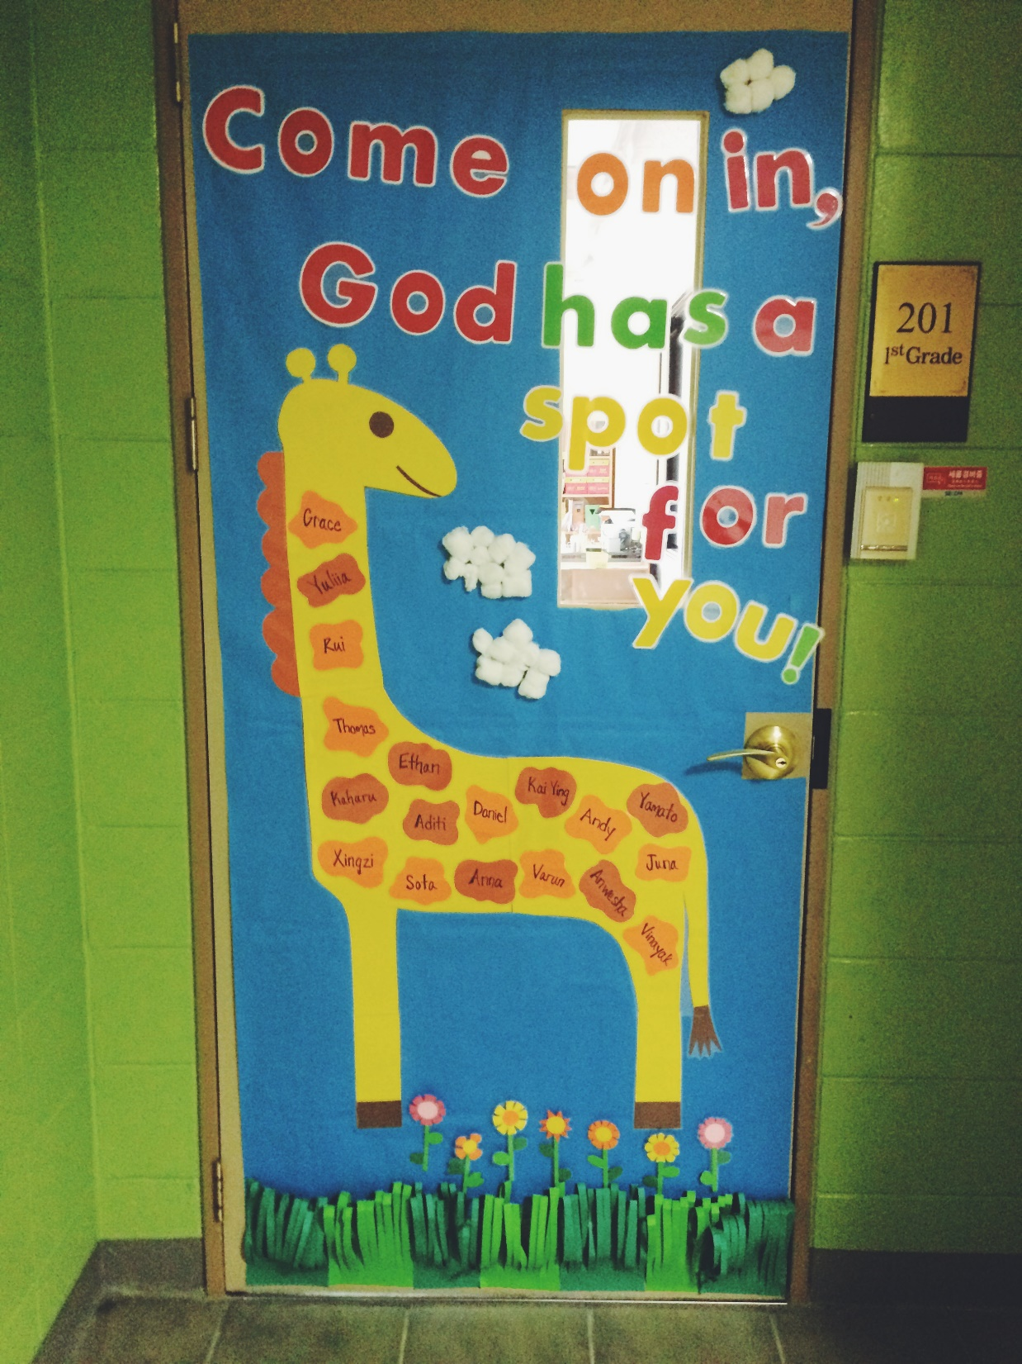
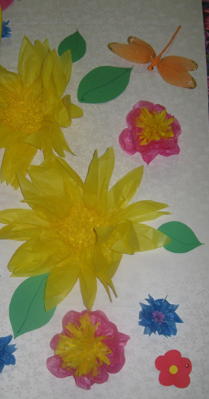
1. Dynamic Doors

Slide 10
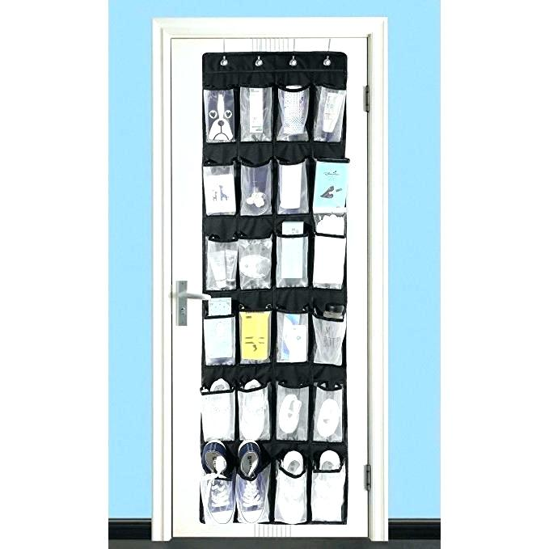
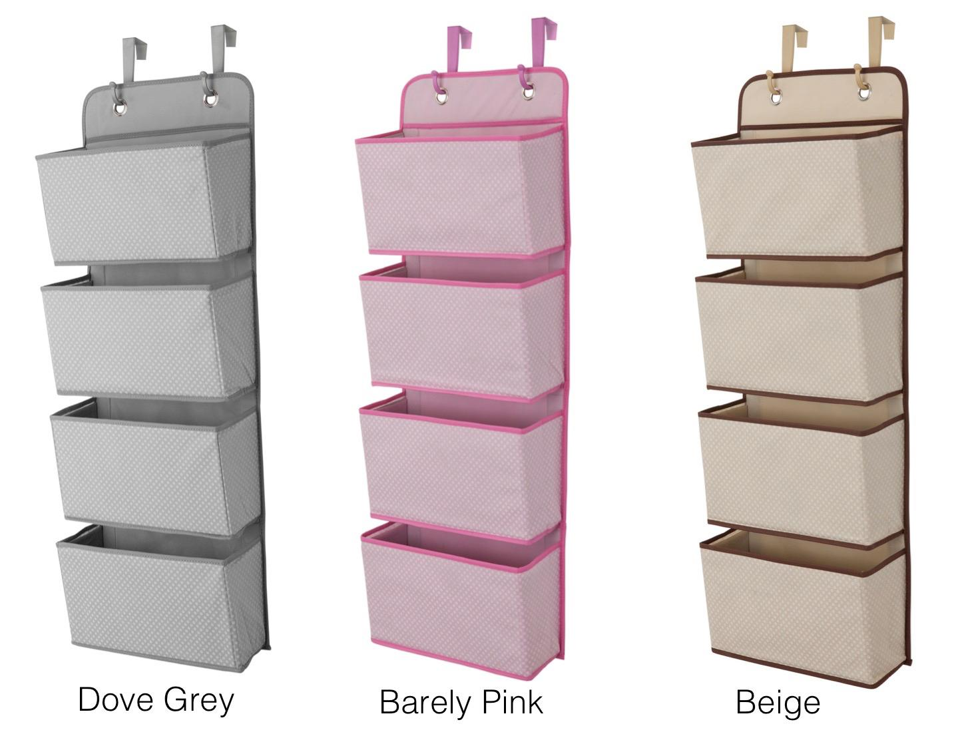
2. Back Pockets
Storage is often an issue in classrooms. Purchase or sew a hanging over-the-door pocket bag.

Slide 11
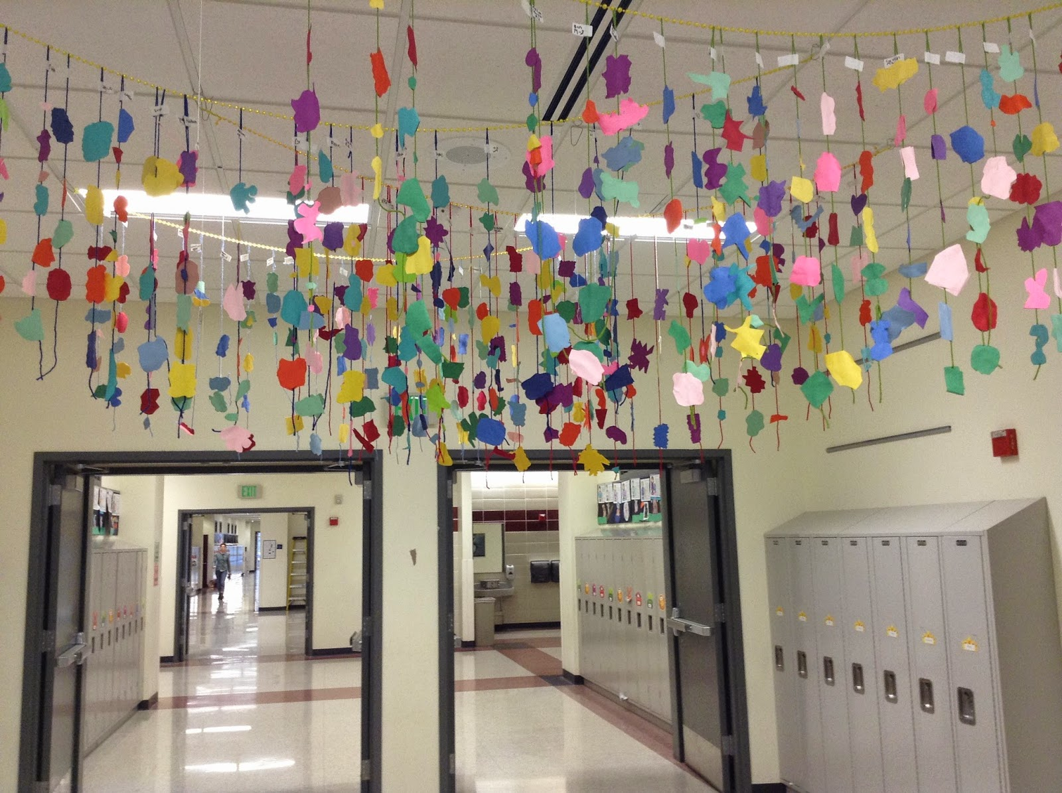
3. Creative Ceilings
Have kids lend a hand to this fun ceiling decoration. Create a handprint border around the top of the wall or ceiling using different colours of tempera paint.

Slide 12
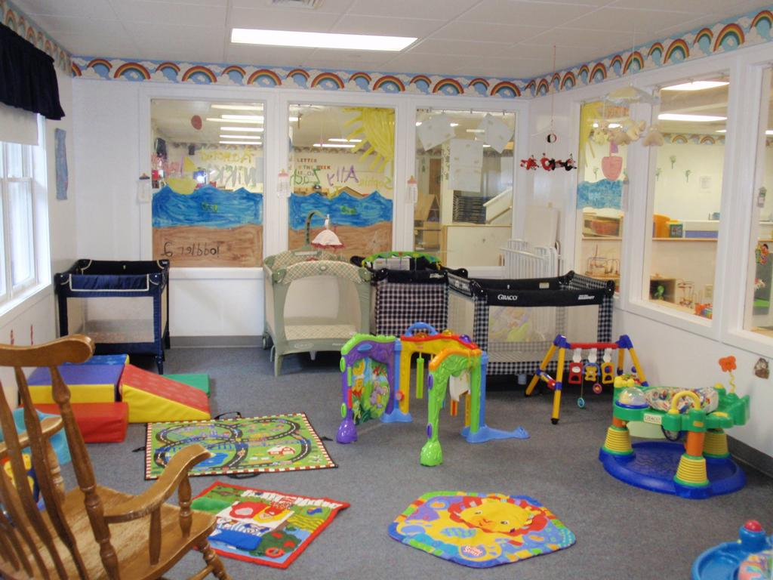
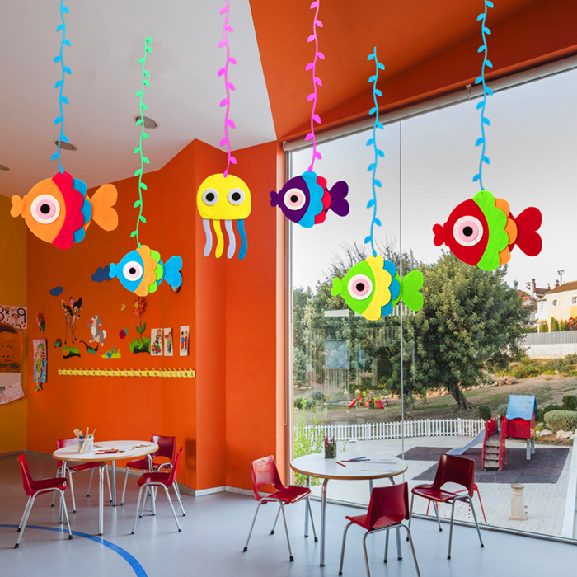

Slide 13
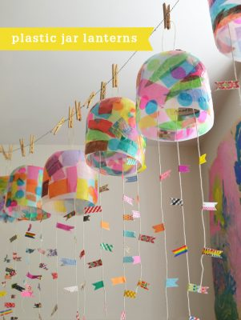
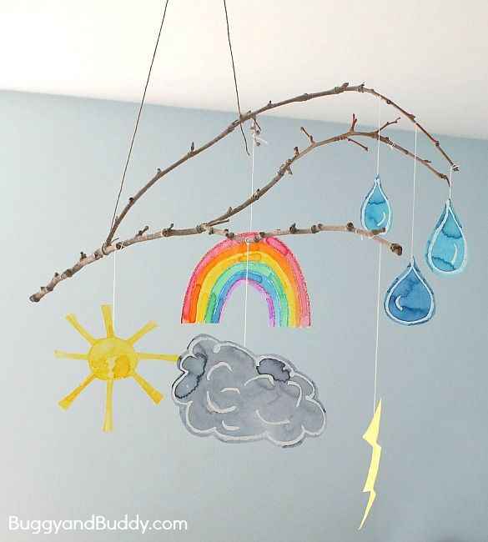
4. Mobiles
Mobiles are an easy way to
liven up a drab room, and
they make a creative class
project.

Slide 14
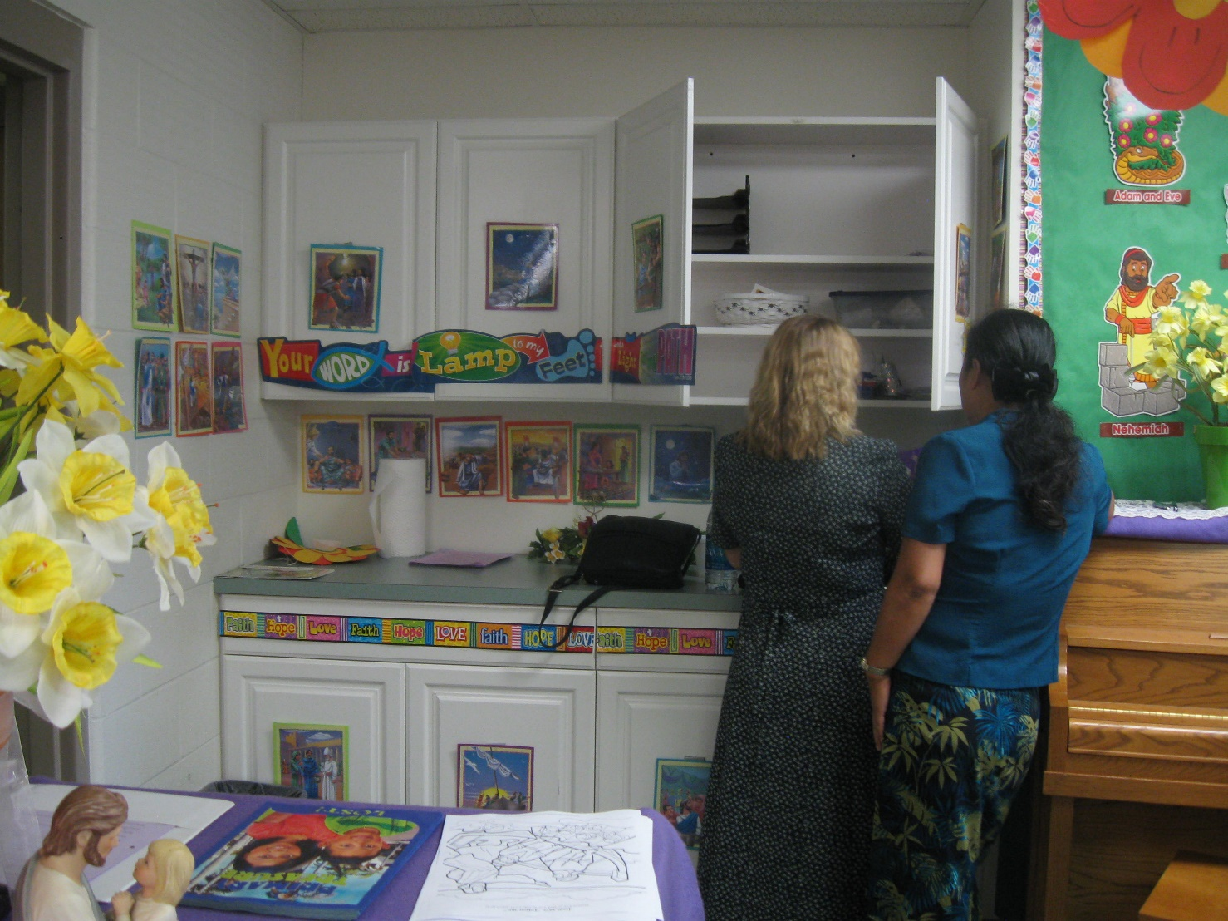
5. Wall Colours Galore
Recruit parents or preteens to help as you give your room a face-lift.

Slide 15
5. Wall Colours Galore

Slide 16
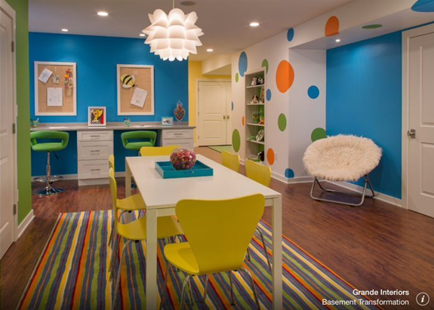
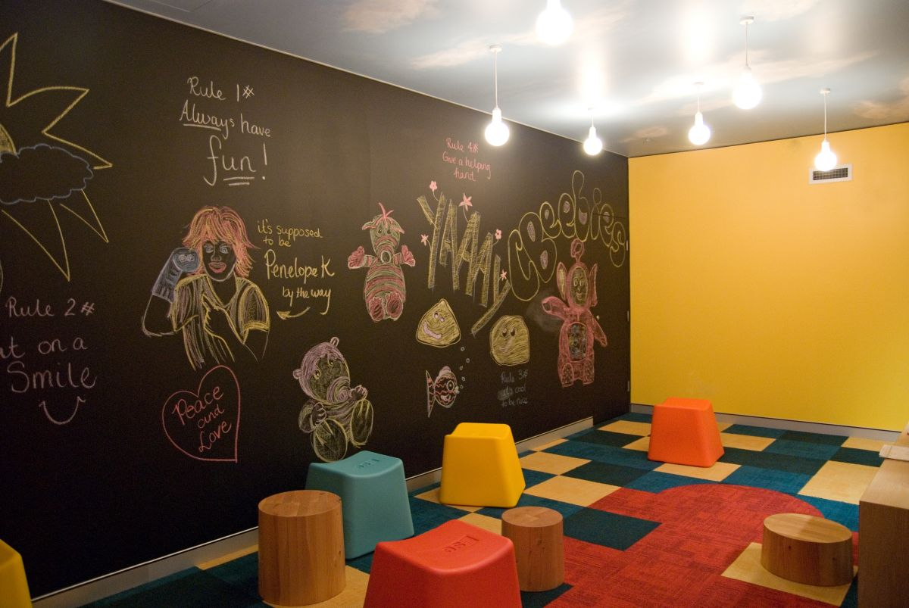
6. Go Dark
Dramatic colours can add depth and interest to your room. They make the perfect background to display kid’s art projects.

Slide 17
7. All Aglow
Glow in the dark paint and stickers are less obvious way to spice up your room, but kids love them. Design a biblical skyline or scene, then decorate the walls and ceilings with stars.

Slide 18
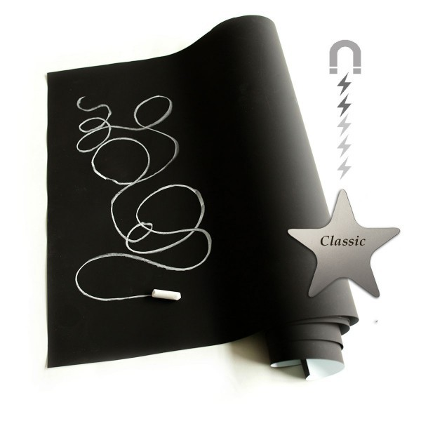
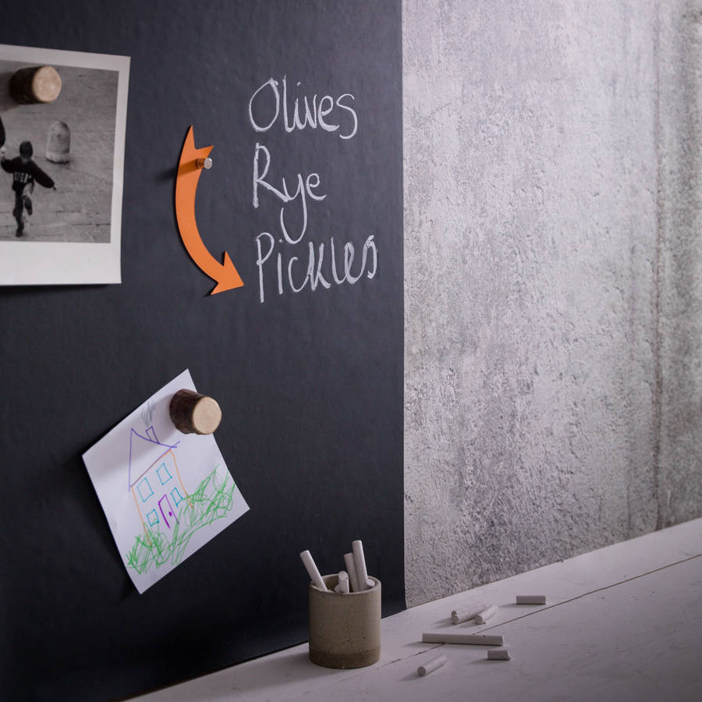
8. Sticky Stuff
Consider “striping” your room with paint. Use magnetic paint, where you can easily attach pictures, art projects, and decorations with magnetic sheets.

Slide 19
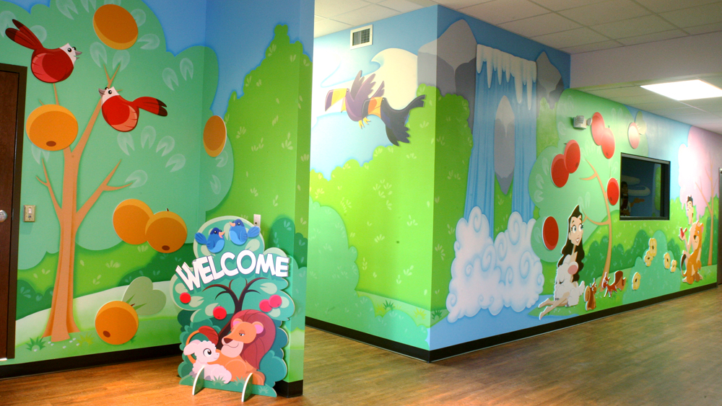
9. Murals
Murals never go out of style, and they are always a fun, cooperative effort. You will need an artistic person to create the outlines of the mural, but anyone with a paintbrush can fill in the rest.

Slide 20
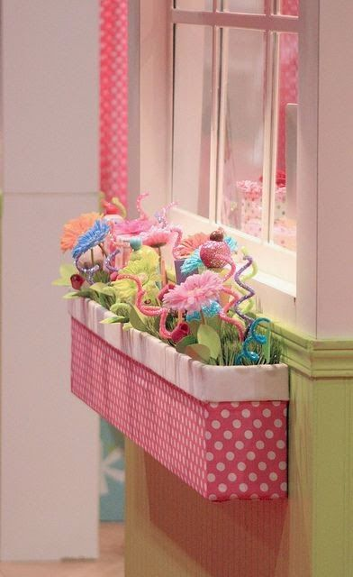
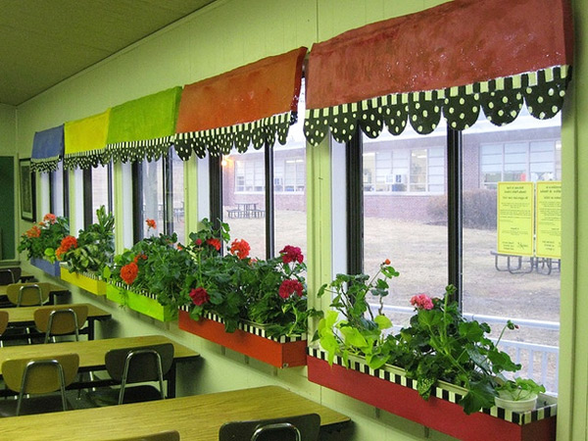
10. Winning Windows
Dress up your window with real potted
plants or artificial ones. colourful curtains
can be eye-catching and appealing.

Slide 21
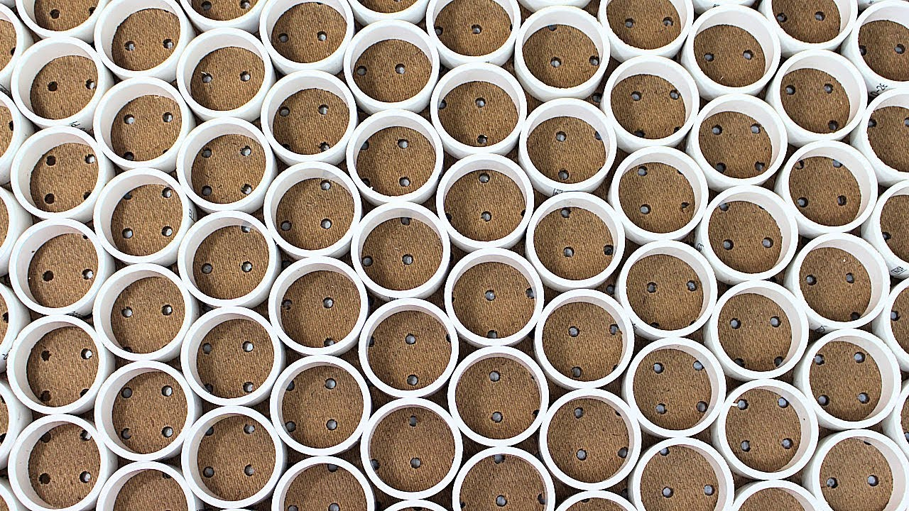
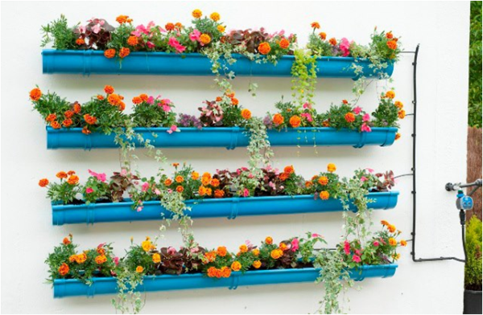
11. PVC SURPRISE
PVC piping is cheap, light, and versatile. To make curtain rods, cut sections just longer than the width of your windows. Drape each section with fabric or cover the pipe itself with glue and fabric.

Slide 22
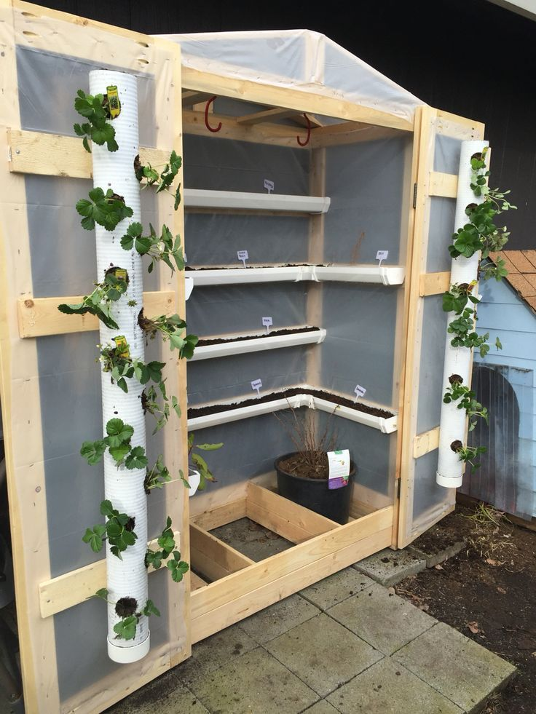
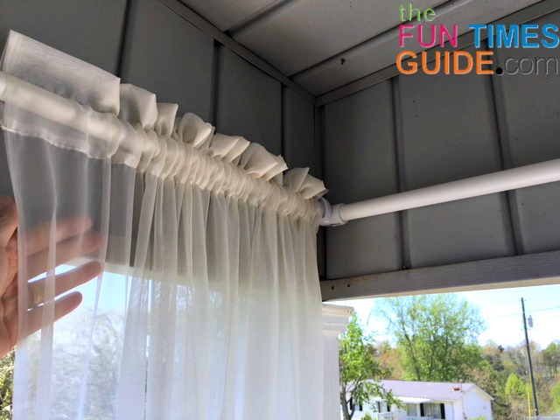

Slide 23
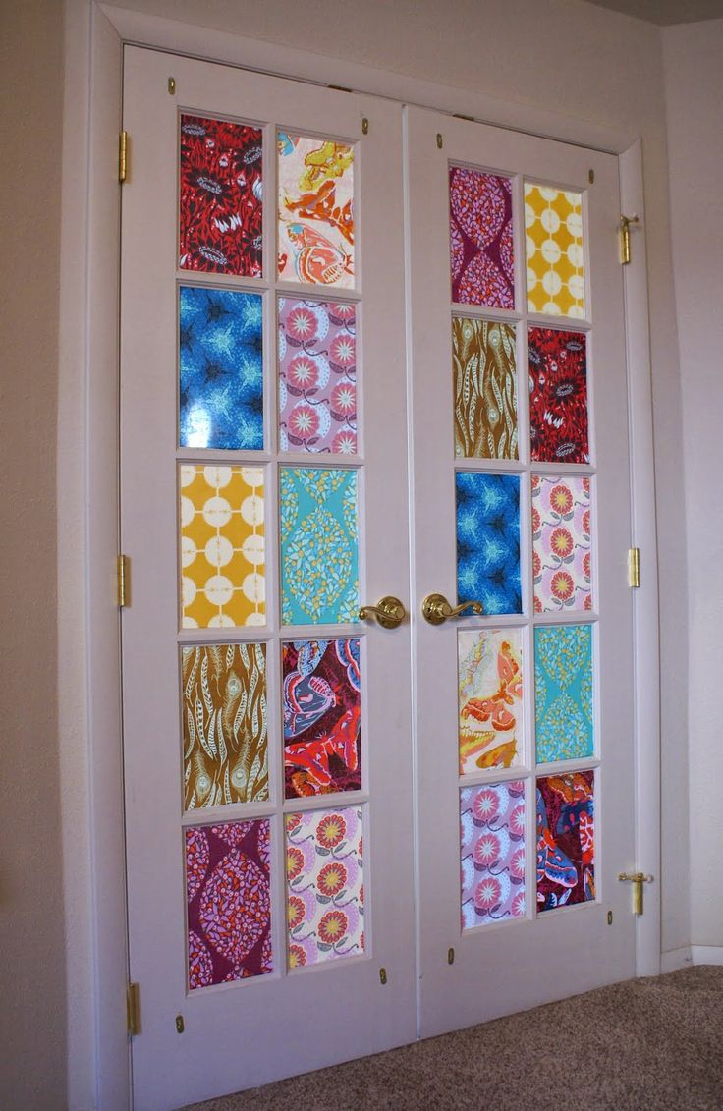
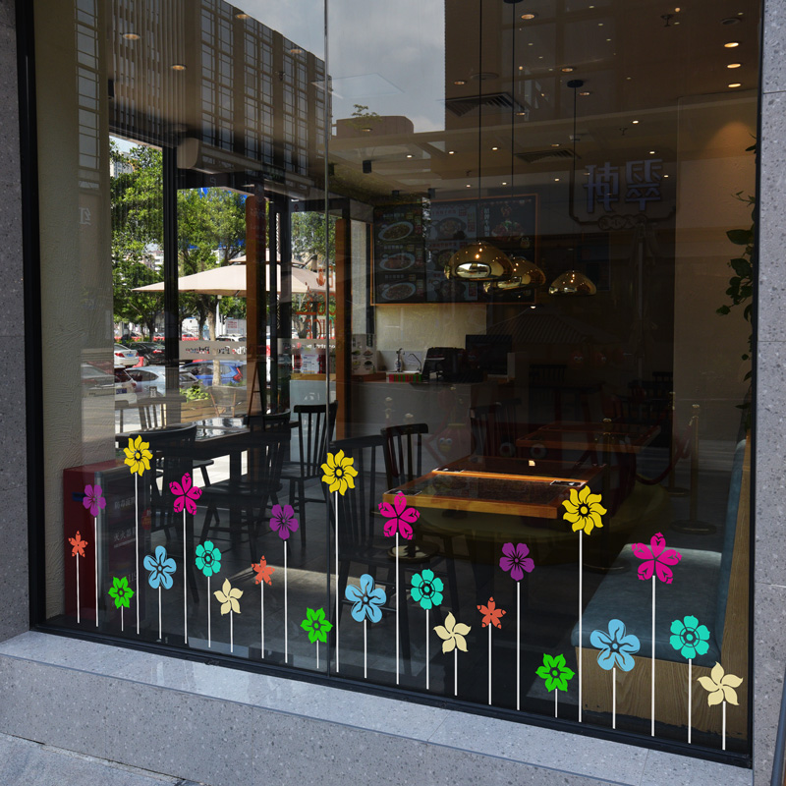
12. GLASS STAIN
Windows are wonderful, but sometimes what’s going on outside them distracts children. If you want the light but loose the distraction, stain your glass.

Slide 24
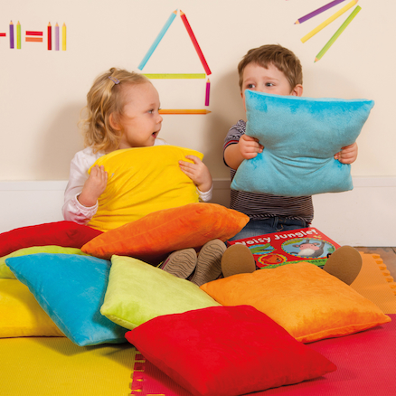
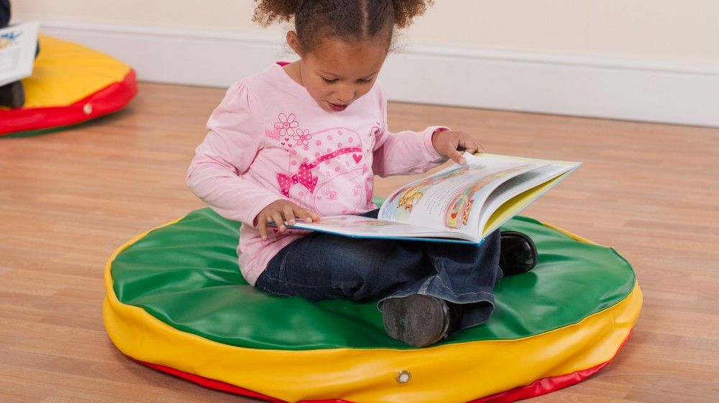
13. FANTASTIC FLOORS
Use colourful throw cushions or beanbags to brighten the floors. Place colourful tiles that appeal to children.

Slide 25
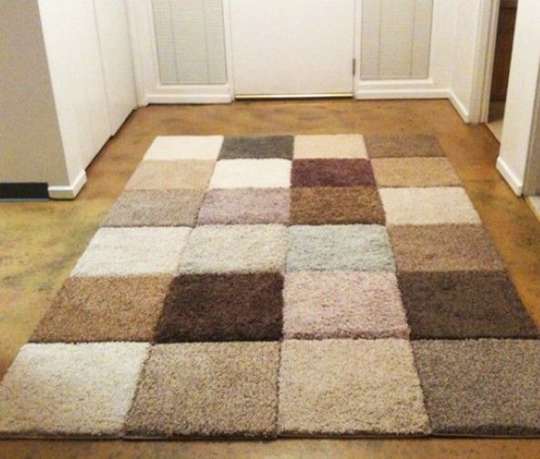
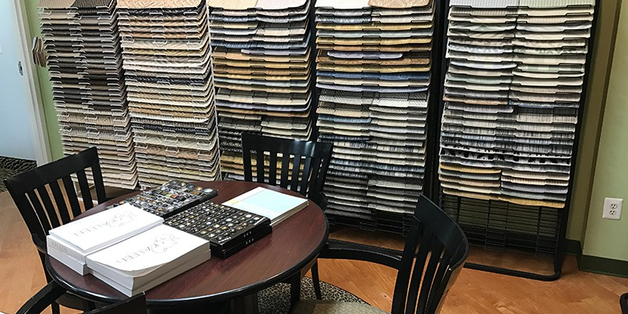
14. REMNANTS AND RUGS
Cover worn-out carpets or soften tile with carpet remnants or inexpensive rugs.

Slide 26
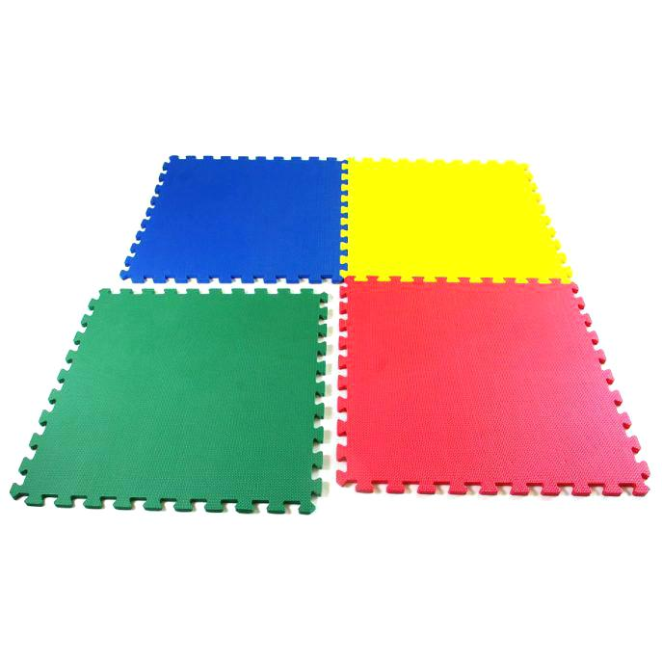
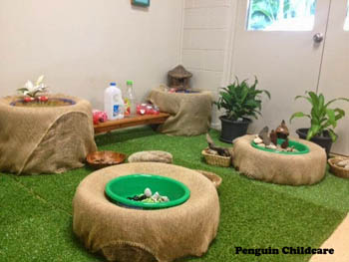
15. PAINT ME A PATH
Make your floor memorable with a new paint job.

Slide 27
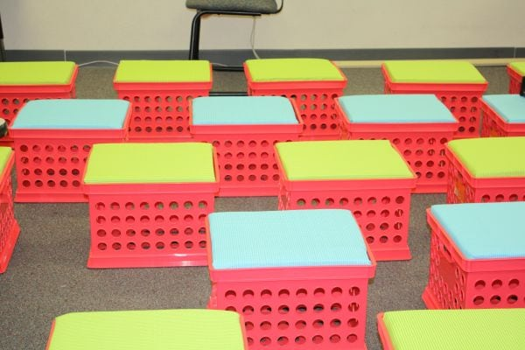
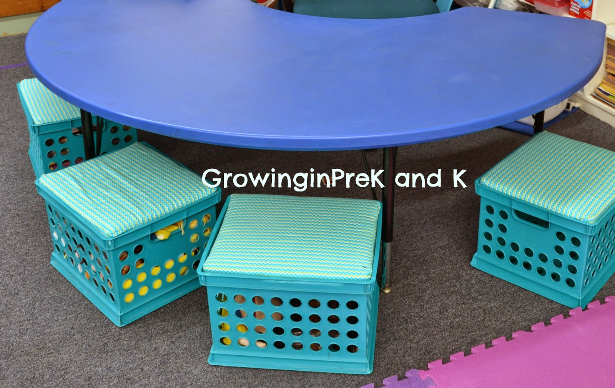
16. CRATES
Crates can do double duty as storage and bench seating. You can paint older crates or cover it with fabric, to improve the appearance.

Slide 28
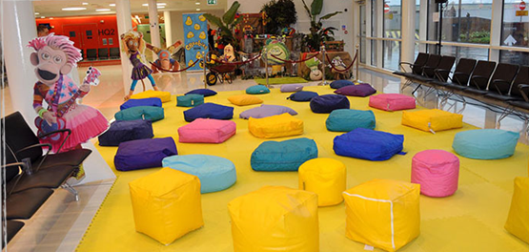
17. MINI BEANBAGS
Beanbags don’t have to cost a lots. Stock up plastic foam packing chips. Stuff a pillowcase full of plastic foam chips, then sew open end close, to make a mini beanbag.

Slide 29
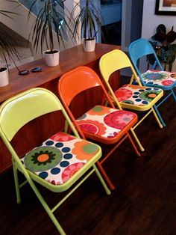
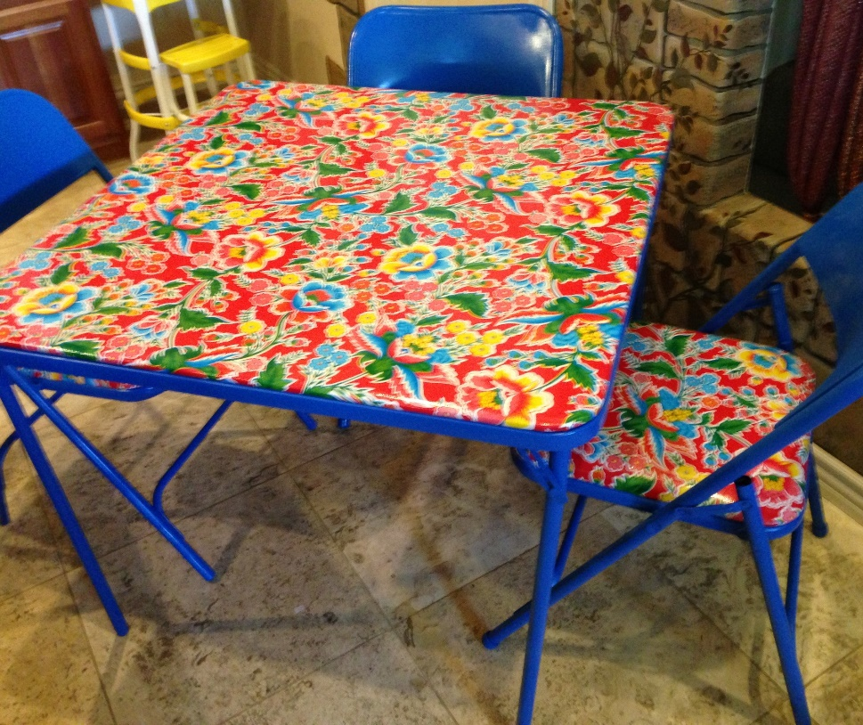
18. TABLES AND CHAIRS
Erase the bland look of classroom furniture with brightly coloured fabric, etc.

Slide 30
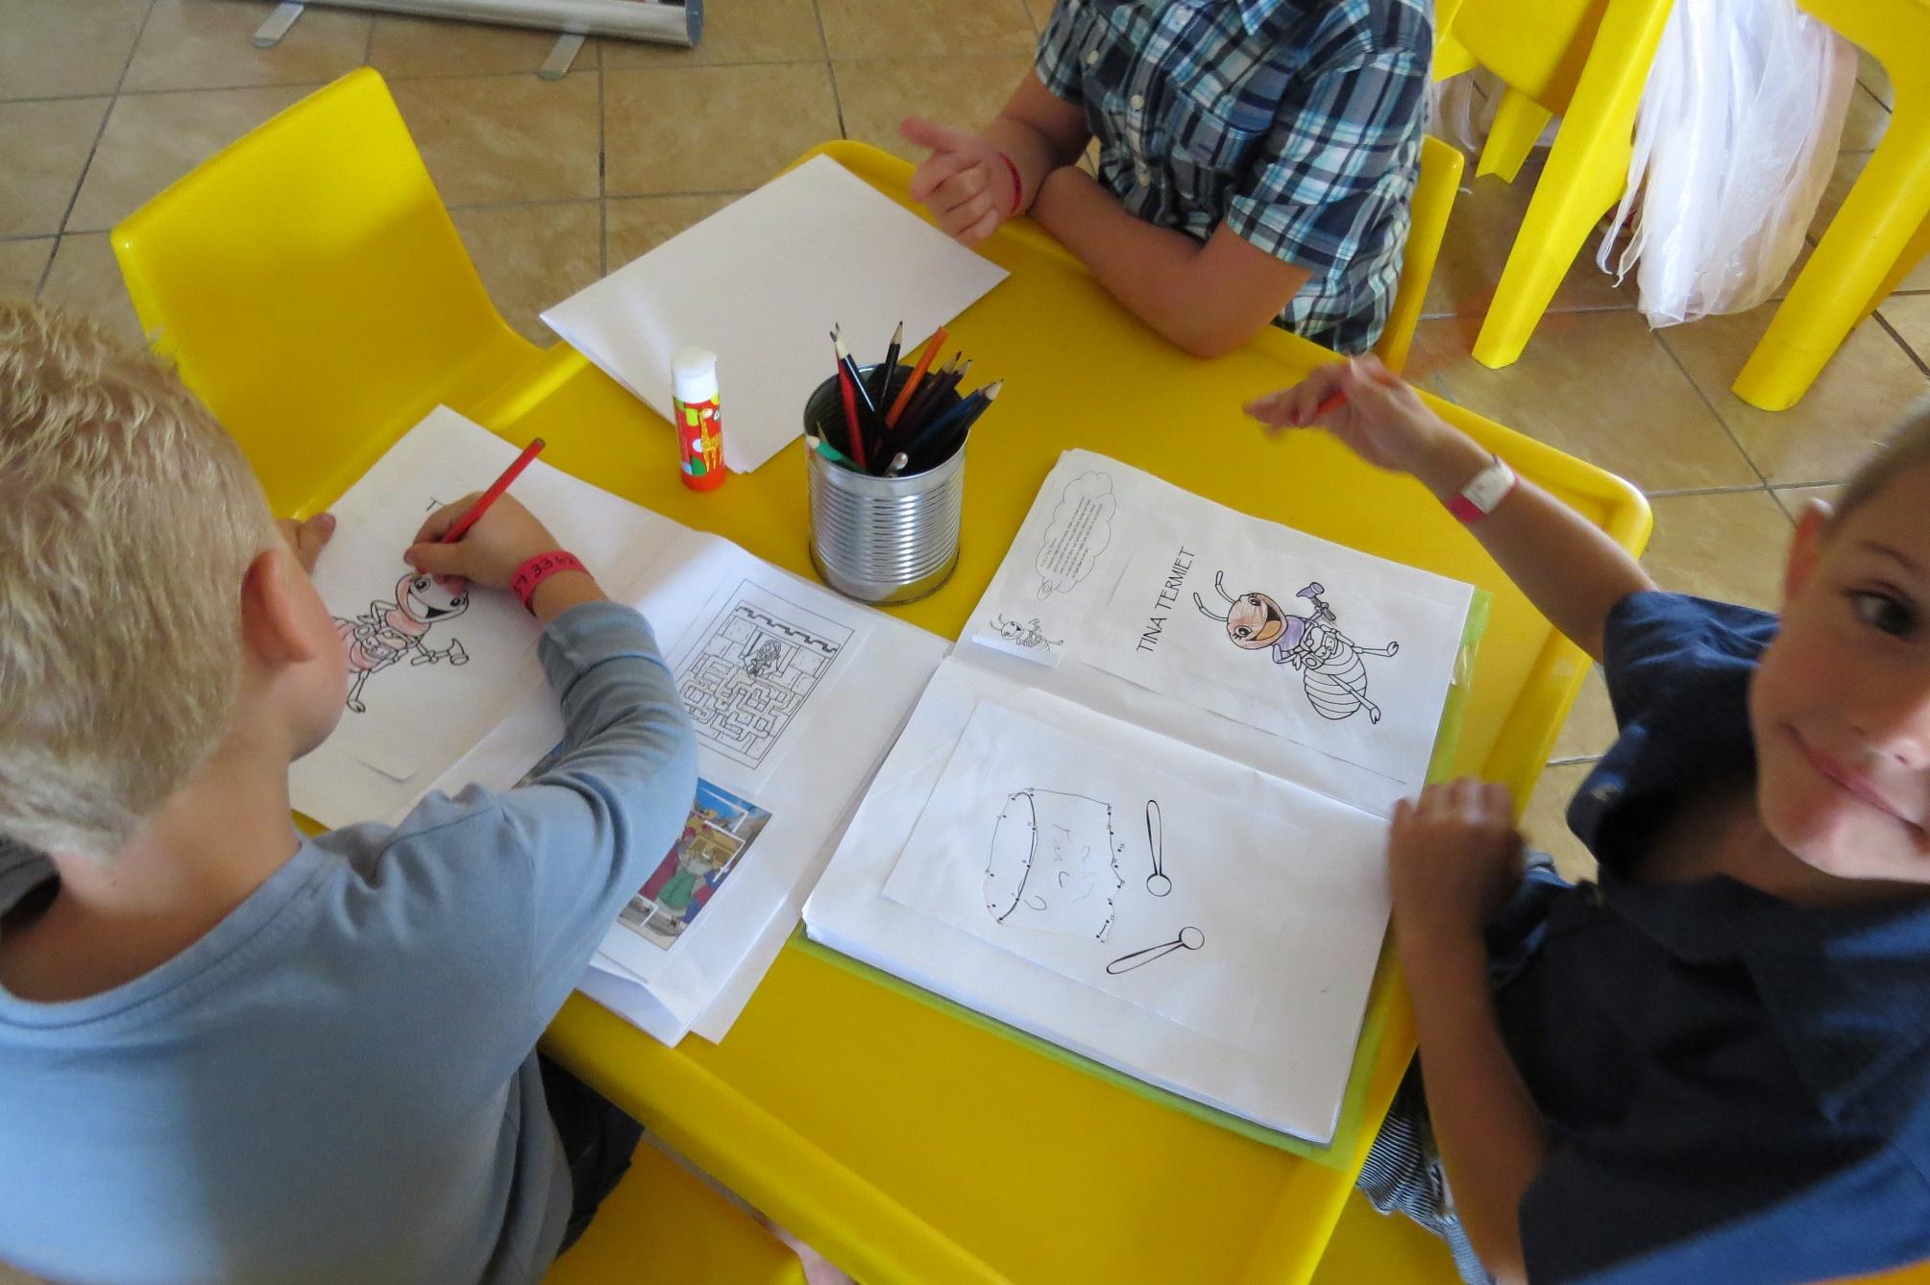
18. TABLES AND CHAIRS

Slide 31
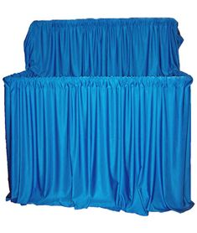
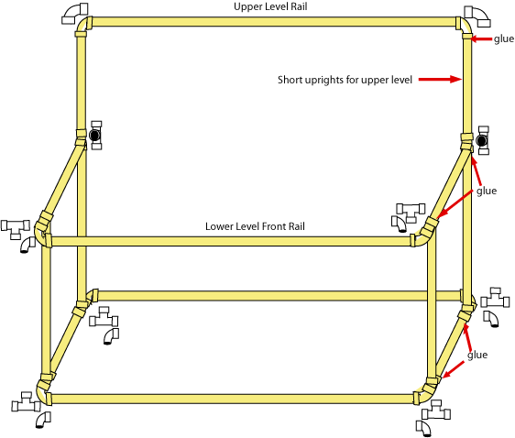
19. PUPPET ALLEY
PVC Pipes works wonders for puppet stages. Then drape fabric over the pipping for curtains.

Slide 32
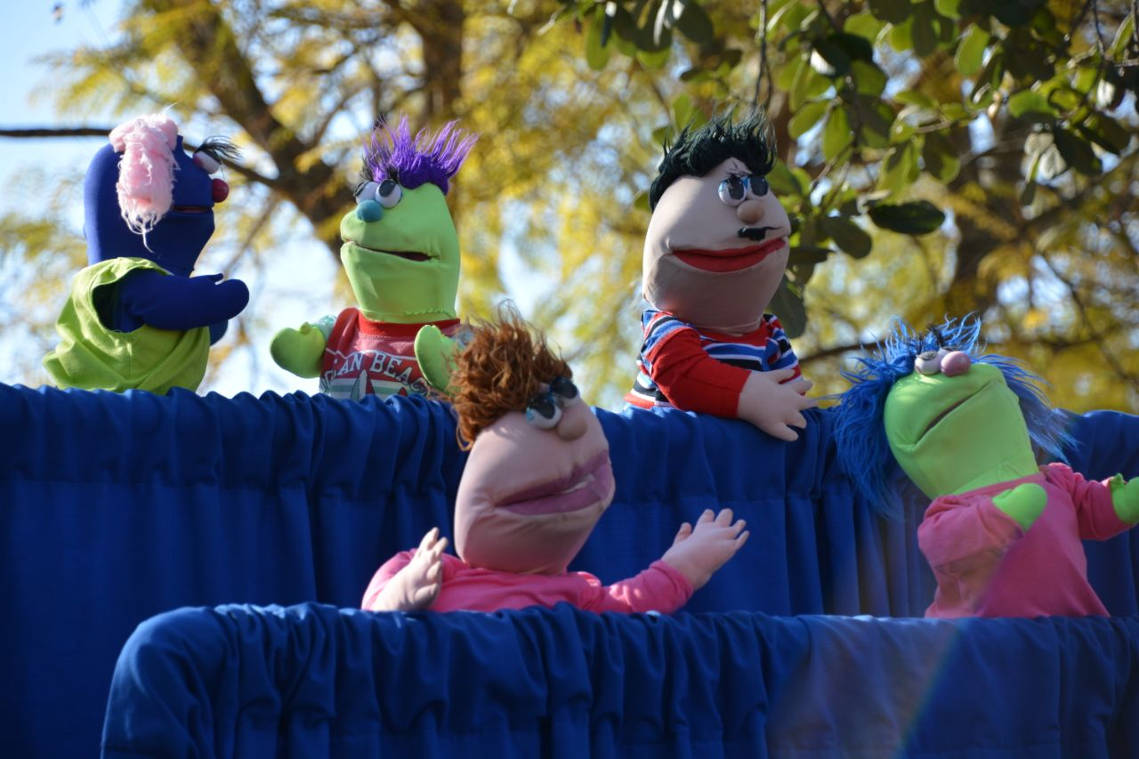
19. PUPPET ALLEY

Slide 33
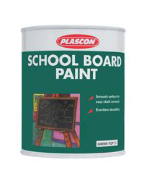
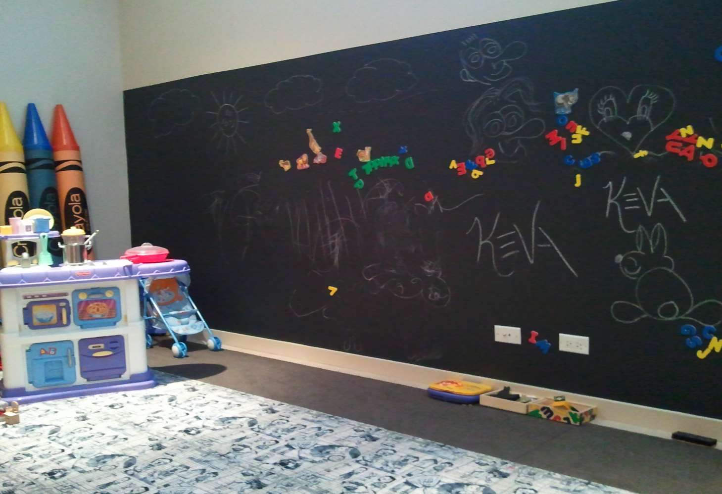
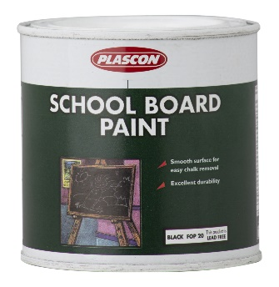
20. FOCAL TEACHING POINT
Apply Chalkboard paint to an entire wall.
 | R150.00
 | R150.00
Heritage | R63.00
Fred Earth | R125.00

