Slide 1



Evangelizing PostModern Teens
Notes:
Evangelizing Postmodern Teens
To reach teenagers today and to lead a person to Christ, you have to reach them where they are and communicate with them in a way they can relate to.
The world our teens are growing up in is dramatically different from the one we all experienced. We grew up in the modern age dominated by Enlightenment-era, scientific, linear thinking. The world of the emerging generations is increasingly postmodern – a change with huge implications for how we evangelize teens.
Mark Tittley , Director of Sonlife Ministries in Africa suggested some key points in evangelizing postmodern teens.
Kevin Ford, in Jesus for a New Generation, speaks about process evangelism, where postmodern teens and youth (and also adults who are postmodern thinkers) are convinced of the reality of God’s love not by propositional arguments or one-time evangelistic rallies, but by a daily consistent, practical demonstration that Christianity works and that God’s love is real.
Process evangelism is quite similar to the patterns used by Jesus with his disciples. He entered into their world, he identified with their pain and their broken condition, he devoted great amounts of time building his life into their lives, he committed himself to a process of evangelizing – not just an evangelistic event.

Slide 2
Process evangelism can be distilled to four essentials:
1. Authenticity
We must be authentic and committed to Jesus Christ. The Christian life must be the core reality of our lives, not just an act.
Notes:
Process evangelism can be distilled to 4 essentials:
Authenticity
We must be authentic and committed to Jesus Christ. The Christian life must be the core reality of our lives, not just an act.

Slide 3

2. Caring
We must demonstrate genuine care and unconditional love for the teens; show love and acceptance regardless of their level of belief or lifestyle.
Notes:
2. Caring
We must demonstrate genuine care and unconditional love for the pre-Christian—regardless of their level of belief or lifestyle. We must always show love and acceptance of the individual, no matter what the sin is.

Slide 4

3. Trust
We must demonstrate absolute integrity, truthfulness, loyalty, confidentiality and openness. Only after we have established a deep level of trust will we be able to share how the story of Jesus Christ has intersected with our life.
Notes:
3. Trust
We must demonstrate absolute integrity, truthfulness, loyalty, confidentiality and openness. Only after we have established a deep level of trust will we be able to share how the story of Jesus Christ has intersected with our life.

Slide 5
4. Transparency
We must be real and allow others to see the reality of our lives through our openness and vulnerability. We must admit our mistakes, confess our sin and tell the story of our pain and our problems so they can see God at work in our lives.
Notes:
4. Transparency
We must be real and allow others to see the reality of our lives through our openness and vulnerability. We must admit our mistakes, confess our sin and tell the story of our pain and our problems so they can see God at work in our lives.

Slide 6

Today’s evangelism requires getting into another person’s world. It has has 5 steps:
1. Do What They Do
As we bond with non-Christian teens trust is built, which lays the foundation for evangelism. While the traditional approach involves inviting people to do what we do, this new approach involves going to do what they do.
Notes:
There was a time when we could preach at people and they would respond to the gospel. But preaching at people doesn’t work too well anymore. We can’t just come at people, especially with teens – we have to go with them. We have to get into their world, just as Jesus came into our world and became one of us.
Getting into the world of the other person. It has five steps:
1. Do what they do
As we bond with non-Christian teens, trust is built, which lays the foundation for evangelism. While the traditional approach to evangelism involves inviting people to do what we do, the incarnational approach involves going to do what they do.

Slide 7
2. Enjoy and Accept Them
If we just go through the motions of doing what pre-Christians do and don’t give them our hearts, they will feel patronized, not loved. Evangelism is most effective when it is natural and not programmed – when we truly enjoy spending time with and talking to the teens.
Notes:
2. Enjoy and accept them.
If we just go through the motions of doing what pre-Christians do and don’t give them our hearts, they will feel patronized, not loved. Evangelism is most effective when it is natural and not programmed – when we truly enjoy spending time with and talking to the teens we are witnessing to.

Slide 8

3. Affirm What is Good In Their Values
Christians tend to be judgmental, but It is helpful to affirm what is good in their value system even though they don’t agree with all our beliefs. Refusing to affirm can create distance between us. Remember that God is already at work in their hearts – planting biblical learnings and values in their mind.
Notes:
3. Affirm what is good in their values
Christians tend to be judgmental, but It is helpful to affirm what is good in their value system even though they don’t agree with all our beliefs. Refusing to affirm can create distance between us. Remember that God is already at work in their hearts – planting biblical learnings and values in their mind.

Slide 9
4. Share the Story of Jesus in Their Terms
This is the transition step and is the trickiest. We may have done the hard work of building trust and getting ourselves into their worlds, but then we can blow it by using church jargon that they don’t understand and which turns them off.
Notes:
4. Share the Story of Jesus in Their Terms
This is the transition step and is the trickiest. We may have done the hard work of building trust and getting ourselves into their worlds, but then we can blow it by using church jargon that they don’t understand and which turns them off.

Slide 10

5. Invite Them to Follow Jesus in A Way They Can Relate To
There are two dangers here – either we get so religious that we scare the person off, or we never get around to inviting the non-Christian at all. But if we have really gotten to know the person, it will not be difficult to ask whether they are ready to follow Jesus.
Notes:
5. Invite Them to Follow Jesus in A Way They Can Relate To
There are two dangers here – either we get so religious that we scare the person off, or we never get around to inviting the non-Christian at all. But if we have really gotten to know the person, it will not be difficult to ask whether they are up to following Jesus.

Slide 11
THE GOSPEL STORY INTERSECTS WITH THIS GENERATION’S EXPERIENCE IN A NUMBER OF WAYS:
1.
They feel alienated: God’s story brings reconciliation.
Notes:
THE GOSPEL STORY INTERSECTS WITH THIS GENERATION’S EXPERIENCE IN A NUMBER OF WAYS:
1) They feel alienated: God’s story brings reconciliation.

Slide 12

2.
They feel betrayed: God’s story restores broken trust.
Notes:
2. They feel betrayed: God’s story restores broken trust.

Slide 13

3.
They feel insecure: God’s story brings a sense of safety within a protective, healing community.
Notes:
3. They feel insecure: God’s story brings a sense of safety within a protective, healing community.

Slide 14
4.
They lack a defined identity: God’s story brings a new identity in Christ.
Notes:
4. They lack a defined identity: God’s story brings a new identity in Christ.

Slide 15
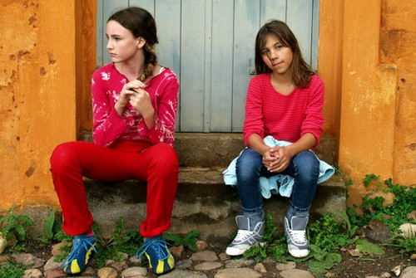
5.
They feel unwanted and unneeded: God’s story offers them a place of belonging, a place for involvement, and a place where their lives can be used in service of a purpose that is larger than themselves.
Notes:
5. They feel unwanted and unneeded: God’s story offers them a place of belonging, a place for involvement, and a place where their lives can be used in service of a purpose that is larger than themselves.

Slide 16
3 ELEMENTS NEEDED FROM MEMBERS:
1. Faithful Community
Postmoderns will best understand a holy, just and forgiving God when they see a holy, just and forgiving community of believers. They will be impressed when the community doing the evangelism lives out the Christian message.
Notes:
The conversion process in narrative evangelism can be called a “collision of narratives” – our story collides with God’s story – his story challenges our story and makes us question our reality.
While this postmodern generation may not be looking for the truth, it is looking for what is real. Our apologetic will need to emphasize an inclusive community that welcomes people to come in and observe the reality of the Christian faith. It needs to emphasize a loving community that reaches out to the needy and the hurting. It also needs to emphasize the hope that we have.
Three Elements needed from Members:
1. Faithful Community
Postmoderns will best understand a holy, just and forgiving God when they see a holy, just and forgiving community of believers. They will be impressed when the community doing the evangelism lives out the Christian message.

Slide 17
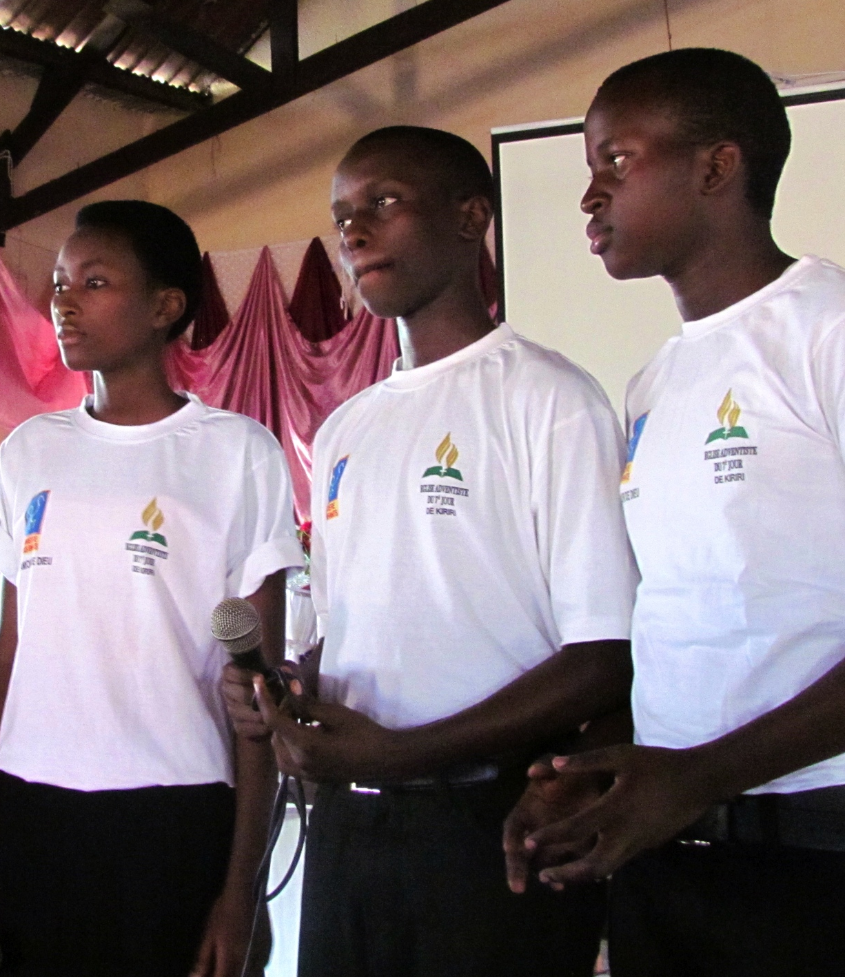
2. Loving Community
The greatest proof for Christianity is a loving community. Don’t try to debate with postmoderns on the basis of right and wrong, we will turn them off and turn them away. We can build bridges to them as we demonstrate compassion to them through performing deeds of love as God’s community.
Notes:
2. Loving Community
Jesus stressed that we would be known by our love. The greatest apologetic for Christianity is a loving community. At the heart of the gospel is a person – not a proposition. As long as we try to debate with this generation on the basis of right and wrong we will turn them off and turn them away. We will, however, build bridges to them as we demonstrate compassion to them through performing deeds of love as God’s community.

Slide 18
3. Hopeful Community
This generation is struggling to find meaning and hope for the future. We will have to empathize with the pain and sufferings of this generation. The community of faith can offer an eternal or heavenly hope where tears and pain will no longer exist (Revelation 21:1-5)
Notes:
3. Hopeful Community
This generation is struggling to find meaning and hope for the future. We will have to empathize with the pain and sufferings of this generation. The community of faith can offer an eternal or heavenly hope where tears and pain will no longer exist (Revelation 21:1-5)

Slide 19
Celek And Zander’s Model For Evangelism Based On Paul’s Encounter On Mars Hill In Acts 17.
1. Be Real
We must work hard at being vulnerable, transparent and showing that we are imperfect. People will relate to us when we are honest about our struggles.
Notes:
Tim Celek and Dieter Zander, in Inside the Soul of a New Generation, present a model for evangelism based on Paul’s encounter on Mars Hill in Acts 17. They suggest four guidelines:
1. Be Real
We must work hard at being vulnerable, transparent and showing that we are imperfect. People will relate to us when we are honest about our struggles.

Slide 20
2. Be Rousing
As we use our genuine, honest experiences, we will rouse people from their hiding places.
Notes:
2. Be Rousing
As we use our genuine, honest experiences, we will rouse people from their hiding places.

Slide 21
3. Be Relevant
It must address the questions this generation is asking and not those of a previous generation.
Notes:
3. Be Relevant
It must address the questions this generation is asking and not those of a previous generation.

Slide 22
4. Be Relational
More and more evangelism is going to happen through relationships. The gospel is going to be communicated more relationally than cognitively.
Notes:
Celek and Zander say: “[Those} with a postmodern mindset ….process truth relationally. In order for them to sort through an issue, or delve into the deep waters of their emotional makeup, they need time to process the radical message of Jesus. They need to think about it, talk about it among their friends, and talk about it some more.
That process isn’t going to be finished in an hour or two. Or maybe even a month or two. When you try to wrap things up nice and tidy, [they] sometimes will see that as being unreal and trite” (page 114)
4. Be Relational
More and more evangelism is going to happen through relationships. The gospel is going to be communicated more relationally than propositionally or cognitively.

Slide 23
Testimonies to Ministers, p. 32
We have an army of youth today who can do much if they are properly directed and encouraged. We want our children to believe the truth. We want them to be blessed of God. We want them to act a part in well-organized plans for helping other youth. Let all be so trained that they may rightly represent the truth, giving the reason of the hope that is within them, and honoring God in any branch of the work where they are qualified to labor....
Notes:
Testimonies to Ministers, p. 32
“We have an army of youth today who can do much if they are properly directed and encouraged. We want our children to believe the truth. We want them to be blessed of God. We want them to act a part in well-organized plans for helping other youth. Let all be so trained that they may rightly represent the truth, giving the reason of the hope that is within them, and honoring God in any branch of the work where they are qualified to labor....”

