Slide 1

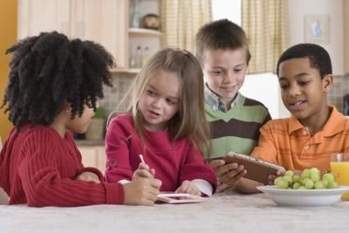
Teach Your Children To Witness
Linda Mei Lin Koh, Ed. D
GC Children’s Ministries
Notes:
Teach Your Children To Witness by Alvin L. Reid. (SBC Life Journal of the Southern Baptist Convention, September 2002)
As an evangelism professor, I like to ask my students how many of them have heard a sermon on the home over the past few years. Nearly every student raises a hand – and that’s good. The home is a premier subject for preachers. But when I ask a follow-up question, almost without exception no students raise a hand. The question: “How many of you have heard a message explaining either how to present the gospel to a child, or how to teach your children to witness?”
Both elements of this question are vital. As a young pastor, I taught the parents of elementary age children how to use a marked New Testament to witness to their own children. I included several do’s and dont’s, particularly related to pushing children too soon without avoiding their obvious spiritual questions, as well as simple counsel on how to lead a child to Jesus Christ. Over the next year several parents had the wonderful joy of helping their own older child come to Christ!
I think we spend so much time trying to protect our children that we overlook the need to prepare them to make a positive impact through the gospel.

Slide 2
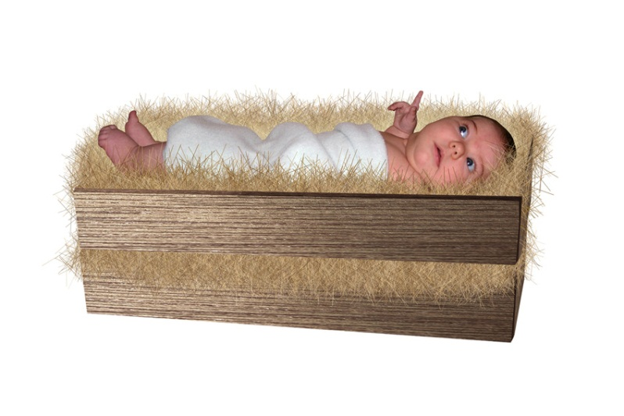
If children can understand salvation, they can also understand how to present the Good News.
Notes:
Illustration
My son, Josh, who turned fourteen this summer, led his little sister to Jesus Christ when he was ten. He was equipped to be a witness for the Lord because he had seen me lead him to faith in Christ and because our children’s minister at church had helped him to know what to say. When Josh went into the youth group, one of the first things he wanted to do was to take the youth evangelism classes our church offers. Over the past six months or so, Josh has led three adults to Christ, and several other youth have had several experiences. I thank God for a church that allows younger people to follow the direction of biblical teens like David, Josiah, and Daniel!
If children can understand salvation, they can also understand how to present the Good News.

Slide 3

Deuteronomy 6:4-7
Hear, O Israel: The Lord our God, the Lord is One! You shall love the Lord your God with all your heart, with all your soul, and with all your strength. We are to teach our children this as well. Part of that training includes talking about the things of God when you sit in your house, when you walk by the way, when you lie down, and when you rise up (verse 7).
Notes:
Illustration
In the second grade Hannah, now in the fourth, asked every single child in her public school classroom if they knew Jesus in a personal way. She also made invitations for all her classmates to come and witness her baptism, and this was her idea!
Deuteronomy 6:4-7 summarizes the heart of our faith: Hear, O Israel: The Lord our God, the Lord is One! You shall love the Lord your God with all your heart, with all your soul, and with all your strength. We are to teach our children this as well. Part of that training includes talking about the things of God when you sit in your house, when you walk by the way, when you lie down, and when you rise up (verse 7).

Slide 4

Our love for God should be obvious, written on the door frames of our houses and tied symbolically to our bodies! In other words, our faith should be a very public matter.
Notes:
Illustration
A couple of years ago Josh was with me at the bank. I spoke with the teller about the Lord, discovering she loved and followed Jesus. As we left, Josh said, “Dad, she is a Christian, isn’t she?” “She sure is,” I replied. Impressed that the teller spoke so openly about Jesus, Josh said, “Wow, Dad, no one talks about Jesus like that in public – well, no one except you. While I was glad Josh saw a positive example of consistent witnessing in my life I was struck by his recognition that witnessing was not the normal part of the everyday life of most believers.
Our love for God should be obvious, written on the door frames of our houses and tied symbolically to our bodies! In other words, our faith should be a very public matter.

Slide 5

The reason most of us don’t talk to lost people about Jesus is that we don’t talk with saved people about Him!
Notes:
The reason most of us don’t talk to lost people about Jesus is that we don’t talk with saved people about Him!

Slide 6
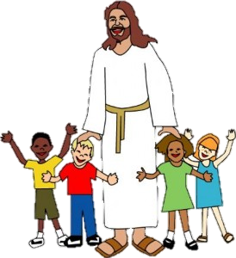
When speaking of Jesus begins to pervade our lives, teaching our children to proclaim Him will not be so difficult.
Notes:
When speaking of Jesus begins to pervade our lives,

Slide 7

How can the church, including ministers and parents, teach our children to witness? Believe in your children. We need to raise the bar of Christianity in America, starting with our homes!
Notes:
How can the church, including ministers and parents, teach our children to witness? Believe in your children. We need to raise the bar of Christianity in America, starting with our homes!

Slide 8

Richard Baxter, the great Puritan pastor who witnessed a mighty movement of God in his day, said we will never see God move in a general way unless He first moves in our homes.
Notes:
I don’t want my kids to simply survive in the culture today; I want them to make an impact to the glory of God!
Richard Baxter, the great Puritan pastor who witnessed a mighty movement of God in his day, said we will never see God move in a general way unless He first moves in our homes.

Slide 9

Principles and Ideas
for
Witnessing
Notes:
Ideas for Witnessing

Slide 10

1. Model Witnessing – it is caught more than taught. Our children will do less of what we say and more of what we do. Are you modeling a witnessing lifestyle?
Notes:
Model Witnessing
Model Witnessing – it is caught more than taught. Our children will do less of what we say and more of what we do. Are you modeling a witnessing lifestyle?

Slide 11
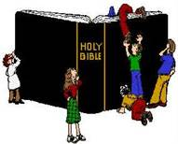
2. Take the kids with you when you witness
Door-to-door, in parks, at car washes, & others.
Use a simple tool.
Gospel tracts
Notes:
Josh, my oldest child, is cautious, less spontaneous, and thus far more comfortable witnessing when he knows the framework. If I tell him we’re going door to door from 1:00 – 2:30, for example, he thrives. Hannah, on the other hand, will talk to anyone, anytime, about virtually anything.
2. Take the kids with You when you witness
Door-to-door, in parks, at car washes, and others.
Use a simple tool.
Gospel tracts

Slide 12
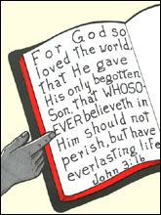
3. Teach children to witness according to their strengths
This is critical for all believers, but especially for children.
Notes:
Teach Children To Witness According To Their Strengths.
This is critical for all believers, but especially for children.

Slide 13

Learn your children’s strengths and encourage them.
Make it fun!
This opens the door to witness in a winsome manner.
Notes:
Learn your children’s strengths and encourage them.
Make it fun!
This opens the door to witness in a winsome manner.
We do a lot of servant evangelism, including free car washes, handing out sodas in the park, and giving away popcorn with tracts.

Slide 14
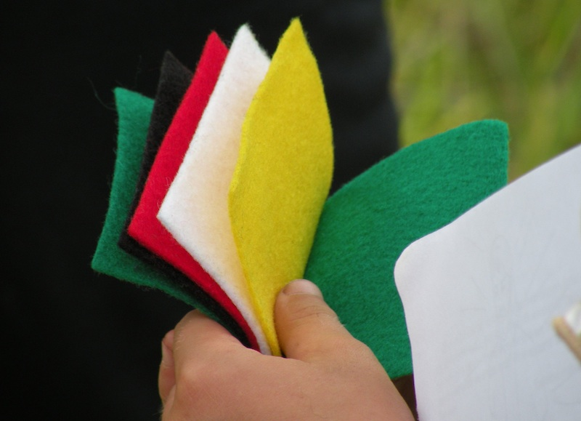

4. USE WORDLESS BOOK
Notes:
4. USE WORDLESS BOOK

Slide 15
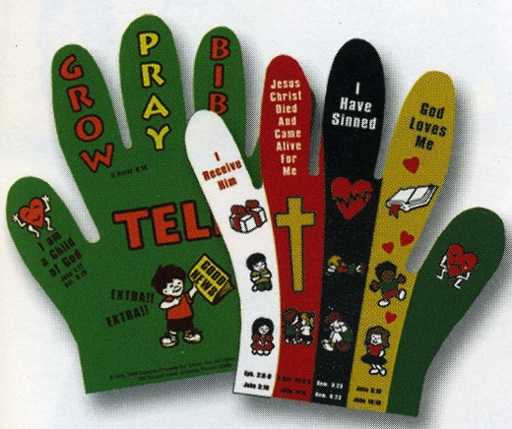
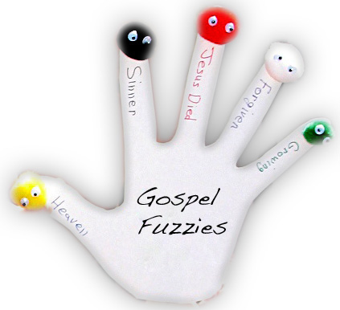
5. Gospel Gloves
Notes:
5. GOSPEL GLOVES

Slide 16

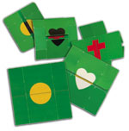
6. Flipper Flapper

Slide 17

7. Backpack Evangelism

Slide 18

Sheets of Paper
Take a piece of paper and draw an X or some words like ‘lie’ and ‘steal’ on the paper.
Hold up a blank piece of paper. Explain that this is how God wants to make our souls, clean. Then hold the other paper that has been marked up.
Point to the words and said, ‘When we make wrong choices, we end up writing on our souls.’ Then crush up the written paper & toss it away.
Next, hold up the clean sheet and say, ‘God gives me a clean sheet of paper, a clean soul, every time I repent. ’
Notes:
Take a piece of paper and draw an X or some words like ‘lie’ and ‘steal’ on the
paper.
-- Hold up a blank piece of paper. Explain that this is how God wants to make our souls, clean. Then hold the other paper that has been marked up.
-- Point to the words and said, ‘When we make wrong choices, we end up writing on our souls.’ Then crush up the written paper & toss it away.
-- Next, hold up the clean sheet and say, ‘God gives me a clean sheet of paper, a clean soul, every time I repent. ’
Books
-- Hold up the books and say, ‘These books can get heavy after carrying them around all day, right?’
-- Then say, ‘Life can get heavy sometimes too, right?Allow some to share about how heavy life gets.
-- Then say, ‘Did you know that Jesus has promised to make life lighter? When you invite him into your heart, he carries life for us!’
Pencils
-- Hold up the unsharpened pencils and let everyone look at them. Then ask, ‘Can we write our homework with these pencils?’
-- Then ask, ‘What do we need to do before we write our homework?’ Kids will say ‘Sharpen them!’
-- Say, ‘Did you know that when you live without Jesus you are like this unsharpened pencil? God can’t write anything nice on our lives when we remain unsharpened. Who wants to be a sharpened pencil for God?’

Slide 19


Books
Hold up the books and say, ‘These books can get heavy after carrying them around all day, right?’
Then say, ‘Life can get heavy sometimes too, right?Allow some to share about how heavy life gets.
Then say, ‘Did you know that Jesus has promised to make life lighter? When you invite him into your heart, he carries life for us!’

Slide 20


Pencils
Hold up the unsharpened pencils and let everyone look at them. Then ask, ‘Can we write our homework with these pencils?’
Then ask, ‘What do we need to do before we write our homework?’ Kids will say ‘Sharpen them!’
Say, ‘Did you know that when you live without Jesus you are like this unsharpened pencil? God can’t write anything nice on our lives when we remain unsharpened. Who wants to be a sharpened pencil for God?’
Pencils

Slide 21
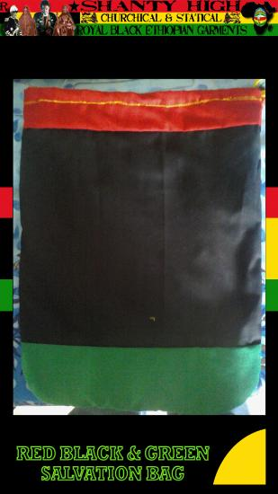

8.
The
Salvation
Bag
Notes:
6. The Salvation Bag

Slide 22
9. ‘Ask Me Now’ Pins
ASK ME NOW
Child puts on pin and knock on neighbor’s door.
When someone opens the door, child points to pin and neighbor will ask her what she wants.
Child starts sharing Jesus and gives neighbor a book to read.
Notes:
7. Ask Me Pins
Child puts on pin and knock on neighbor’s door.
When someone opens the door, child points to pin and neighbor will ask her what she wants.
Child starts sharing Jesus and gives neighbor a book to read.

Slide 23
10. Gospel Tracts
Children can use the Primary Treasure tracts to share with their friends and classmates.
Use Children Evangelism Fellowship Gospel tracts for kids to share the good news.

Slide 24
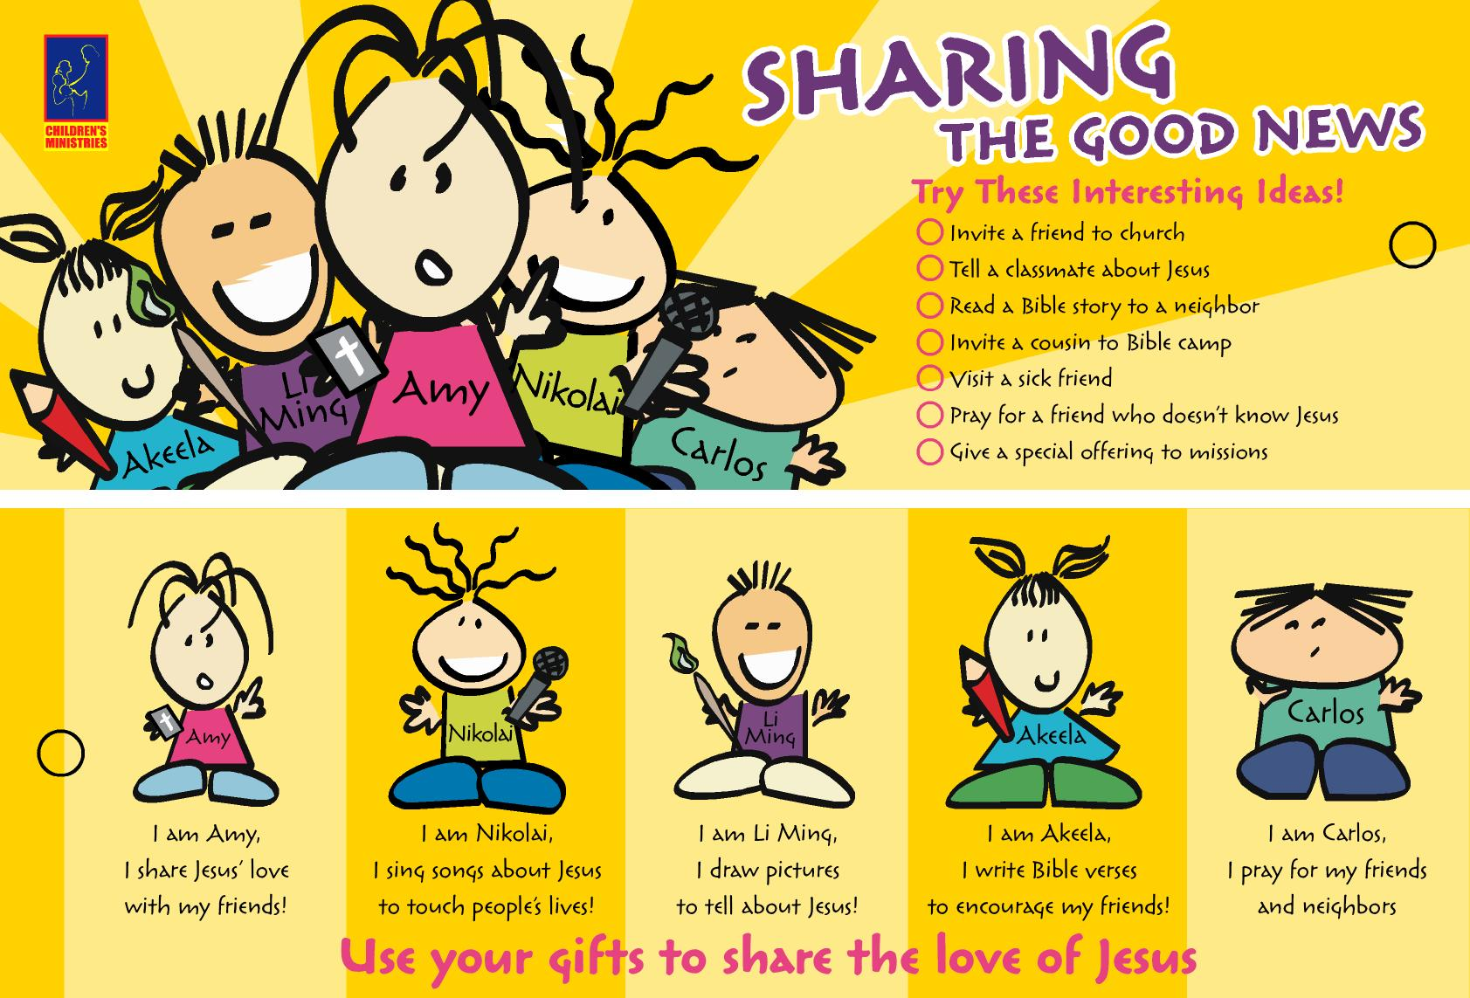
11. Sharing Jesus Bookmarks
Notes:
Sharing Jesus Bookmarks

Slide 25
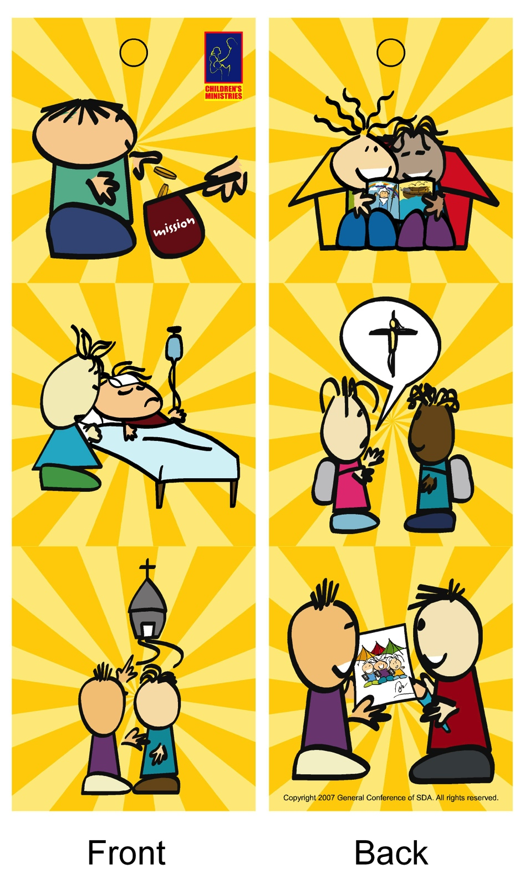
Sharing Jesus Bookmarks
Without word
Notes:
Sharing Jesus Bookmarks Without Words

Slide 26
12.
Gracelink Story Flipchart
Notes:
10. Gracelink Story Flipchart

Slide 27

Teach children that success is in sharing, not winning.
Winning is the work of the Holy Spirit!
Notes:
Teach children that success is in sharing, not winning. Winning is the work of the Holy Spirit.

Slide 28
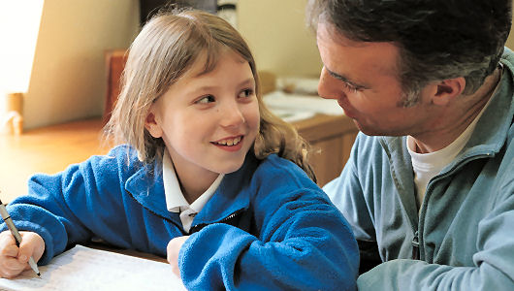
If we can help them discover that knowing Jesus is the most important thing in the world, they’ll soon conclude that the most important thing they can do is to tell others.
Notes:
If we can help them discover that knowing Jesus is the most important thing in the world, they’ll soon conclude that the most important thing they can do is to tell others.

Slide 29
Counsels to Teachers and Parents,166,167
“In the closing scenes of earth’s history, many of these children and youth will astonish people by their witness to the truth, which will be borne in simplicity, yet with spirit and power. They have been taught the fear of the Lord, and their hearts have been softened by a careful and prayerful study of the Bible. In the near future, many children will be endued with the Spirit of God, and will do a work in proclaiming the truth to the world, that at that time cannot well be done by the older members of the church.”
Notes:
Counsels to Teachers and Parents,166,167
“In the closing scenes of earth’s history, many of these children and youth will astonish people by their witness to the truth, which will be borne in simplicity, yet with spirit and power. They have been taught the fear of the Lord, and their hearts have been softened by a careful and prayerful study of the Bible. In the near future, many children will be endued with the Spirit of God, and will do a work in proclaiming the truth to the world, that at that time cannot well be done by the older members of the church.”

