Slide 1
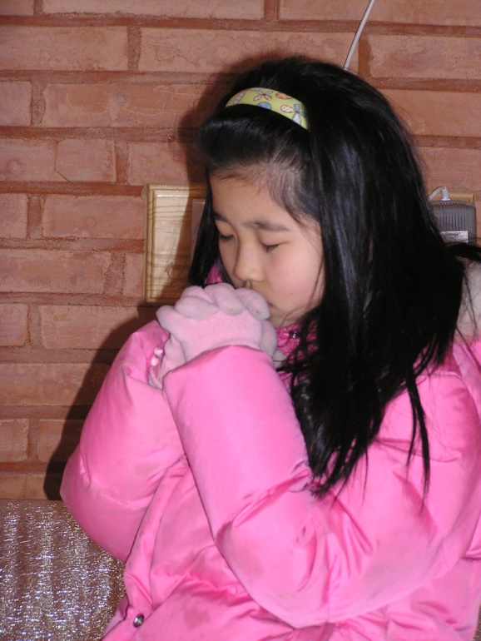
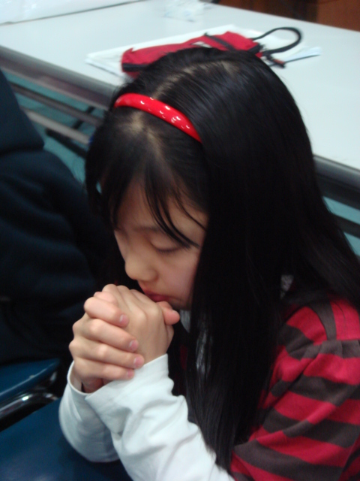
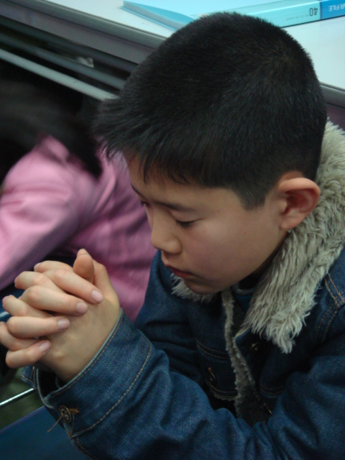
Fostering Kid’s Time Alone with God
CHM Leadership Certification
Level III, Course #5
Sally Phoon
Children’s Ministries Director
Northern Asia-Pacific Division
Notes:
Fostering Kid’s Time Alone with God

Slide 2
What is this Mother thinking?
Notes:
What is this Mother thinking?
Usually parents set secular goals as opposed to spiritual goals.

Slide 3
Survey Results
How often did your parents talk to you about God?
43% Never
32% Occasionally
13% Once a week
13% On a daily basis
Notes:
Survey Results
How often did your parents talk to you about God?
43% Never
32% Occasionally
13% Once a week
13% On a daily basis

Slide 4
Home
Church
School
Community
Notes:
Interaction between these 4 entities but the Home plays the role of primary discipler

Slide 5
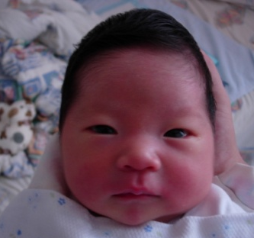
Home Influences
Mother
Father
Grand-parents
Uncles Aunts
Relatives
Notes:
Home Influences

Slide 6
Questions to Ponder
Am I saved by grace through faith in Jesus Christ?
Do I experience the joy of a new life in Jesus?
Am I growing every day in my relationship with Jesus?
Do I have time alone with God myself?
Do my children know that I read the Bible and pray daily?
Notes:
Modeling—the most powerful teaching tool
Don’t do as I say but do as I do
Saved by Grace—all of us are sinners
humility of being a learner instead of I’m a parent, therefore I know it all
the ability to admit I am wrong
Joy of a new life—operate from joy
when things go wrong, what is my reaction—anger? Worry? Trust? Peace? Children watch how we handle life
Growing relationship with Jesus
can children see that you are changing and growing, getting better
yesterday you lost your temper; today you exercise more self-control
share what you are learning from God’s word with your children
talk about your prayer life—who, what, why you are praying for or about
share answered prayers

Slide 7
Questions to Ponder
Do I believe that God has dreams for my children?
Am I intentional about my children’s spiritual growth and development as much as their physical, academic and social development?
Do I teach my kids to love God’s Word?
Do I lead my kids to worship God?
Do I recognize the importance of helping our children become God’s children, not His grandchildren?
Notes:
Most parents don’t set spiritual goals for their kids
Intentionality—clear about your direction
Focus not only on their future success in this world but a world to come
God has no grandchildren—the kite illustration

Slide 8
Questions to Ponder
Do I have the skills to be a spiritual mentor for my children?
Is my family comfortable discussing spiritual things?
Is family worship an important part of our family life?
Notes:
Spiritual mentor—parents often push responsibility to the church and the school
Is there a focus on the spiritual aspect in your family?
tearing the pastor/spiritual leaders apart @ Sabbath lunch?
respect for leadership
showing compassion instead of criticism
Family worship

Slide 9
Questions to Ponder
Do I walk the talk?
Are you positive in your outlook?
Do you worry and lose your temper when something goes wrong?
Does God’s love shine through your behaviour everyday, not only on Sabbath?

Slide 10
Questions to Ponder
In my relationships
Am I involved with my spouse?
Do the children feel secure with the connection and love between both parents?
Are you involved intimately with your children (fathers especially)?
Are you involved with your close relatives & church family?

Slide 11
Questions to Ponder
Am I active in sharing my faith in God with others?
Am I active in leading my children in serving others?

Slide 12
Home
Church
School
Community

Slide 13
Fathers and mothers, we entreat you to take up your long-neglected duties. Search the Scriptures yourselves; assist your children in the study of the Sacred Word. Make diligent work because of past neglect. Do not send the children away by themselves to study the Bible, but read it with them, teach them in a simple manner what you know, and keep in the school of Christ as diligent students yourselves. CSW 20
Notes:
Admonition from EGW; because of the NEGLECT
To change a habit—21 days
Study first with the children and then transition to TAG if they are old enough

Slide 14
TAG—Time Alone with God
Preparing the heart with prayer
ACTS
Adoration
Confession
Thanksgiving
Supplication

Slide 15
TAG—Time Alone with God
Connecting with the Word
What does this mean to me today?
Praying the Word
Application in real life

Slide 16
How do we foster TAG
at the different ages?
0 – 5 years
6-10 years
11-15 years

Slide 17
Making
Disciples
www.kidsindiscipleship.org

Slide 18
THE K.I.D. MOVEMENT
Hear, O Israel: The LORD our God, the LORD is one. Love the LORD your God with all your heart and with all your soul and with all your strength. These commandments that I give you today are to be upon your hearts. Impress them on your children. Talk about them when you sit at home and when you walk along the road, when you lie down and when you get up. Deut 6:4-7

Slide 19
Prayer
Christian parents, morning and evening, by earnest prayer and persevering faith, to make a hedge about their children. They should patiently instruct them, kindly and untiringly teach them how to live in order to please God. {1T 397}

Slide 20
Prayer
“Could our children learn these lessons of finding at dawn and twilight a quiet season for communion with their Father in heaven] in the morning of their years, what freshness and power, what joy and sweetness, would be brought into their lives!” – CG 525

Slide 21
Drawing Deep from the Word of God & Prayer
The lily on the lake strikes its roots down deep beneath the surface of rubbish and slime, and through its porous stem draws those properties that will aid its development and bring to light its spotless blossom to repose in purity on the bosom of the lake. {ML 263}

Slide 22
Survey Results
Generally, the church has no aggressive or intentional effort to nurture and disciple the children.
Ministry to children lack strong support from church leaders and pastors in finances, programming, etc.
Programs for children in the church tend to entertain with little opportunity for them to experience the relevance of God in their daily living.
Most of the parents do not buy nurturing materials for their children such as Bible, Bible Study Guide (BSG) or Sabbath School lessons.

Slide 23
Survey Results
5. Most of the children’s leaders are in need of training seminars to develop and enhance leadership skills and capabilities.
6. Most of the children’s leaders, including SS teachers lack commitment to render meaningful leadership and services to the children( e.g. They come to Sabbath School unprepared, no regular programs for the kids, etc)
7. Many children are not interested in spiritual matters (E.g. Do not attend church activities regularly, do not study Bible Study Guide)

