Slide 1
The Ins and Outs of Adolescent Brain Development
…You Can Make a Difference!
Dr. Diane Bales
Notes:
The Ins and Outs of Adolescent Brain Development
… You Can Make a Difference!
By Child and Family Learning Center

Slide 2
The Adolescent Brain: An Example
Last weekend, Jacob celebrated his birthday with a sleepover party that included four male friends. The five boys were in the basement playing video games. Jacob’s mom received a call about 9:30 pm from the police, asking her to come down to the local laundromat. When Jacob’s mom arrived, she learned from the officer that the five boys had slipped out of the basement, gone down to the laundromat, and were taking turns drying each other in the large industrial clothes dryers. A customer at the laudomat flagged down the officer, who asked the boys why they were playing in the dryers.
Why did Jacob and his friends do this?
About how old do you think Jacob is?
Notes:
The Adolescent Brain: An Example
Last weekend, Jacob celebrated his birthday with a sleepover party
that included four male friends. The five boys were in the basement
playing video games. Jacob’s mom received a call about 9:30 pm from
the police, asking her to come down to the local laundromat. When
Jacob’s mom arrived, she learned from the officer that the five boys
had slipped out of the basement, gone down to the laundromat, and
were taking turns drying each other in the large industrial clothes
dryers. A customer at the laundromat flagged down the officer, who
asked the boys why they were playing in the dryers.
Why did Jacob and his friends do this?
About how old do you think Jacob is?

Slide 3
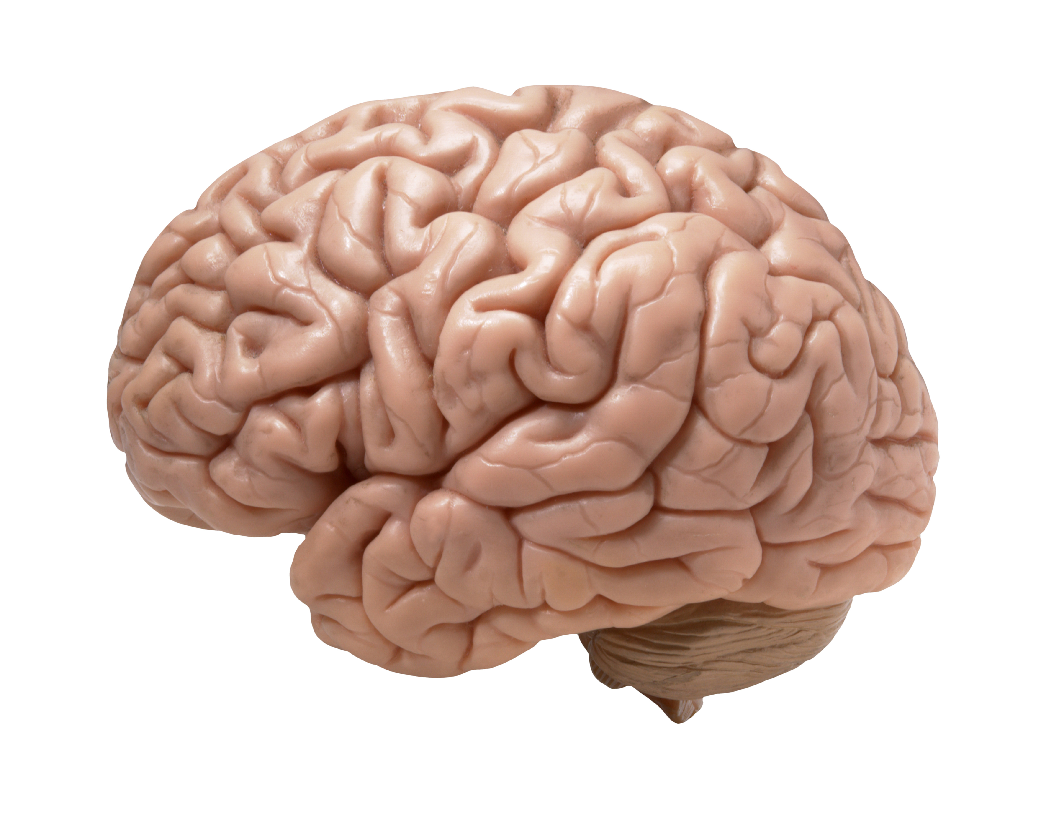
Why is it so important to study the brain?
Recent brain research tells us…
The brain is not fully developed at birth
Important foundations are formed before age 3
Early, positive interactions with nurturing adults are vital to healthy brain development
Sensory experiences affect early brain development
Notes:
Why is it so important to study the brain?
Recent brain research tells us…
The brain is not fully developed at birth
Important foundations are formed before age 3
Early, positive interactions with nurturing adults are vital to healthy brain development
Sensory experiences affect early brain development

Slide 4
Parts of the Brain
Notes:
Parts of the Brain
Cerebral cortex: The outer layer of the brain often referred to as gray matter. It plays a key role in memory, attention, perception, awareness, thought, language, and consciousness.
Limbic system: A complex system of nerves and networks in the brain, involving several areas near the edge of the cortex concerned with instinct and (inside of brain) areas near the edge of the cortex concerned with instinct and mood. It controls the basic emotions (fear, pleasure, anger) and drives (hunger, sex, dominance, care of offspring).
-Amygdala; The integrative center for emotions, emotional behavior, and motivation.
-Hippocampus; The hippocampus is a small region of the brain that forms part of the limbic system and is primarily associated with memory and spatial navigation.
Brain stem: It is the region that connects the cerebrum with the spinal cord. It coordinates motor control signals from from the brain to the body.
Cerebellum: The part of the brain at the back of the skull in vertebrates. Its function is to coordinate and regulate muscular activity.

Slide 5
Executive Function
Notes:
Lobes of the Brain
Four lobes in each hemisphere
Frontal – Executive Function

Slide 6
What Is Executive Function?
Higher-order thinking skills that enable complex problem solving and goal-directed behavior
  Planning
  Focused attention and filtering distractions
  Remembering instructions even when interrupted
  Appropriate multi-tasking
  Prioritizing tasks and setting goals
  Evaluating progress toward goals
  Controlling impulses and self-regulation
Notes:
What is Executive Function?
Higher-order thinking skills that enable complex problem solving and goal-directed behavior
Planning
Focused attention and filtering distractions
Remembering instructions even when
interrupted
Appropriate multi-tasking
Prioritizing tasks and setting goals
Evaluating progress toward goals
Controlling impulses and self-regulation

Slide 7
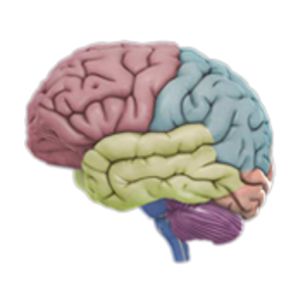
Executive Function and the Brain
Largely controlled in the prefrontal cortex
Last part of the brain to finish developing
Depends on three types of brain function
  * Working memory
  * Cognitive flexibility
  * Inhibitory self-control
Foundations begin developing early
Development depends on practice in supportive environments that scaffold progress
Notes:
Executive Function and the Brain
Largely controlled in the prefrontal cortex
Last part of the brain to finish developing
Depends on three types of brain function
* Working memory
* Cognitive flexibility
* Inhibitory self-control
Foundations begin developing early
Development depends on practice in supportive environments that scaffold progress

Slide 8
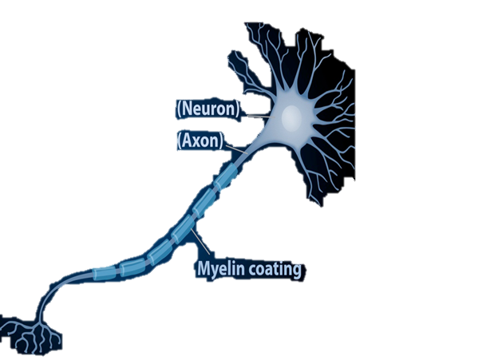
How the Brain Develops
Neurons are formed
Neurons migrate into positions
Neurons are covered with myelin
Synapses are formed
Synapses are pruned
Notes:
How the Brain Develops
Neurons are formed
Neurons migrate into positions
Neurons are covered with myelin
Synapses are formed
Synapses are pruned

Slide 9
Adolescent Development
Myelination continues in frontal lobes
Pruning and some synapse formation continue
Areas for planning and judgment finish developing last.
Notes:
Adolescent Development
Myelination continues in frontal lobes
Pruning and some synapse formation continue
Areas for planning and judgment finish developing last

Slide 10
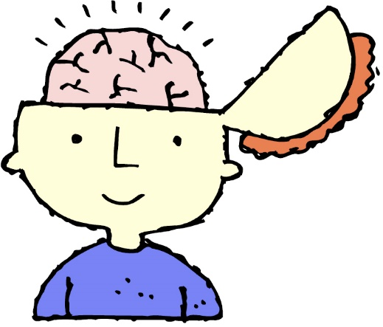
Key Changes in the Adolescent Brain
Increase in gray matter
Quicker reaction time
Better reasoning abilities
Hormone changes affect social behavior and responses to stress
Continued improvements in impulse control
Parts of the brain responsible for emotional responses are better-developed than parts responsible for self-control
Notes:
Key Changes in the Adolescent Brain
Increase in gray matter
Quicker reaction time
Better reasoning abilities
Hormone changes affect social behavior and responses to stress
Continued improvements in impulse control
Parts of the brain responsible for emotional responses are better-developed than parts responsible for self-control

Slide 11

Some Issues Related to Teen Brains
Continuing challenges with impulse control
Changes in sleep patterns
Increase in risk-taking behaviors
  Drinking alcohol
  Smoking
  Using drugs
  Sexual experimentation
Driving a car
Notes:
Some Issues Related to Teen Brains
Continuing challenges with impulse control
Changes in sleep patterns
Increase in risk-taking behaviors
Drinking alcohol
Smoking
Using drugs
Sexual experimentation
Driving a car

Slide 12

Sleep and the Adolescent Brain
Adolescents require as much sleep time as younger children, but don’t always get it
Sleep patterns change with puberty
Differences in weekday and weekend sleep-wake patterns
Common adolescent sleep problems include too little sleep, trouble falling asleep or awakening, and poor quality sleep
Consequences may include increased risk of injury, poor school performance, negative mood, and increased stimulant use
Notes:
Sleep and the Adolescent Brain
Adolescents require as much sleep time as younger children, but don’t always get it
Sleep patterns change with puberty
Differences in weekday and weekend sleep-wake patterns
Common adolescent sleep problems include too little sleep, trouble falling asleep or awakening, and poor quality sleep
Consequences may include increased risk of injury, poor school performance, negative mood, and increased stimulant use

Slide 13

Sleep and Teens: What Adults Can Do
Structure and encourage regular sleep schedules
Create effective sleep environments
Adjust high school start times to accommodate adolescents’ sleep patterns
Limit the hours and times of day adolescents are allowed to work for pay
Teach about the dangers of drowsy driving
Encourage balance in teens’ schedules
Be alert to signs of sleep deprivation
Notes:
Sleep and Teens: What Adults Can Do
Structure and encourage regular sleep schedules
Create effective sleep environments
Adjust high school start times to accommodate adolescents’ sleep patterns
Limit the hours and times of day adolescents are allowed to work for pay
Teach about the dangers of drowsy driving
Encourage balance in teens’ schedules
Be alert to signs of sleep deprivation

Slide 14

Alcohol and the Adolescent Brain
The teen brain processes alcohol differently than the adult brain
  Adults tend to drink more overall
  When teens drink, they are more likely to binge
Regular alcohol use can cause long-term impairments in brain functioning
Risk of alcohol dependence is higher in
  Younger drinkers
  Binge drinkers
Notes:
Alcohol and the Adolescent Brain
The teen brain processes alcohol differently than the adult brain
Adults tend to drink more overall
When teens drink, they are more likely to binge
Regular alcohol use can cause long-term impairments in brain functioning
Risk of alcohol dependence is higher in
Younger drinkers
Binge drinkers

Slide 15
Driving and the Adolescent Brain
Notes:
Driving and the Adolescent Brain
Why do most 16-year-olds drive like they’re missing a part of their brain?

Slide 16

Driving and the Adolescent Brain
Motor Vehicle crashes are the leading cause of death for 15 – 20 year olds
Teens tend to take more risks when driving
Risk-taking is higher when other teens are in the car
Time and experience needed to build complex skills required for safe driving
Notes:
Driving and the Adolescent Brain
Motor Vehicle crashes are the leading cause of death for 15 – 20 year olds
Teens tend to take more risks when driving
Risk-taking is higher when other teens are in the car
Time and experience needed to build complex skills required for safe driving

Slide 17
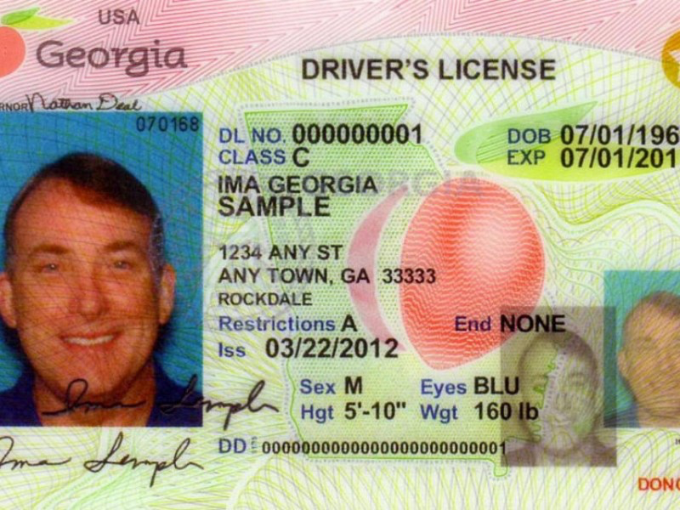

Georgia’s Graduated Driver Licenses
Step 1: Instructional Permit (age 15)
Step 2: Intermediate License (ages 16-17)
  Driver Education and road experience requirements
  Stricter limits on cell phone use while driving
  Restrictions on passengers
    First 6 months: Immediate family only
    Next 6 months: No more than one non-related passenger under 21
    After first 12 months: No more than three non-related passengers under 21
  Limits on driving hours
Step 3: Full License (age 18)
Notes:
Georgia’s Graduated Driver Licenses
Step 1: Instructional Permit (age 15)
Step 2: Intermediate License (ages 16-17)
Driver Education and road experience requirements
Stricter limits on cell phone use while driving
Restrictions on passengers
First 6 months: Immediate family only
Next 6 months: No more than one non-related passenger under 21
After first 12 months: No more than three non-related passengers under 21
Limits on driving hours
Step 3: Full License (age 18)

Slide 18
Risk-Taking in Adolescents:
What Adults Can Do
Set the stage for adolescent decision making
  Build solid relationships with children
  Provide opportunities for independence and decision making (beginning before adolescence)
  Maintain open communication; and LISTEN
  Be an “askable” adult
Have appropriate expectations
  Set limits, and explain them
  Be specific about appropriate behavior
  Create safety plans
Notes:
Risk-Taking in Adolescents: What Adults Can Do
Set the stage for adolescent decision making
Build solid relationships with children
Provide opportunities for independence and decision making (beginning before adolescence)
Maintain open communication; and LISTEN
Be an “askable” adult
Have appropriate expectations
Set limits, and explain them
Be specific about appropriate behavior
Create safety plans

Slide 19

Risk-Taking in Adolescents: What Adults Can Do
Respond appropriately to risk-taking
  Follow through on safety plans
  Use consequences of decision-making as teaching opportunities
  Don’t “rescue” teens from every case of bad judgment
  Continue to provide support
  Be patient – recognize that the brain is still developing!
Notes:
Risk-Taking in Adolescents: What Adults Can Do
Respond appropriately to risk-taking
Follow through on safety plans
Use consequences of decision-making as teaching opportunities
Don’t “rescue” teens from every case of bad judgment
Continue to provide support
Be patient – recognize that the brain is still developing!

Slide 20
Some Resources on the Adolescent Brain
Key Concepts: Executive Function: Harvard Center on the Developing Child - http://bit.ly/execfunction
Building the Brain’s “Air Traffic Control” System: How Early Experiences Shape the Development of Executive Function: Harvard Center on the Developing Child-http://bit.ly/VG7Q3T
Adolescent Brain Development: Unlocking the Potential of Georgia’s Youth - http://bit.ly/BBBadolbrainbrief
Notes:
Some Resources on the Adolescent Brain
Key Concepts: Executive Function: Harvard Center on the Developing Child - http://bit.ly/execfunction
Building the Brain’s “Air Traffic Control” System: How
Early Experiences Shape the Development of Executive
Function: Harvard Center on the Developing Child-http://bit.ly/VG7Q3T
Adolescent Brain Development: Unlocking the Potential of
Georgia’s Youth - http://bit.ly/BBBadolbrainbrief

Slide 21
Some Resources on the Adolescent Brain
The Teen Brain: Still Under Construction: National Institute of Mental Health - http://bit.ly/NIMHteenbrain
Adolescent Sleep Needs and Patterns: Research Report and Resource Guide: The National Sleep Foundation - http://bit.ly/1ojVGVl
The Teen Brain: Harvard Magazine – http://bit.ly/lojXpdp
Notes:
Some Resources on the Adolescent Brain
The Teen Brain: Still Under Construction: National Institute of Mental Health - http://bit.ly/NIMHteenbrain
Adolescent Sleep Needs and Patterns: Research Report and Resource Guide: The National Sleep Foundation - http://bit.ly/1ojVGVl
The Teen Brain: Harvard Magazine – http://bit.ly/lojXpdp

Slide 22

Brain Development
Society cannot continue to ignore the laws of biology . The more we learn about early brain development, the more responsibility we have to act on that knowledge.
            Bruce D. Perry, M.D., Ph.D.
        … you can make a difference!
Notes:
Brain Development
Society cannot continue to ignore the laws of biology . The more we learn about early brain development, the more responsibility we have to act on that knowledge.
Bruce D. Perry, M.D., Ph.D.
… you can make a difference!

